Slide 1


Instructor’s
Title & Name
Course Title….

Slide 2
Copyright © 2021 by the authors (A. Ertas and U. Gulbulak). This is an open access article distributed under the Creative Commons Attribution License (https://creativecommons.org/licenses/by/4.0/), which permits unrestricted use, distribution, and reproduction in any medium, provided the original work is properly cited.

Slide 3
Integration is a basic law of life; when we resist it, disintegration is the natural result, both inside and outside of us. Thus we come to the concept of harmony through integration. (Norman Cousins)

Slide 4
Transdisciplinary tools have been applied in many fields including product development, project management, many engineering disciplines, design of the organization, sustainable development, social issues, environmental issues, and others across many industries including automotive, aerospace, telecom, semiconductor, defense, transportation, energy, healthcare, agriculture, and more.

Slide 5
Transdisciplinary Tools Integration for Product Design
The integrated TD tools can be used in a wide range of domains. A new framework for integrated TD tools (see Figure 7.1) which has great potential benefits to solve large-scale complex problems will be introduced in this module.

Slide 6
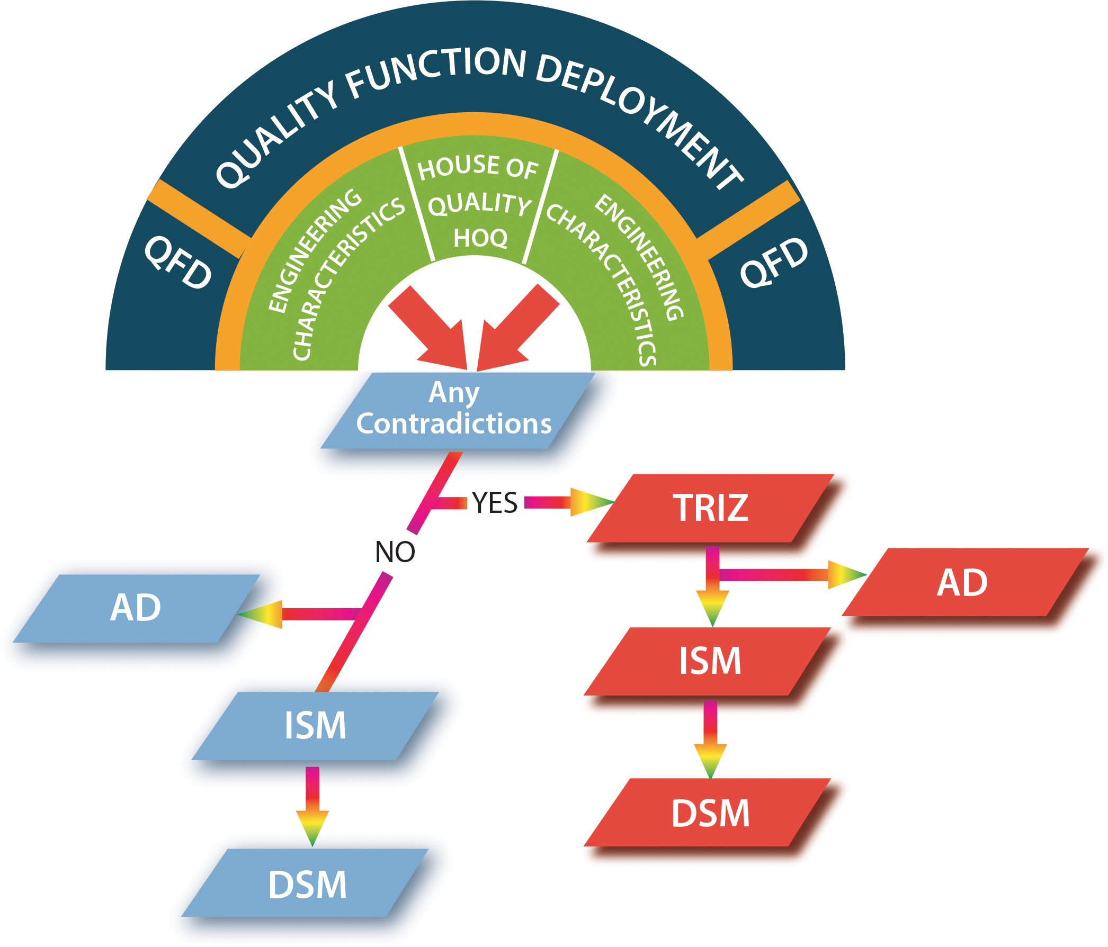
Figure 7.1: Framework of integrated TD tools.

Slide 7
Integrating QFD and TRIZ
The customer requirements, in general, include contradictions, which are mainly solved by trade-o˙ or compromises between the two parameters. The TRIZ inventive problem solving can be used to remove compromises by resolving contradictions in the product development – The contradiction resolution is more innovative than any other trade-o˙ solution.

Slide 8
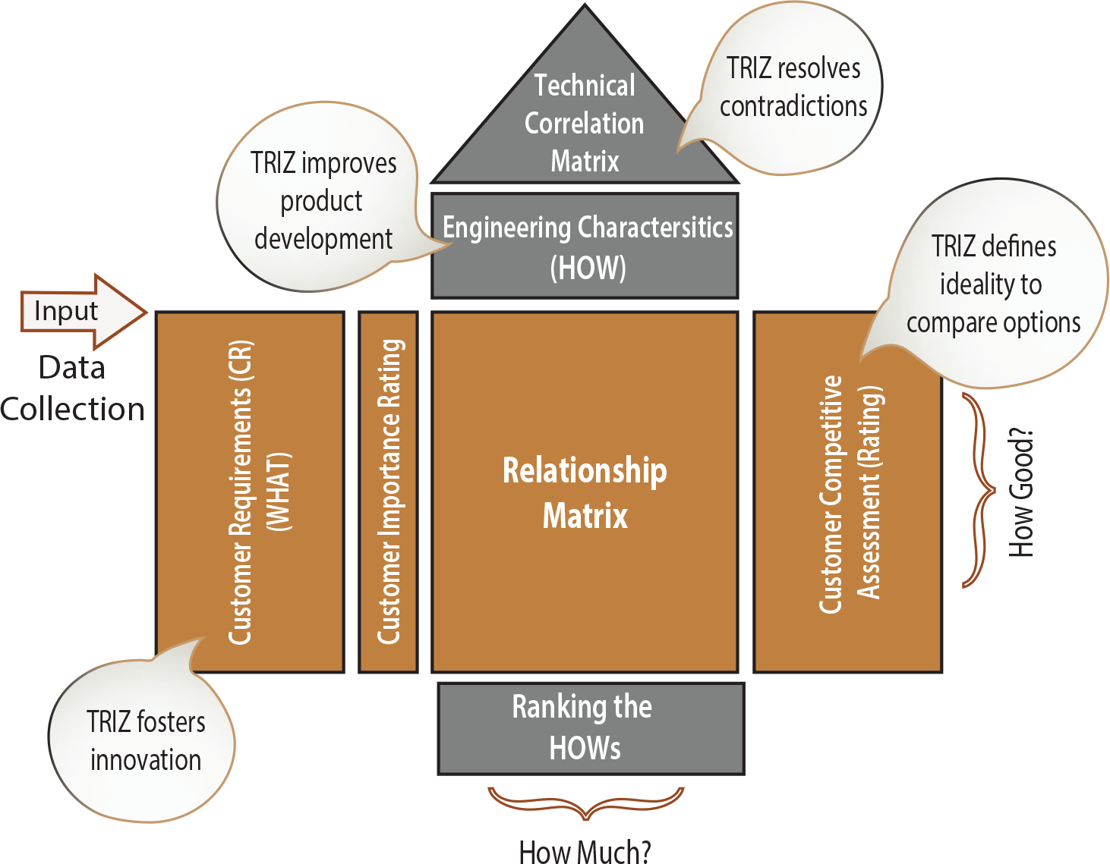
Integrating QFD and TRIZ
As shown in Figure 7.2, the TRIZ method offers a wide array of applications in QFD. QFD and TRIZ have complementary approaches and different viewpoints for product development and planning.
Figure 7.2: TRIZ application in QFD (adapted from reference 1)

Slide 9
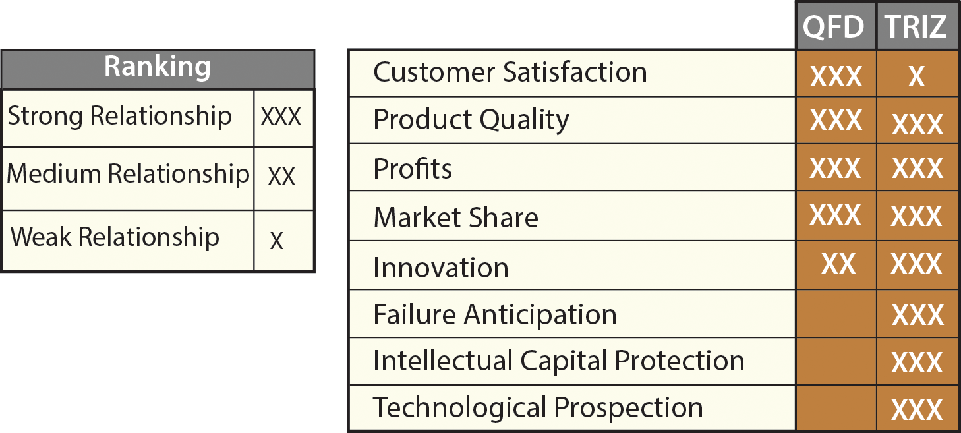
Integrating QFD and TRIZ
The level of impacts and relationships of QFD and TRIZ on certain requirements of product development is shown in Figure 7.3.
Figure 7.3: QFD and TRIZ synergy (from reference 2).

Slide 10
Integrating QFD and TRIZ
The TRIZ inventive principles may eliminate the conflicts between engineering characteristics when occurred in the HOQ correlation matrix. The steps for finding solutions for conflicting problems that exist in the QFD with TRIZ is the following (see Figure 7.4):
Identify the conflicting engineering characteristics (EC) with negative correlation in the HOQ correlation matrix.
Identify the EC’s type, which one is improving and which one is worsening characteristics.
Replace the ECs with corresponding parameters from TRIZ 39 contradiction matrix (Tables 3.1 through 3.6)
Using the contradiction matrix tables, identify which of the 40 inventive principles is applicable for your problem to resolve the contradiction (see Table 3.8 for 40 inventive principles).
After brainstorming, adapt the appropriate solution from 40 inventive principles to resolve the conflict among the ECs in the HOQ correlation matrix.
Re-construct the HOQ with the new ECs.

Slide 11
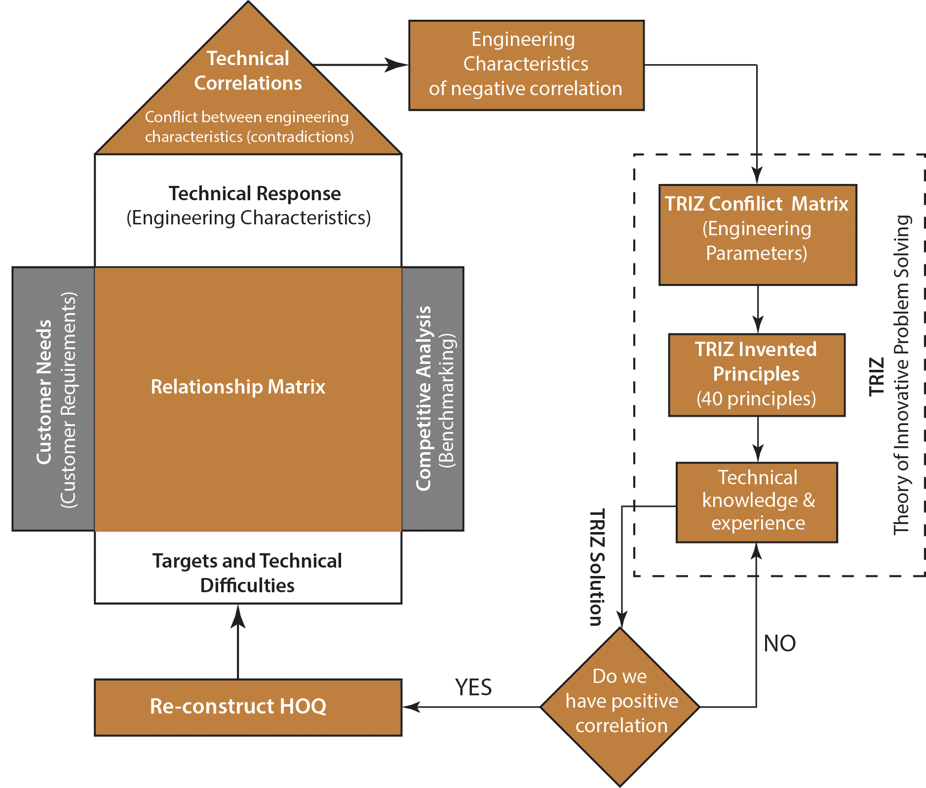
Integrating QFD and TRIZ
Figure 7.4: Flow chart.

Slide 12

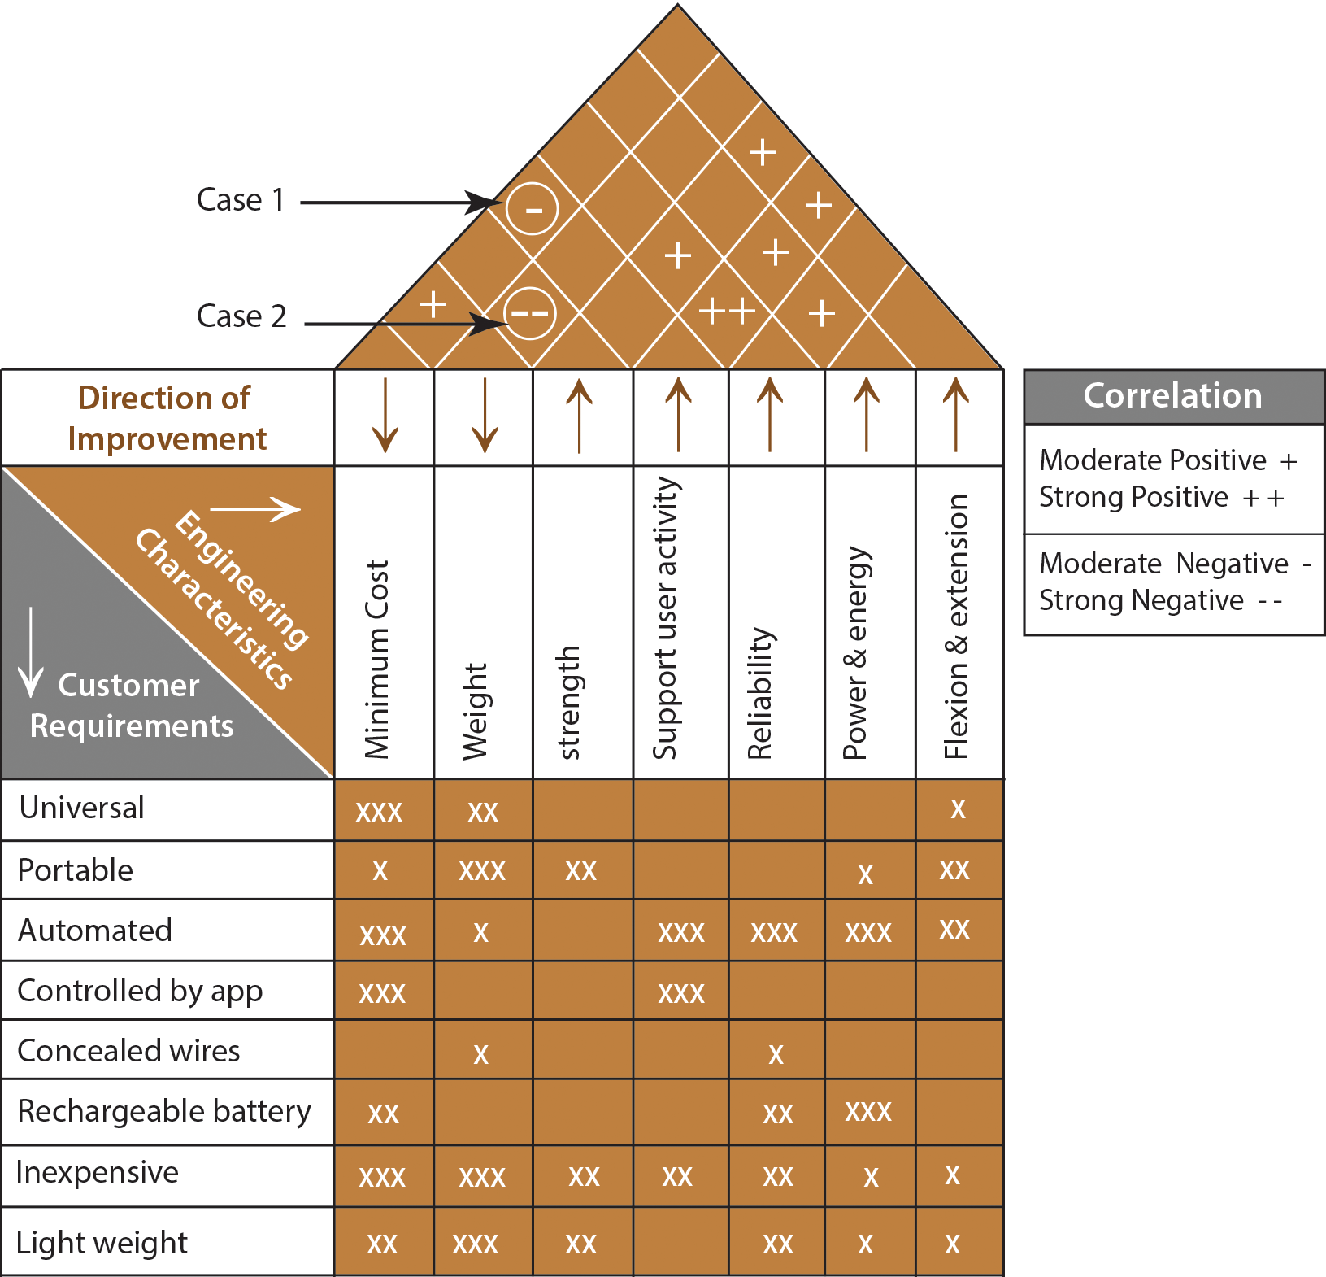
Module 7 – Transdisciplinary Tools Integration
Example 7.1: Using the TRIZ inventive principles to resolve the conflicts among the ECs shown in Figure 7.5.
Figure 7.5: Finger rehab device of QFD.

Slide 13
Case 1: The improvement of the “support user activity” causes an increase of production “cost”, thus resulting in a moderate negative correlation in the correlation matrix. In this case, “support user activity” is the improving characteristic and the “cost” of production is the worsening characteristic. In other words, If we want to improve the “support user activity” it will cost more money and time.

Slide 14
Many people have difficulty with the issue of cost since cost reduction is a widespread topic throughout the industry. However, many techniques of TRIZ do not deal with cost explicitly.
Darrell Mann (2004) has developed a business matrix similar to the contradiction matrix. His direct cost parameters for the business matrix are as follows:
• R&D Cost
• Production Cost
• Supply Cost
• Support Cost

Slide 15
He also included some of the same parameters used in the TRIZ matrix that cause costs to increase:
• Complexity of the system
• Complexity of control
• System-generated harmful factors
• Time and risk issues for the R&D, Production, Supply, and Support
• Speed of a process
• Duration of action
• Loss of energy, loss of material, loss of information, loss of time
• Reliability• System-generated harmful factors
• Ease of operation, ease of production, ease of repair
• System complexity
• Extent of automation
• Productivity
Using the above information about what causes the cost to increase, we adopt “complexity of device” for “cost of production” and “reliability” for “support user activity”.

Slide 16
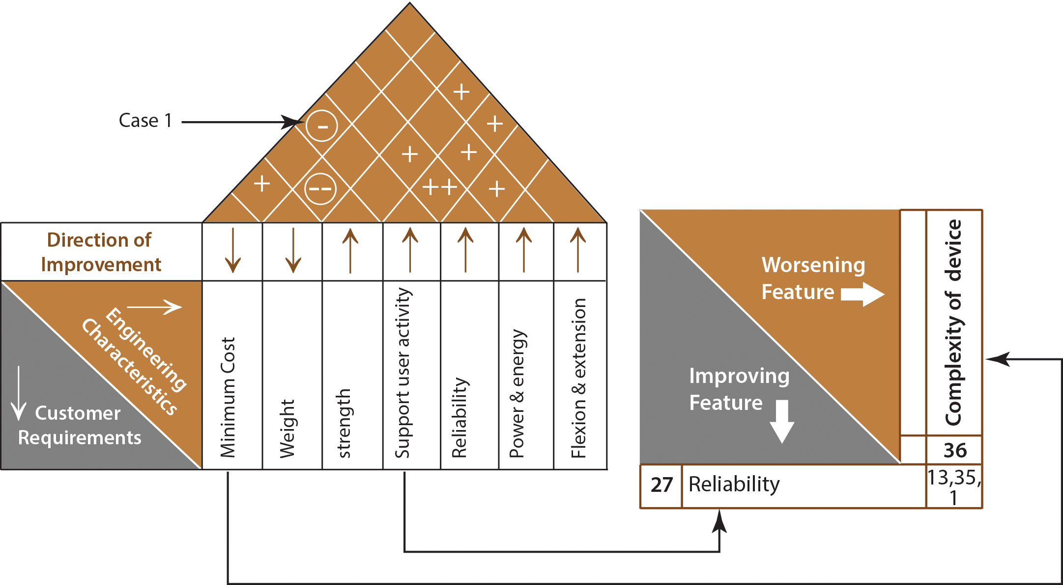
From the matrix of contradictions, using “Reliability (27)” as the improving characteristic and “complexity of device (36)” worsening characteristic, at the intersection of the two characteristics (see Figure 7.6) the following three potential solution principles (see Table 3-8) for the contradiction are possible:
Figure 7.6: TRIZ potential principles solutions.

Slide 17
Segmentation (1) – Divide an object into independent parts.
  • Replace mainframe computers with personal computers.
  • Replace a large truck with a truck and trailer.
  • Use a work breakdown structure (WBS) for a large project.
Make an object easy to disassemble.
Increase the degree of fragmentation or segmentation.

Slide 18
2. Inversion (the other way around) (13) – Invert the action(s) used to solve the problem (e.g. instead of cooling an object, heat it).
• To loosen stuck parts, cool the inner part instead of heating the outer part.
• Bring the mountain to Mohammed, instead of bringing Mohammed to the mountain.
Make movable parts (or the external environment) fixed, and fixed parts movable.
Turn the object (or process) ’upside down'.

Slide 19
3. Parameter change (35) – change an object’s physical state (e.g. to a gas, liquid, or solid).
After thorough analysis, principle 1- segmentation of “use a work breakdown structure (WBS) for a large project,” will be implemented. A WBS helps to make a large project more manageable. Breaking it down into smaller pieces work can be done simultaneously by different team members, leading to better team productivity. This will save a lot of time and effort, ultimately, saves money, and reduce the production cost.

Slide 20

Case 2: The improvement of the“ strength” causes an increase of “weight”, thus resulting in a strong negative correlation in the correlation matrix. In this case, strength is the improving characteristic and weight is the worsening characteristic. From the matrix of contradictions, using “strength (14)” as the improving characteristic and “weight (1)” worsening characteristic, at the intersection of the two characteristics (see Figure 7.7) the following four potential solution principles (see Table 3-8) for the contradiction are possible:
Figure 7.7: TRIZ potential principles solutions.

Slide 21
1. Segmentation (1) – Divide an object into independent parts.
2. Counterweight (8) – To compensate for the weight of an object, merge it with other
objects that provide lift.
3. Dynamicity (15) – Allow (or design) the characteristics of an object, external environment,
or process to change to be optimal or to find an optimal operating condition.
4. Composite material (40) – Change from uniform to composite (multiple) materials.
  Composite epoxy resin/carbon fiber golf club shafts are lighter, stronger, and more flexible than metal. Same for airplane parts.
  Fiberglass surfboards are lighter and more controllable and easier to form into a variety of shapes than wooden ones.

Slide 22
For this case, among the other suggested solutions, composite material (40) will lead to a solution. This solution will eliminate the contradiction between weight and strength.
Relationships of the engineering characteristics with these new characteristics (WBS) and composite material should be carefully reconsidered to re-build the HOQ.

Slide 23
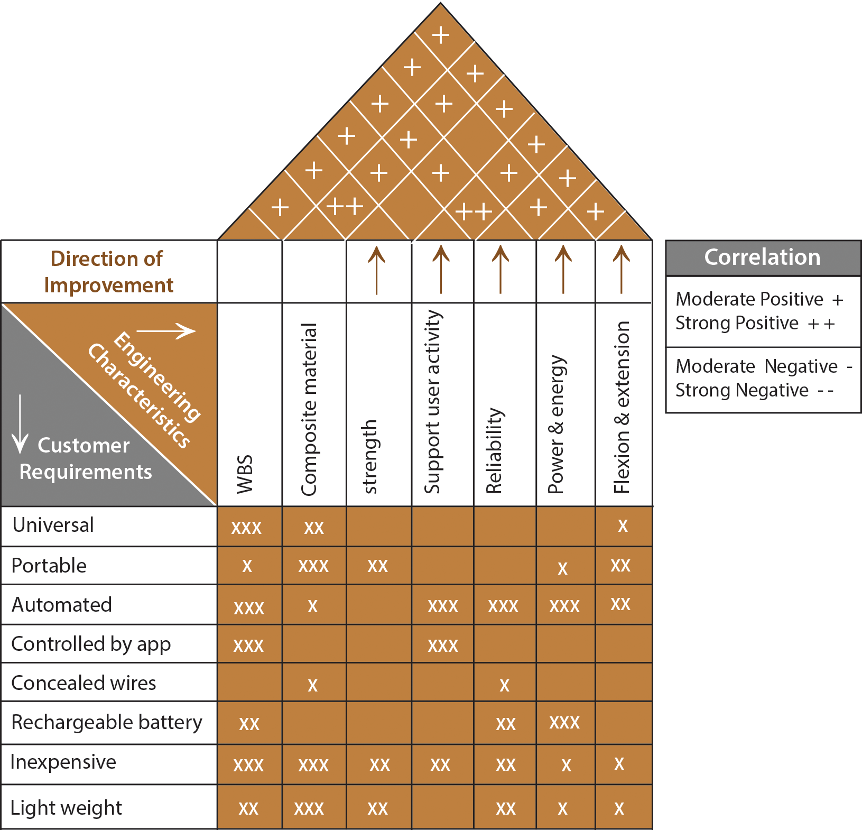
A negative correlation between ECs, mainly “cost of production” and “weight (material)”, certainly affects the performance of product design. Thus, these ECs, which have negative correlations are replaced in the HOQ as shown in Figure 7.8.
Figure 7.8: New re-build HOQ.

Slide 24
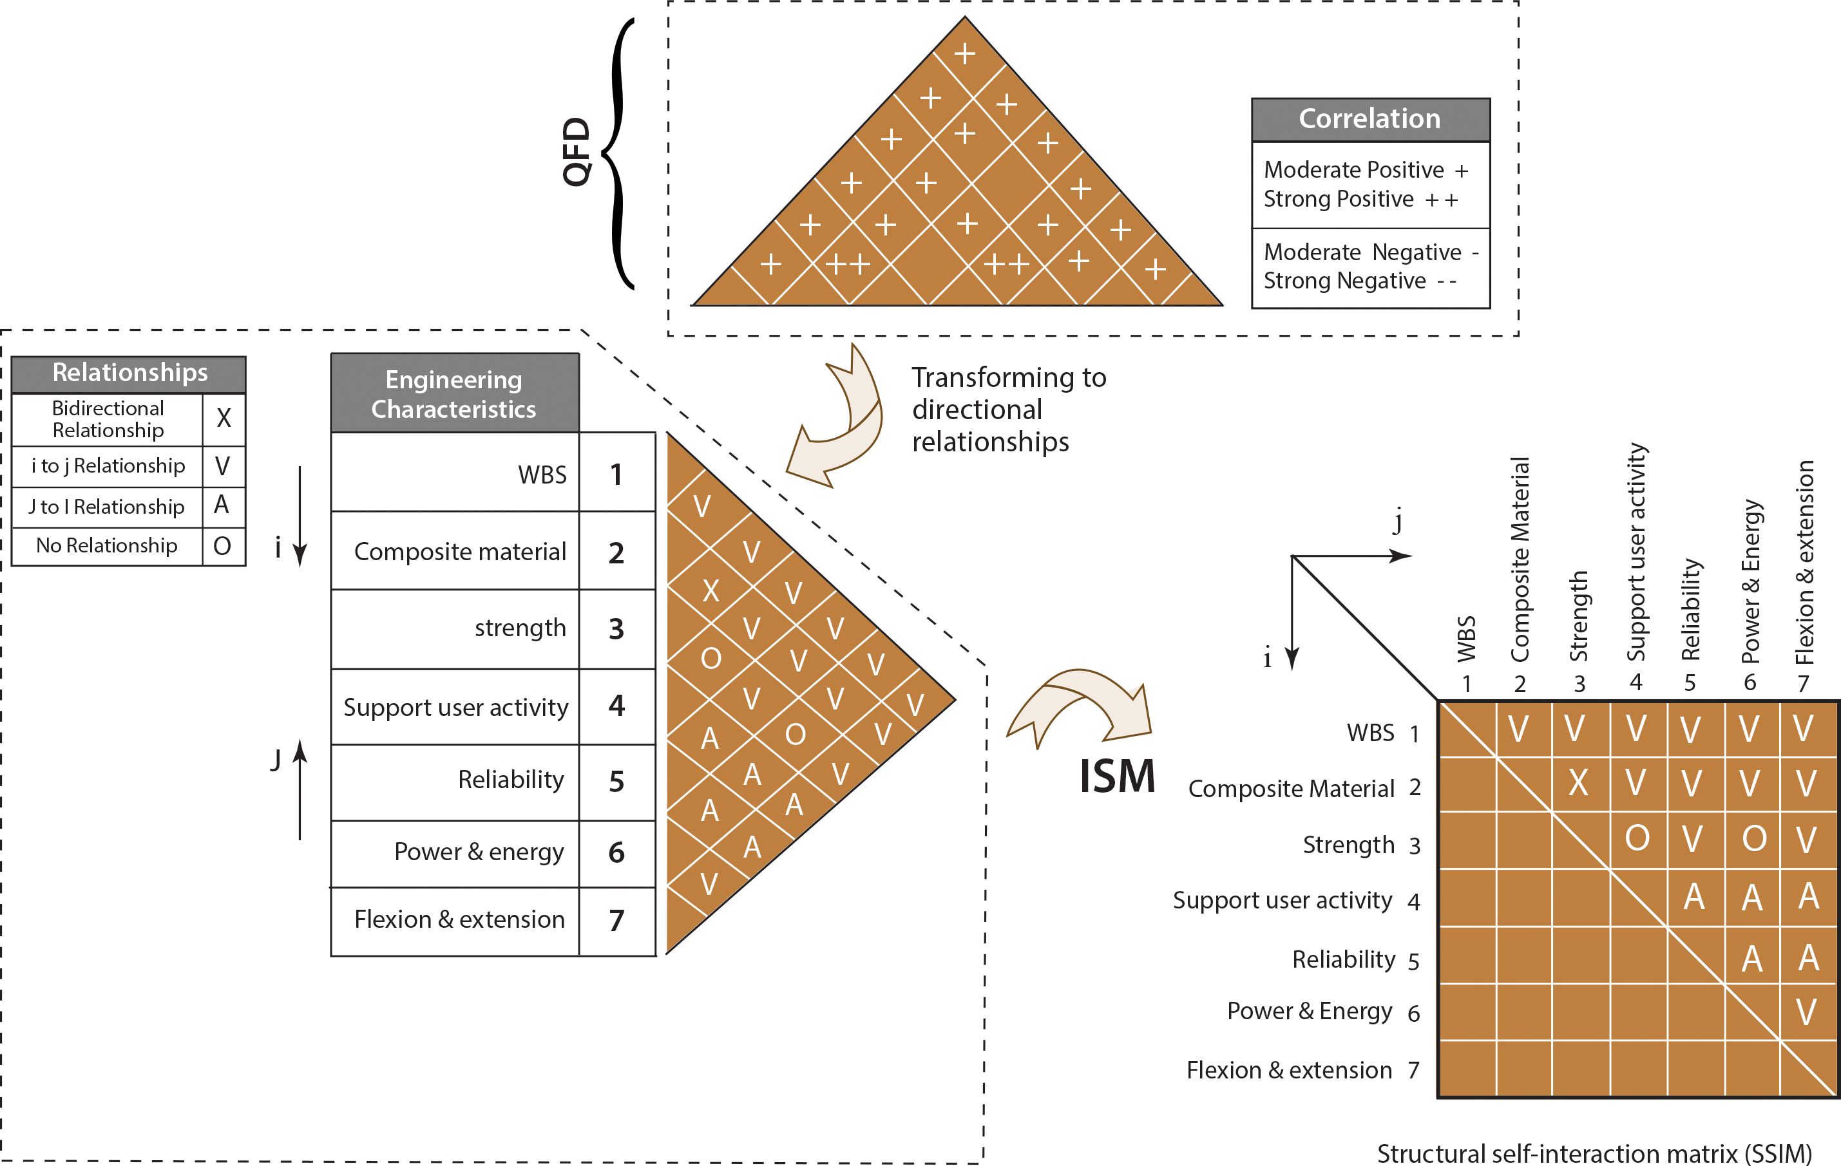
Integrating ISM with QFD-TRIZ Results
Integrating ISM from the Result of Example 7-1 as shown in Figure 7.9.
Figure 7.9: Transforming QFD to directional relationships.

Slide 25
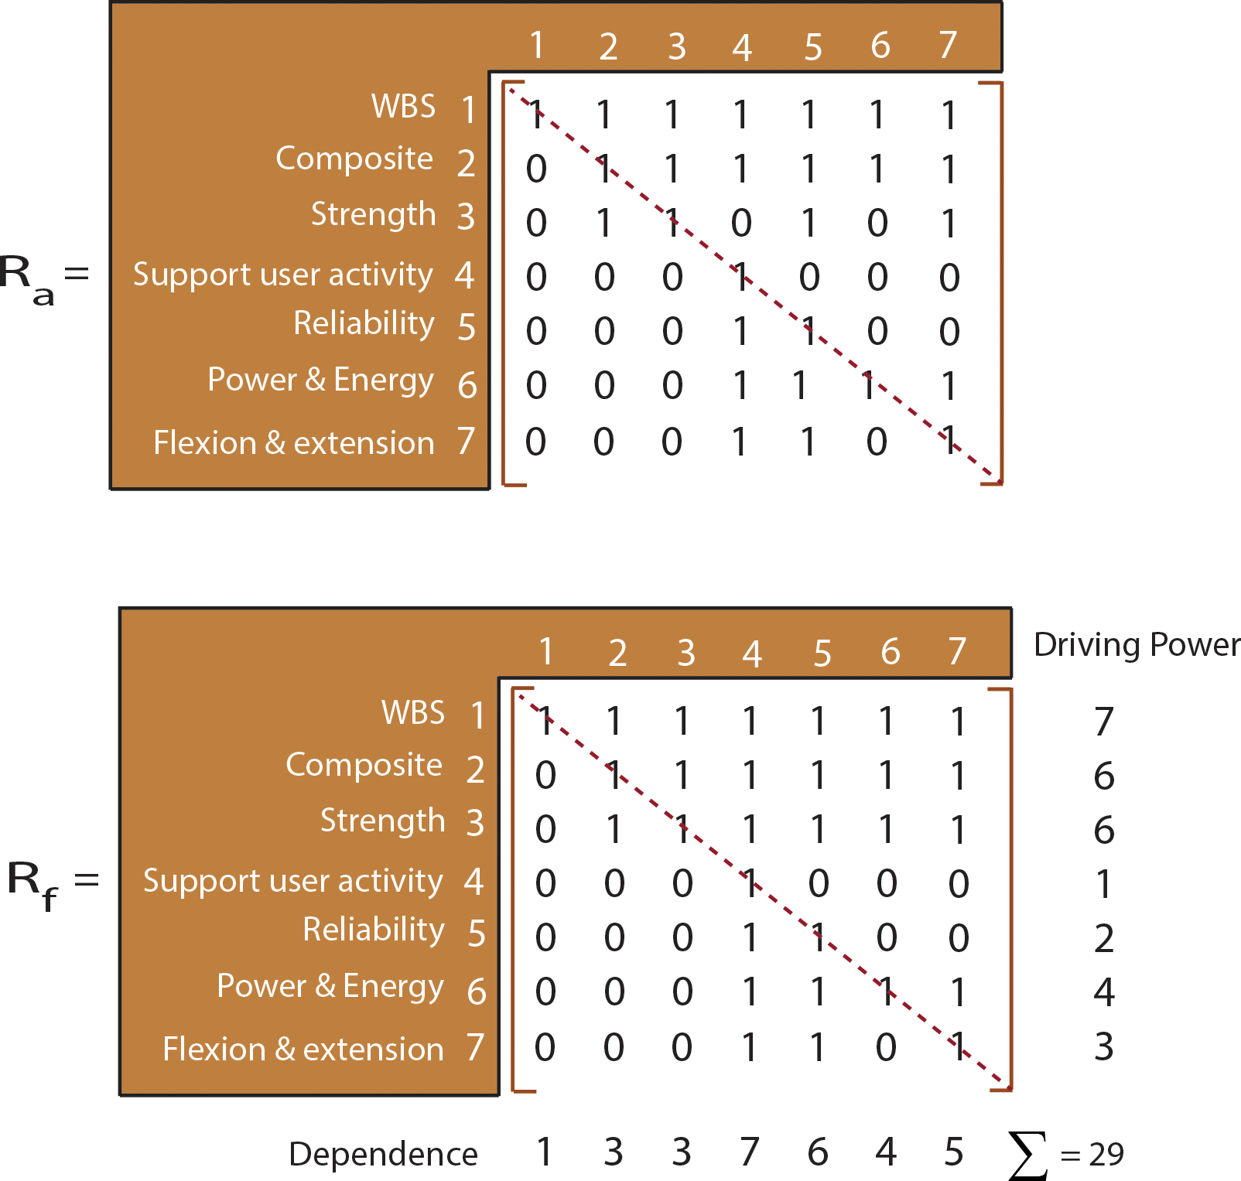
ISM Results
Figure 7.10: Adjacency matrix.
Figure 7.11: Final reachability matrix.

Slide 26
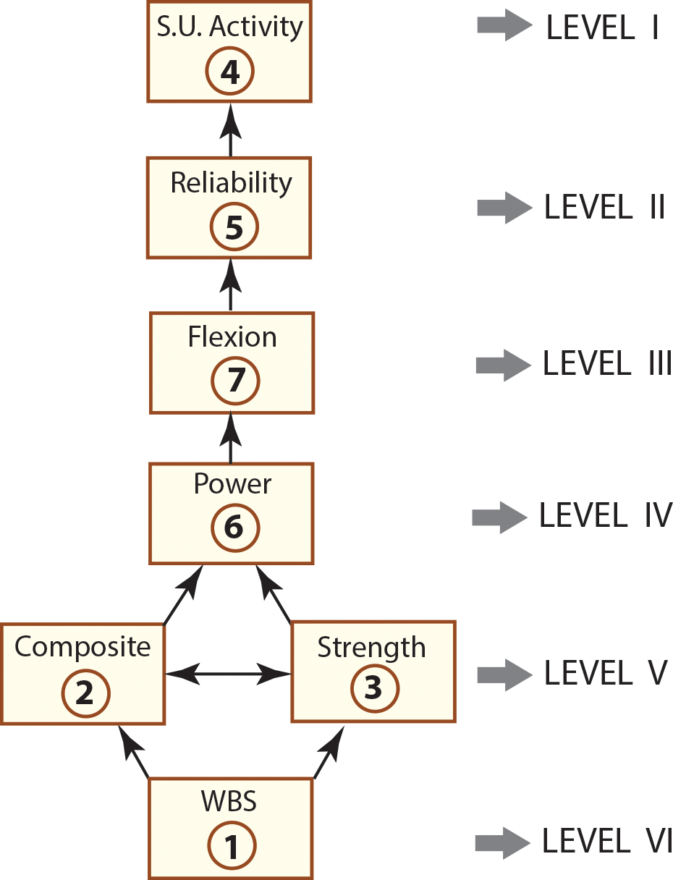
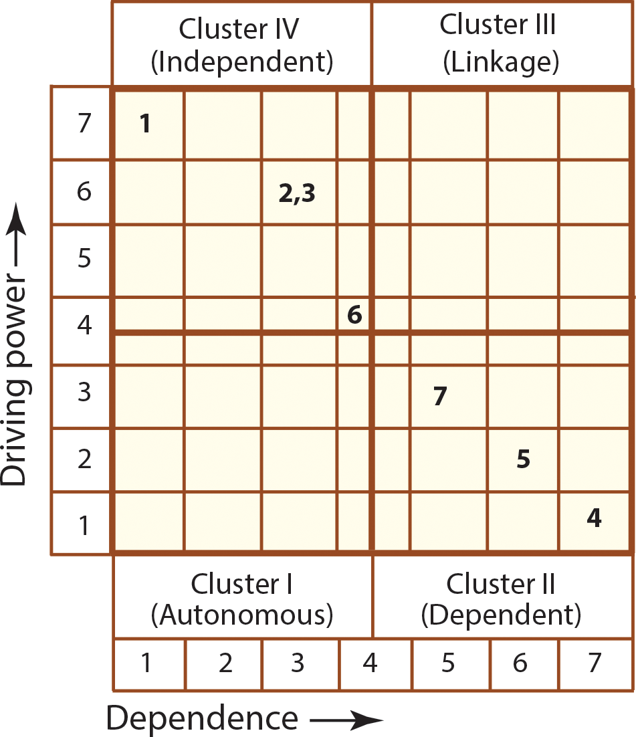
ISM Results
Figure 7.12: Digraph.
Figure 7.13: MICMAC analysis.

Slide 27
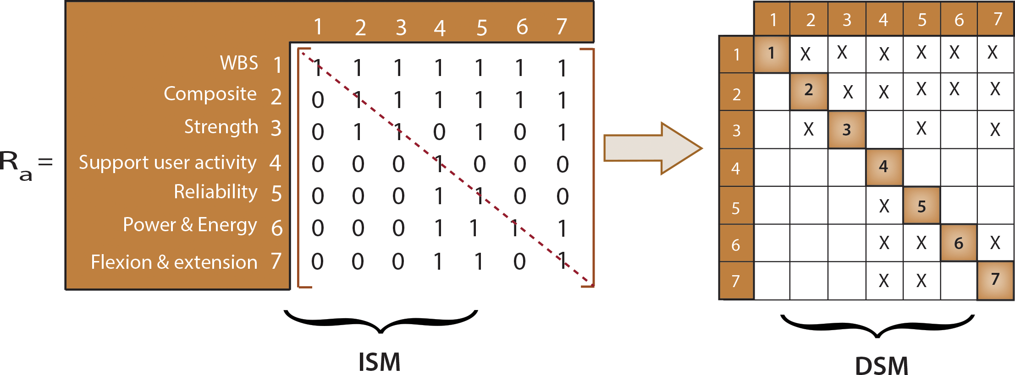
Integrating ISM Results with DSM
Figure 7.14: Transforming ISM to DSM.

Slide 28
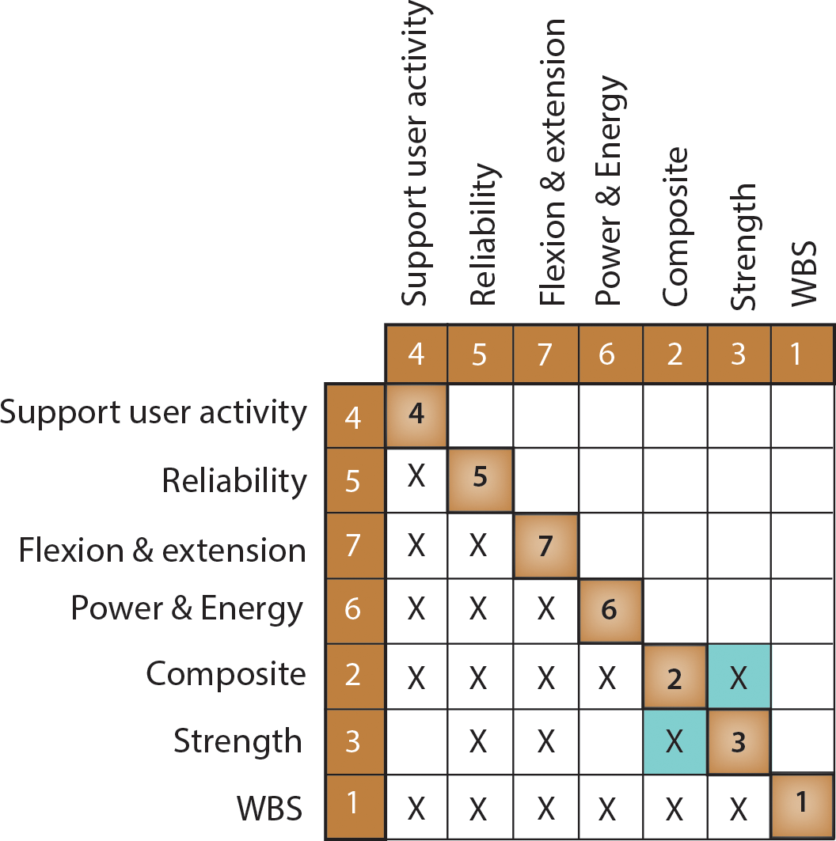
Integrating ISM Results with DSM
Figure 7.15: Partitioned DSM.

Slide 29
Integrating QFD, TRIZ, and AD for Product Design
QFD will not help us to describe details of functions and design parameters required to satisfy customer needs or to determine the functional requirements and design parameters without conflicting with each other. Therefore, QFD requires the use of other tools, such as TRIZ to resolve the conflicts in engineering characteristics or functional requirements and axiomatic design to determine the minimum set of design characteristics while satisfying the independence axiom – FRs should be independent of each other.

Slide 30
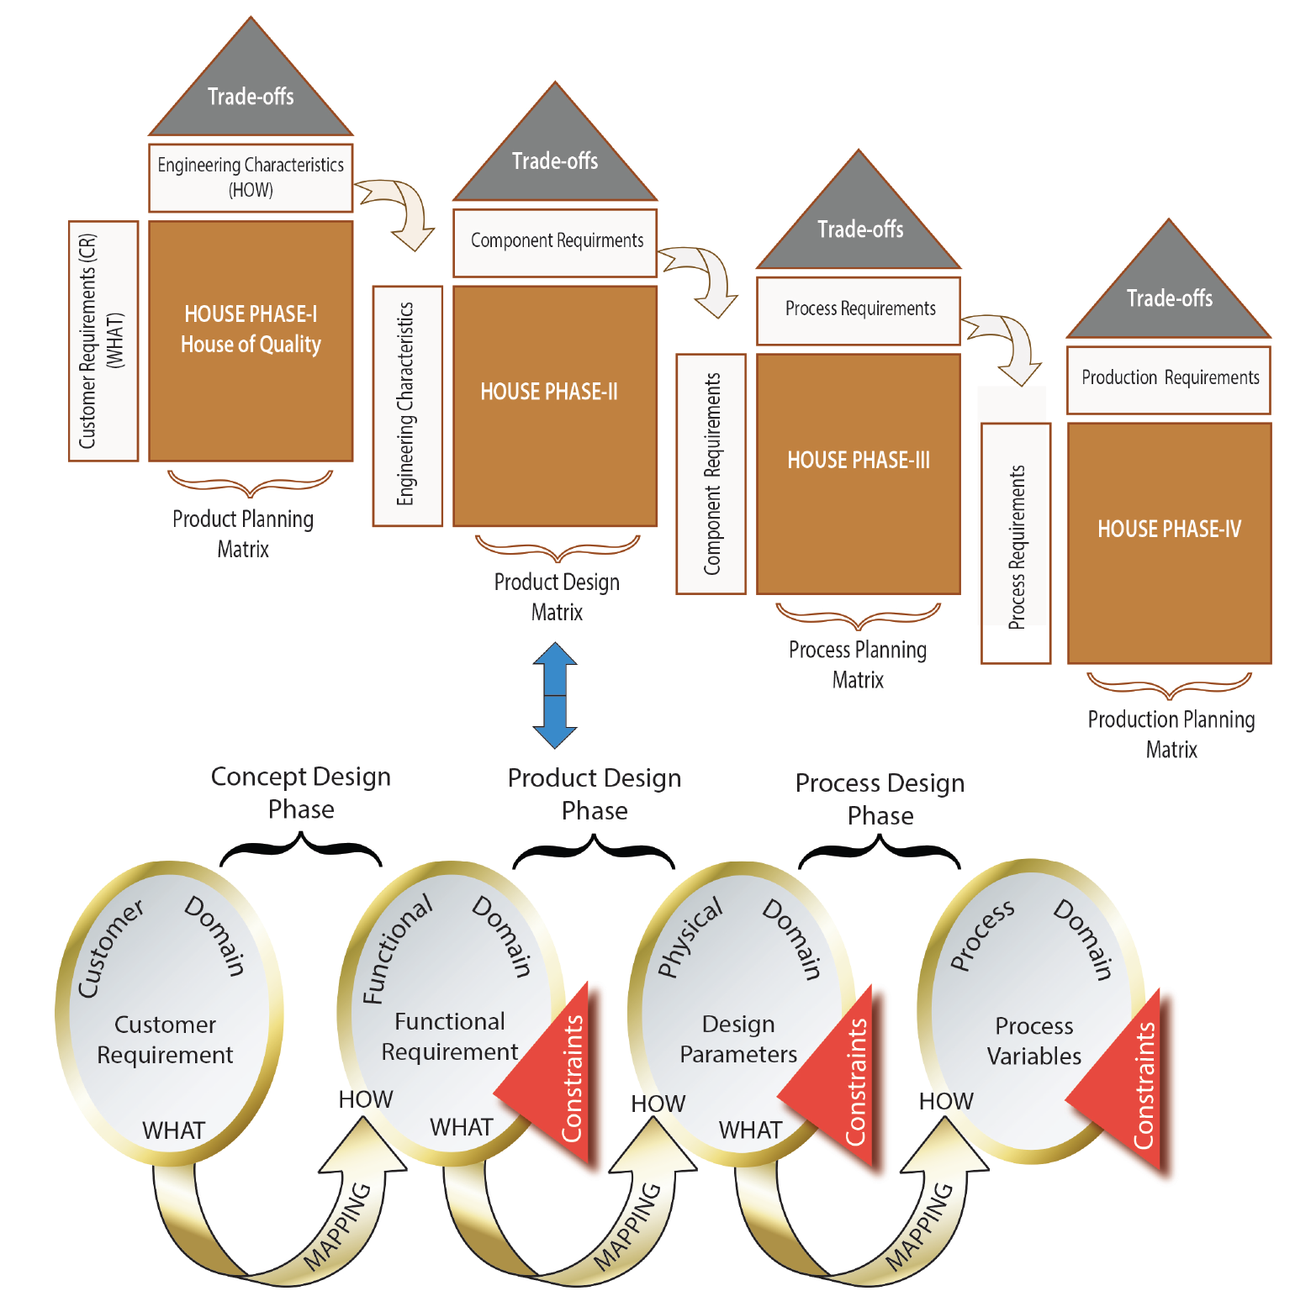
As shown in Figure 7.16, both AD and QFD Phase II form the design process as a mapping between domains, and both the QFD’s relationship matrix and the AD’s design matrix serve the same purpose: mapping from WHAT to HOW. Usually, QFD focuses on customer needs but not on the product’s architecture which is important for new product development (NPD). On the other hand, AD considers the customer needs as QFD does, but AD does not have a methodical process of converting the customer needs into functional requirements.
Figure 7.16: Framework of integrated TD tools.

Slide 31
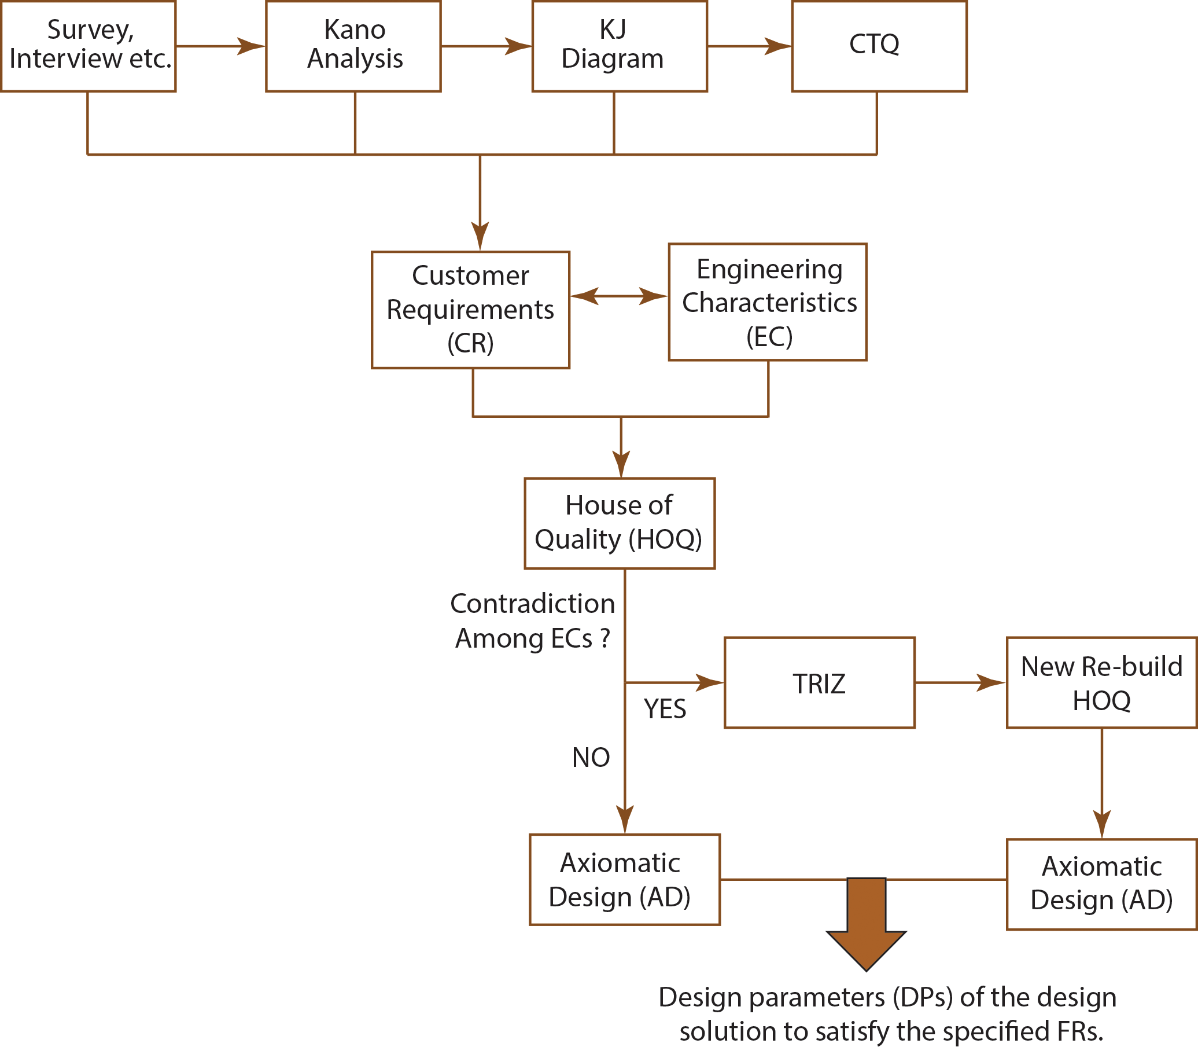
Figure 7.17 shows the development of conceptual architectural design steps for QFD-TRIZ-AD integration.
Figure 7.17: Conceptual architectural design steps for QFD-TRIZ-AD integration.

Slide 32
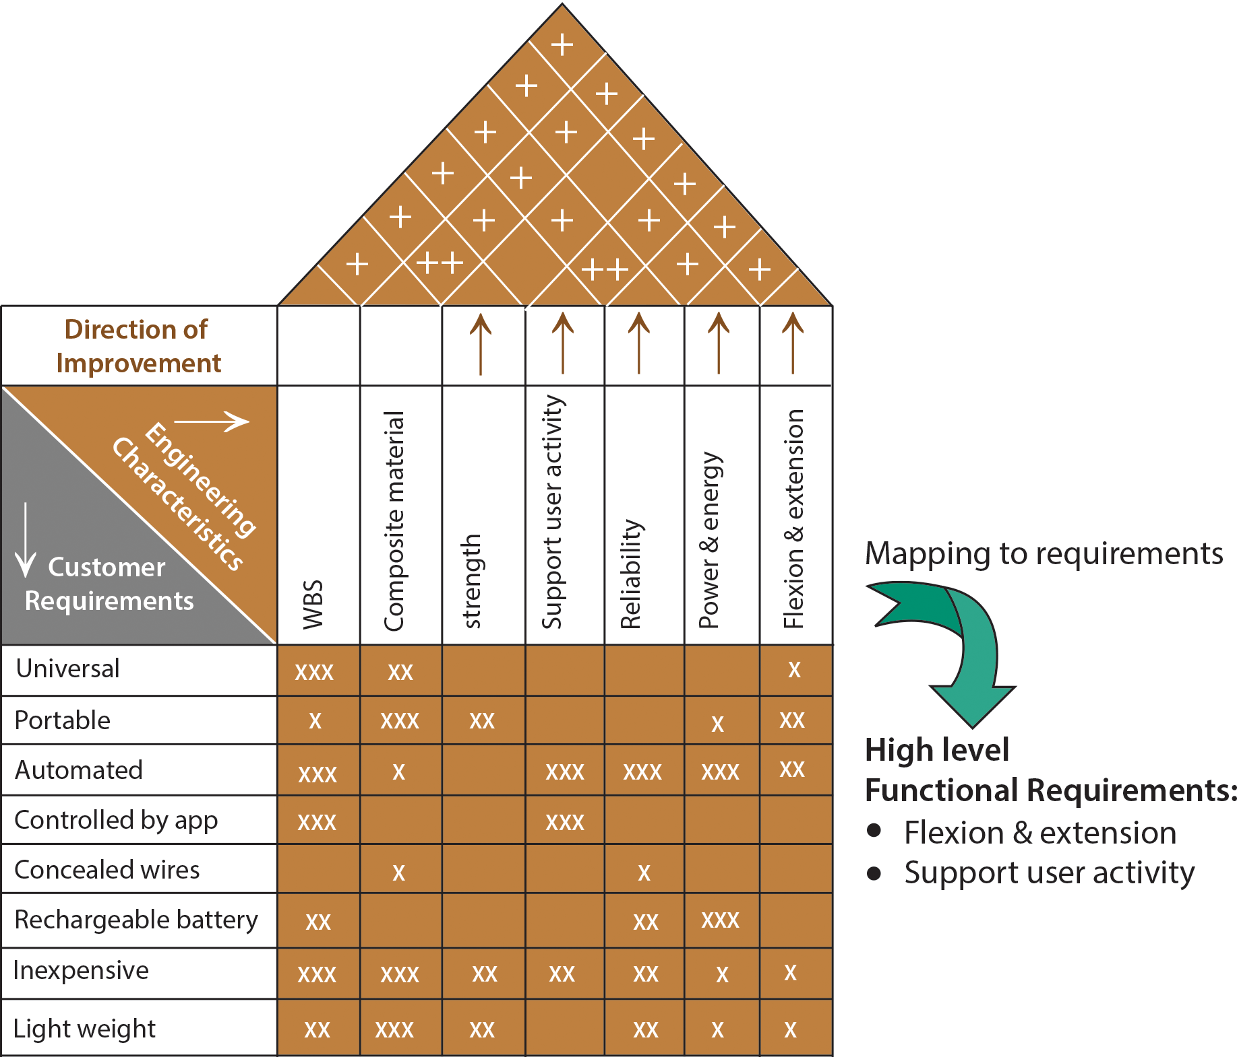
CASE STUDY:
Develop the design parameters (DPs) of the design solution of the finger rehab device shown in Example 7.1 to satisfy the specified FRs. Use Axiomatic Design principles.
Figure 7.18: Mapping to requirements.

Slide 33
High-level functional requirements are
FR1: Product shall be capable of Flexion & extension
FR2: Product shall be capable of supporting user activity
Using high-level FRs the following design parameters (DPs) are selected to fulfill each of the FRs:
DP1: Soft robotic
DP2: Activity monitoring tool

Slide 34
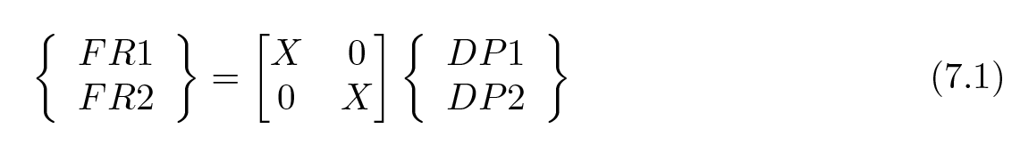
Formulation of the design matrix for this initial level of decomposition is shown in matrix Eq. 7.1. Design matrix is shown in Eq. 7.1 should be formulated for each level to avoid violating the Independence Axiom.
Eq. 7.1 reveals that the design is uncoupled at the top level and the independence axiom is not violated. This initial step determined the starting point for the further decomposition into additional levels of FRs. A road map for the levels of decomposition is shown in Figure 7.19.

Slide 35
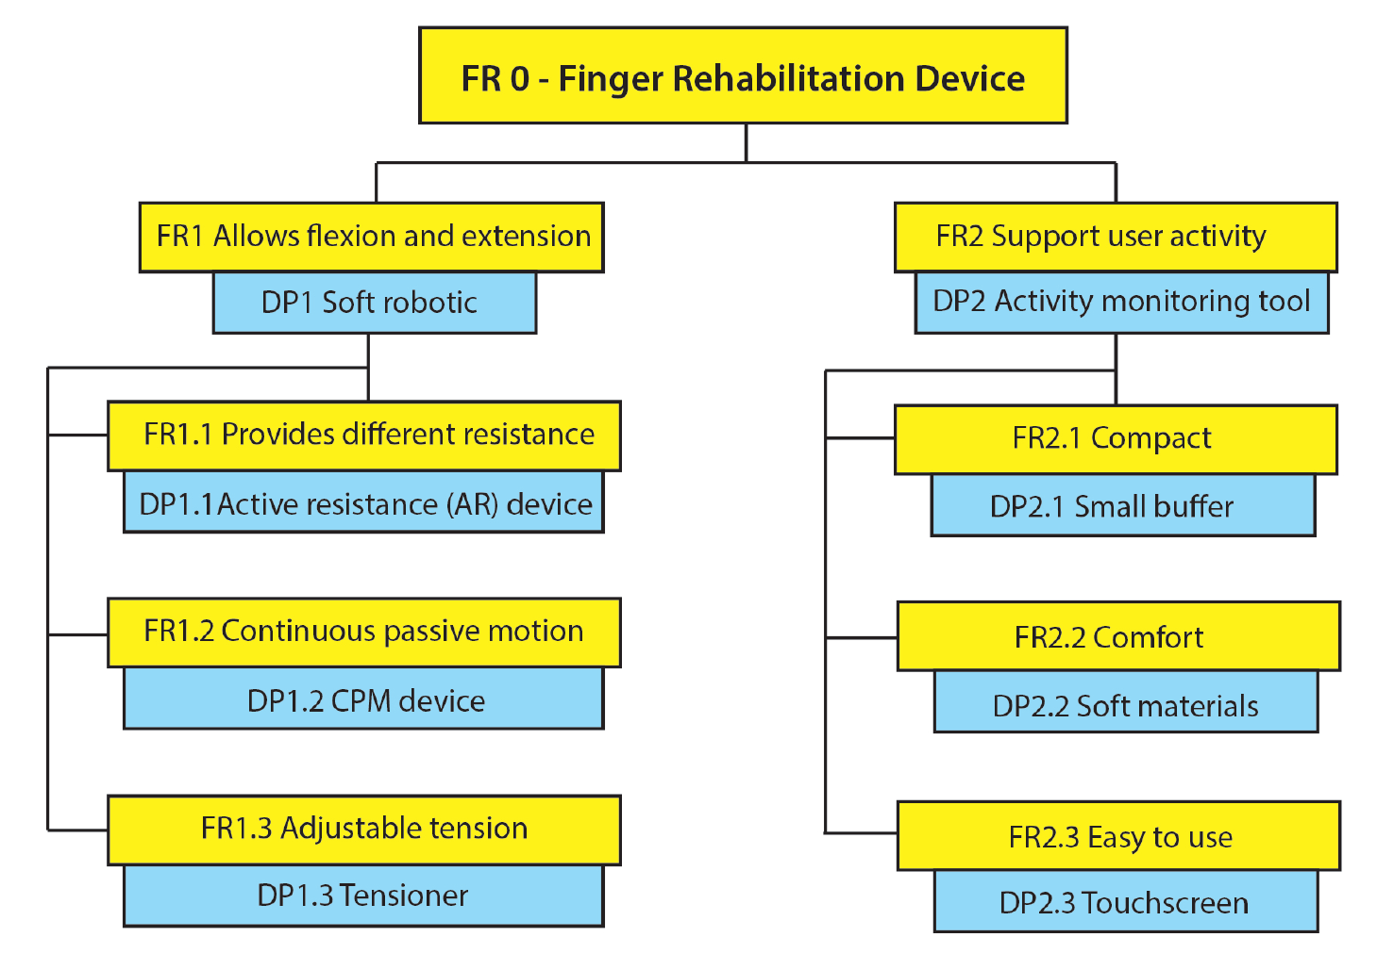
Figure 7.19: Design rod map.

Slide 36
Next, using zigzagging and maintaining independence within each matrix, the additional
FR levels were developed. Since all the FRs will follow a similar decomposition format, for
briefness, only FR1 (Allows flexion and extension) decomposition will be shown.
FR1.1: Provides different resistance
FR1.2: Continuous passive motion (CPM)
FR1.3: Adjustable tension
The following design parameters (DPs) are selected to fulfill each of the above FRs:
DP1.1: Active resistance (AR) device
DP1.2: CPM device
DP1.3: Adjustable tensioner

Slide 37
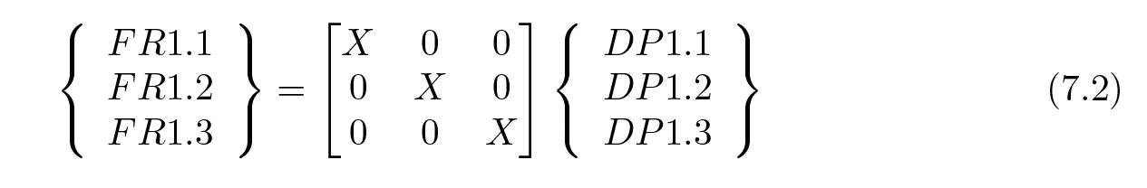
The following design matrix has been developed to ensure the independent axiom is not violated.
Eq. 7.2 shows that the design is uncoupled at the second level and the independence axiom is
not violated. Figure 7.20 shows the remaining part of the decomposition of the high-level functional requirement of FR1.

Slide 38
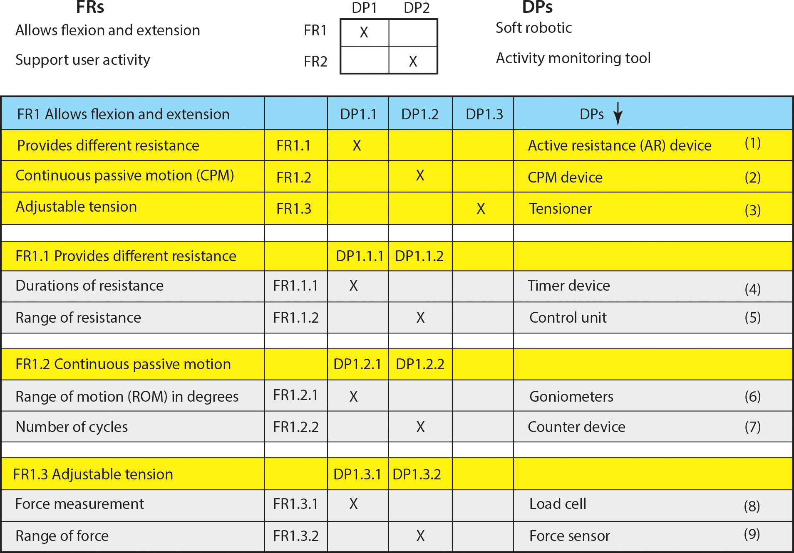
Figure 7.20: Decomposition of FR1.

Slide 39
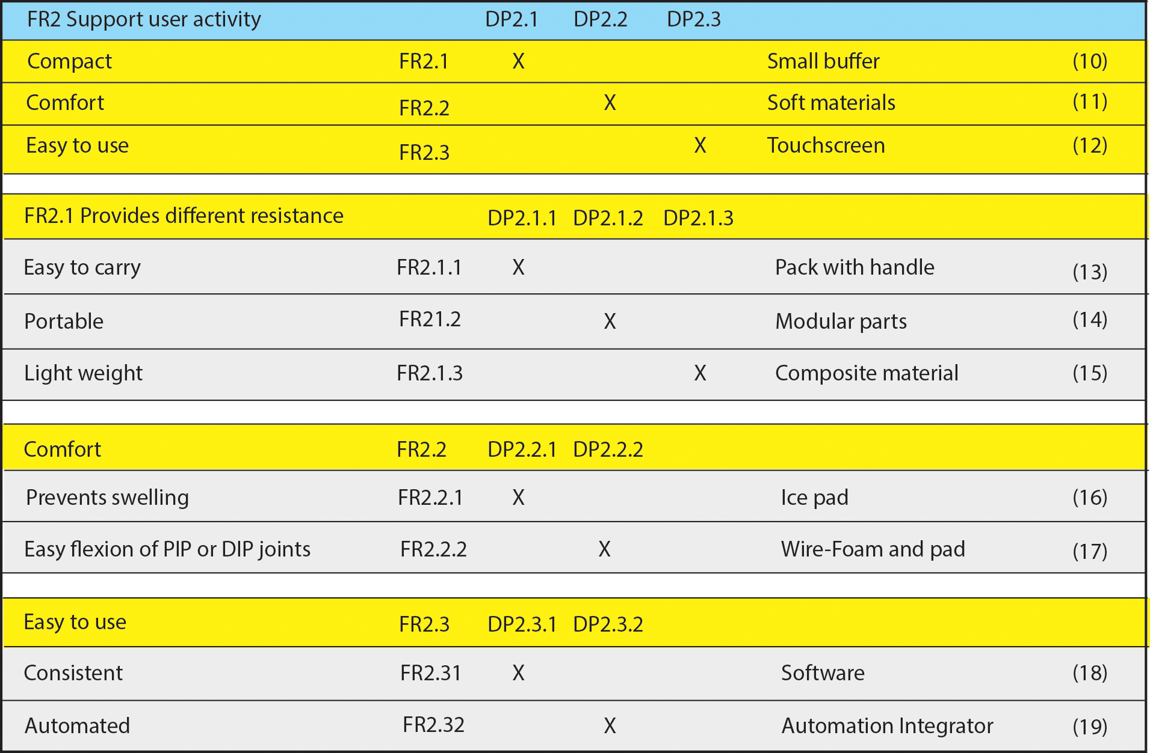
Figure 7.21 shows the decomposition of high-level functional requirement of FR2.
Figure 7.21: Decomposition of FR2.

Slide 40
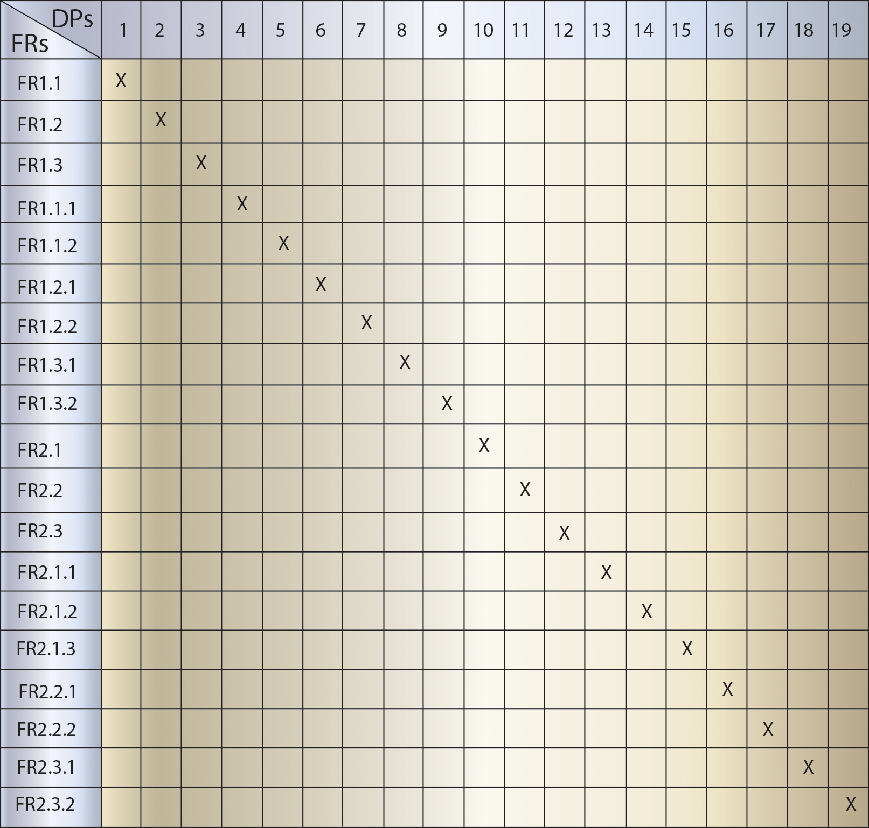
Figure 7.22 shows the combined design matrix of all the levels of FRs and DPs. It
represents an uncoupled design. That is, each FR is satisfied by only one DP.
Figure 7.22: Combined design matrix.

