Slide 1

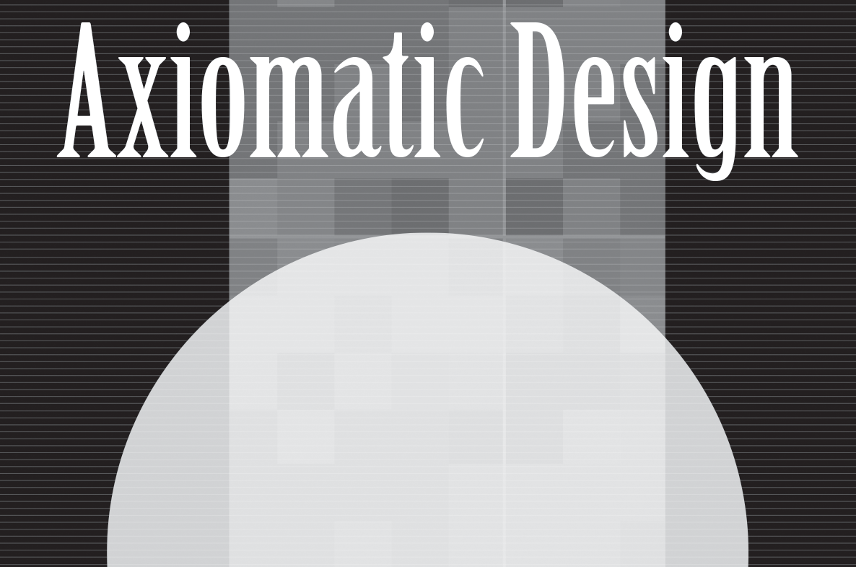
Instructor’s
Title & Name
Course Title….

Slide 2
Copyright © 2021 by the authors (A. Ertas and U. Gulbulak). This is an open access article distributed under the Creative Commons Attribution License (https://creativecommons.org/licenses/by/4.0/), which permits unrestricted use, distribution, and reproduction in any medium, provided the original work is properly cited.

Slide 3
Axiomatic design (AD) provides discipline-independent representations of a generic design process, general criteria for effective decision making, and scalability for complex systems development.
Axiomatic design process reduces product development risk, reduces cost, and speeds time to market.

Slide 4
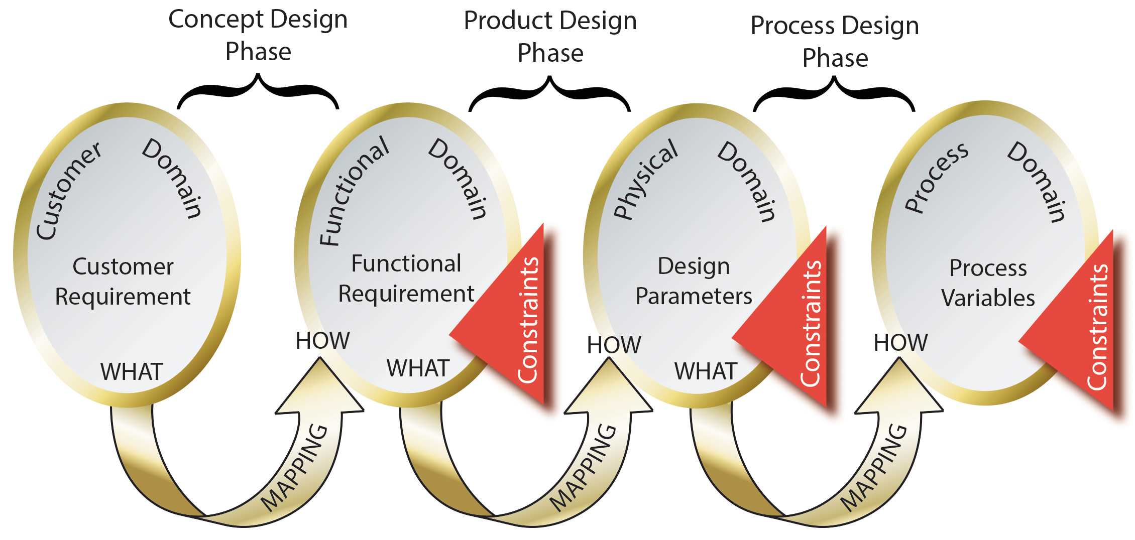
As shown in Figure 6.1, to move between any two nearby domains, the domain to the left signifies “what we want to achieve”, and the domain to the right signifies “how it will be achieved.”
Figure 6.1: Four domains of the design.

Slide 5
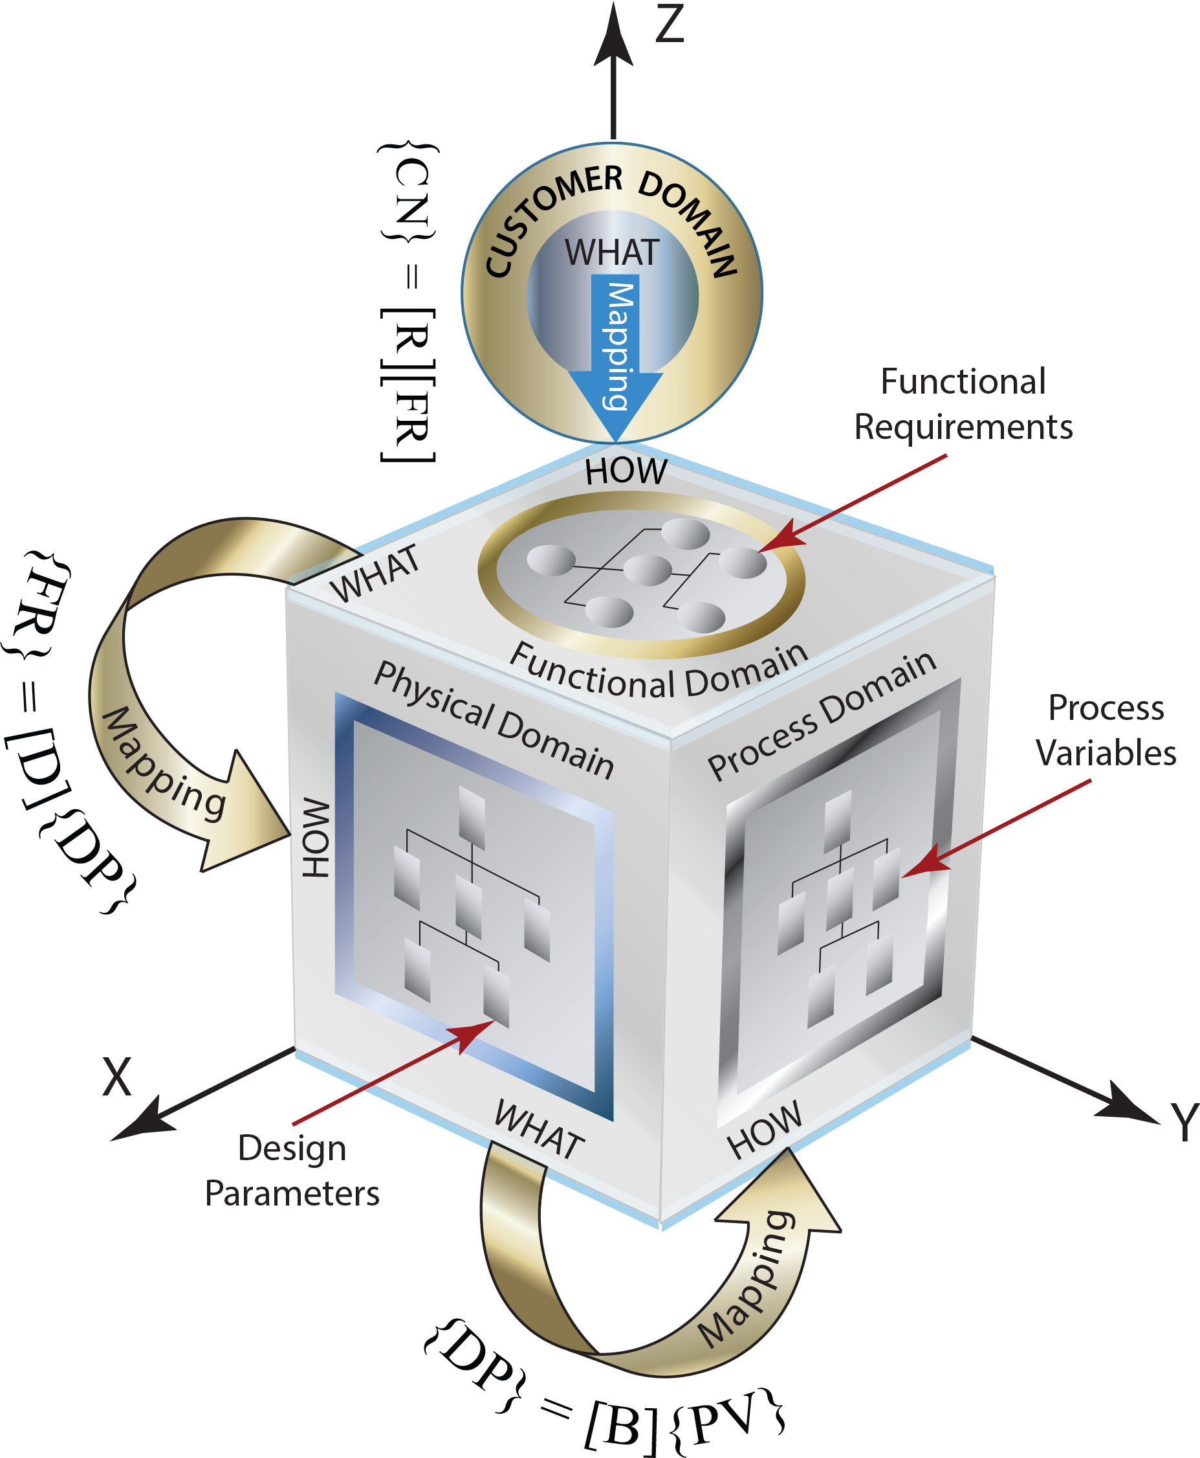
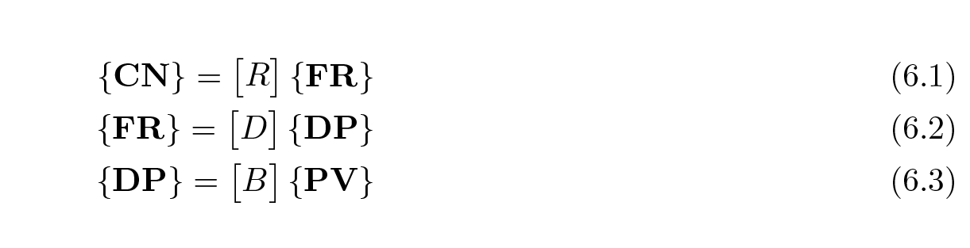
As shown in Figure 6.2, the mapping between domains is defined by a set of matrices as:
where, [R] is the requirement matrix, [D] is the
design matrix, and [B] is the component matrix.
Figure 6.2: Design domains.

Slide 6
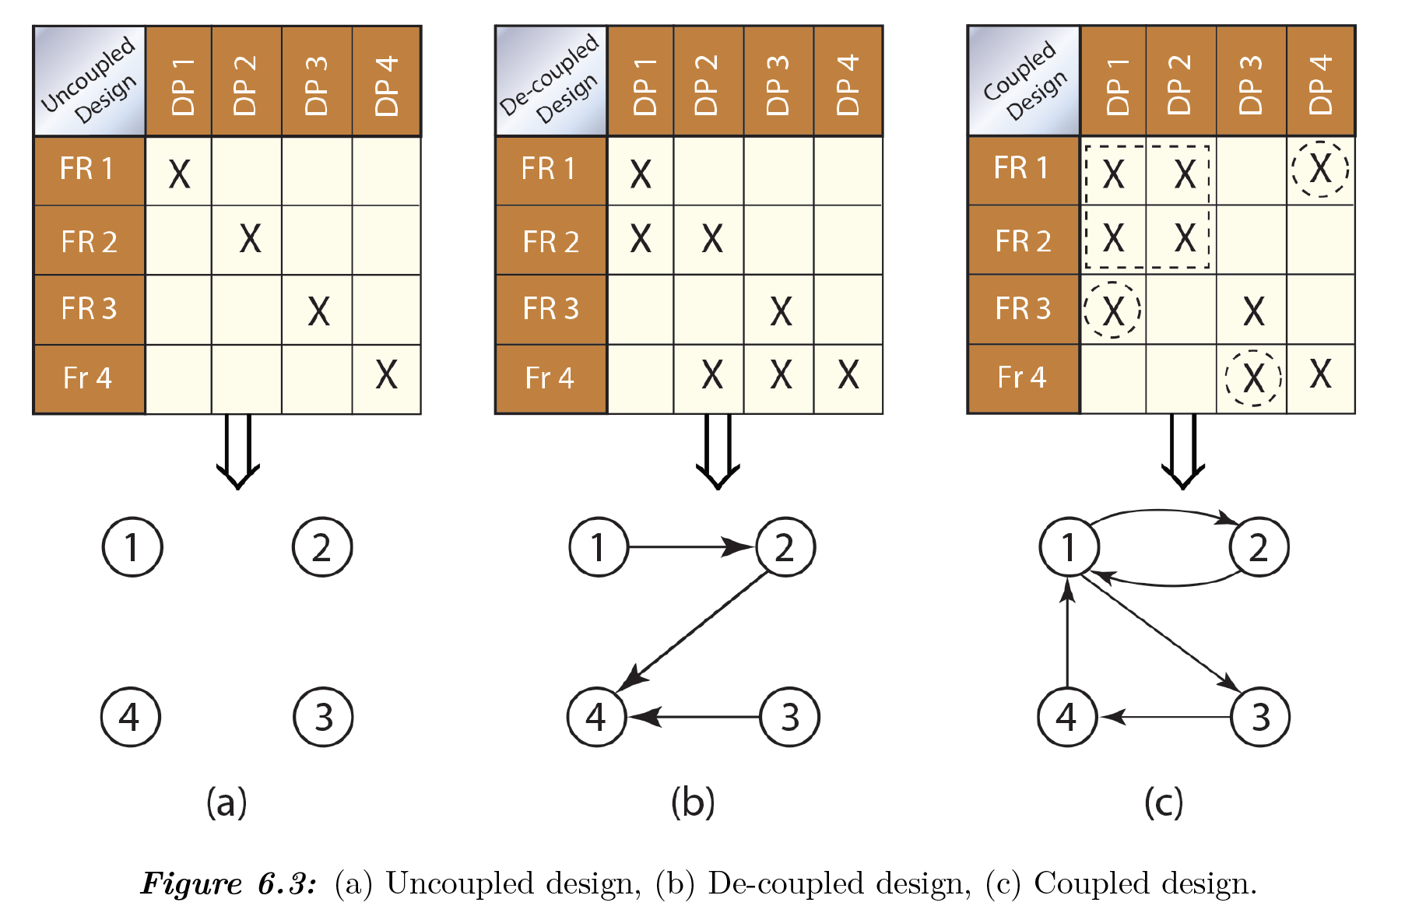
Uncoupled, De-coupled, and Coupled Design
Two fundamental AD axioms offer a rational basis for the evaluation of given solution alternatives.
Independence Axiom
“Maintain the independence of the functional requirements (FRs).” Each functional requirement should be satisfied by its corresponding design parameters (DP) without affecting the other functional requirements. In other words, one design parameter satisfies one and only one functional requirement.

Slide 7
Uncoupled, De-coupled, and Coupled Design
When design parameters are constrained, for example, by weight, size, cost, etc., they will have secondary effects on the other functional requirements as shown in Figure 6.3(b) – DP1 is
affecting FR1 and FR2, DP2 is affecting FR2 and FR4, and DP3 is affecting FR3 and FR4. A
triangular matrix is shown in Figure 6.3(b) represents a decoupled design.

Slide 8
2. Information Content Axiom
“Minimize the information content of the design”. After satisfying the Independence Axiom, the
Information Axiom is used to select the best design among several acceptable design choices.
Among all the design alternatives that satisfy the independence axiom the one that possesses the least information is the best choice.
The Information Axiom is related to the complexity of a design. It indicates that the simpler design is the better one.

Slide 9
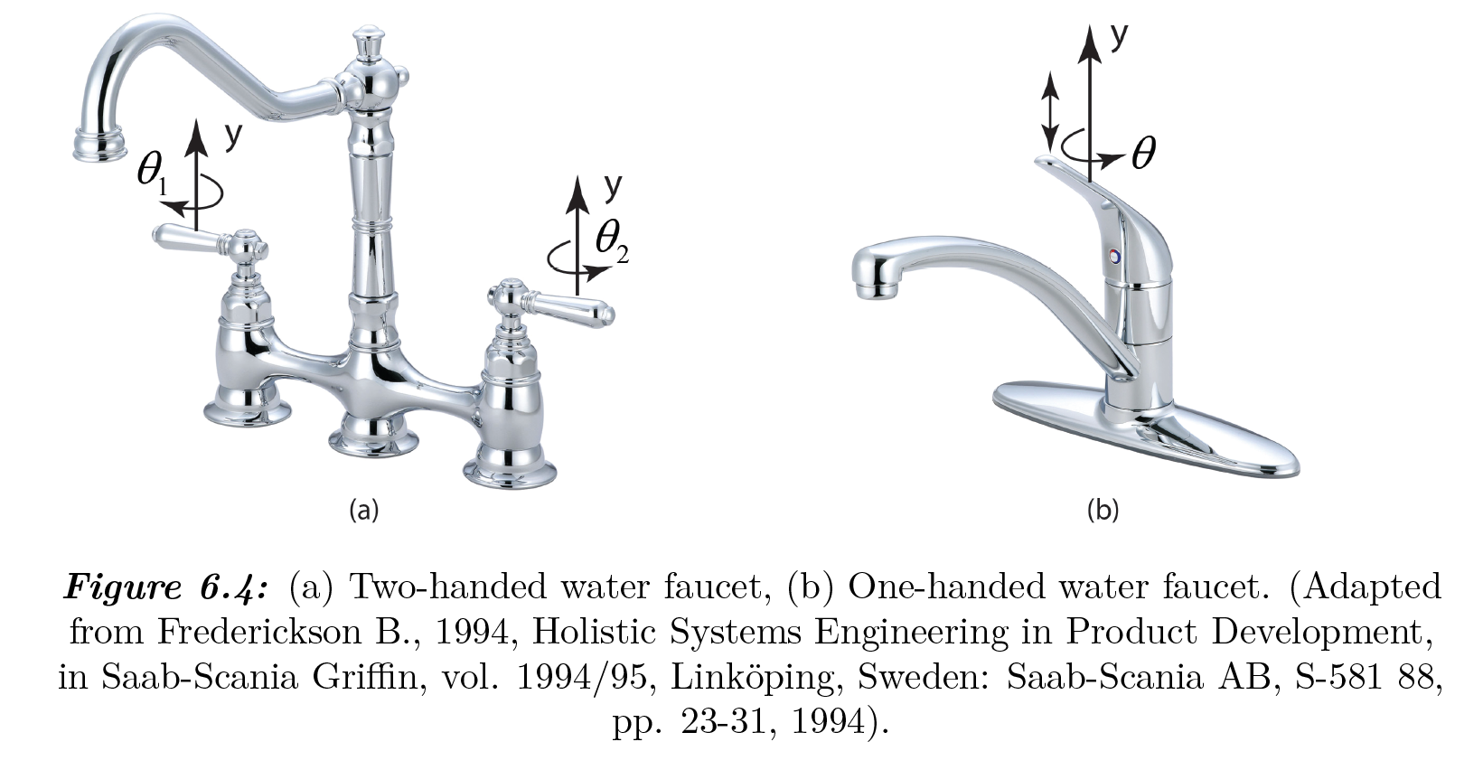
EXAMPLE
Use independence axiom for a typical water
faucet shown in Figure 6.4.
There are two functional requirements for
the water faucet is shown in Figure 6.4. They are:
FR1: Control flow rate (Q) of water
FR2: Control temperature (T) of water

Slide 10
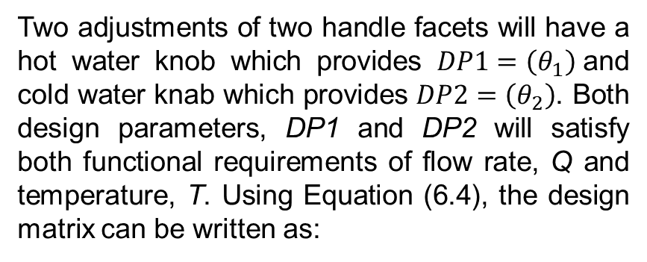
Two adjustments of two handle facets will have a hot water knob which provides $DP1=\left(θ_{1}\right)$and cold water knab which provides $DP2=\left(θ_{2}\right)$. Both design parameters, DP1 and DP2 will satisfy both functional requirements of flow rate, Q and temperature, T. Using Equation (6.4), the design matrix can be written as:

Slide 11
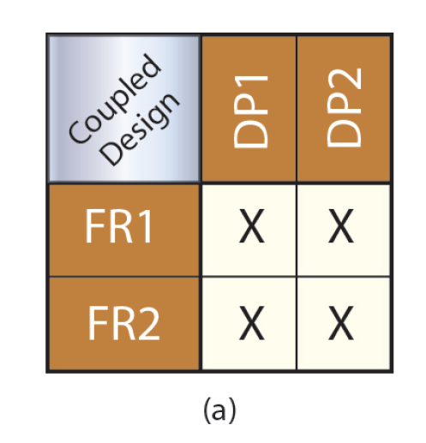
As seen from the matrix, flow rate control (FR1) will be satisfied by both DP1 (hot) and DP2 (cold) and temperature control (FR2) will be also satisfied by both DP1 (hot) and DP2 (cold) – DP1 affects FR1 and FR2 and similarly, DP2 affects the same functional requirements. This is called a coupled design as shown in the relationship matrix (see Figure 6.5(a)) and doesn’t satisfy the independence criterion.
Figure 6.5: (a) Coupled design

Slide 12
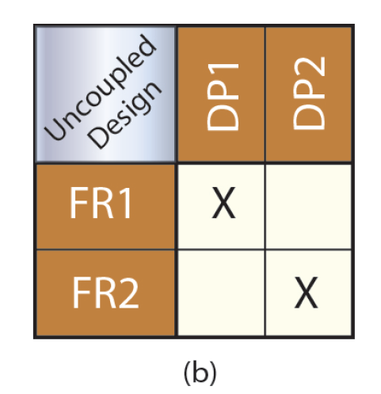
With a one-handed facet, as shown in Figure 6.4(b), the flow rate is adjusted by the vertical motion of the lever to satisfy FR1 and the temperature is adjusted by the angle, to satisfy FR2. DP1 affects only the functional requirement of FR1 and DP2 affects the other functional requirement, FR2 – each DP is satisfying one functional requirement – this design is called an uncoupled design, and it satisfies the independence criterion.
Figure 6.5: (b) Uncoupled design

Slide 13
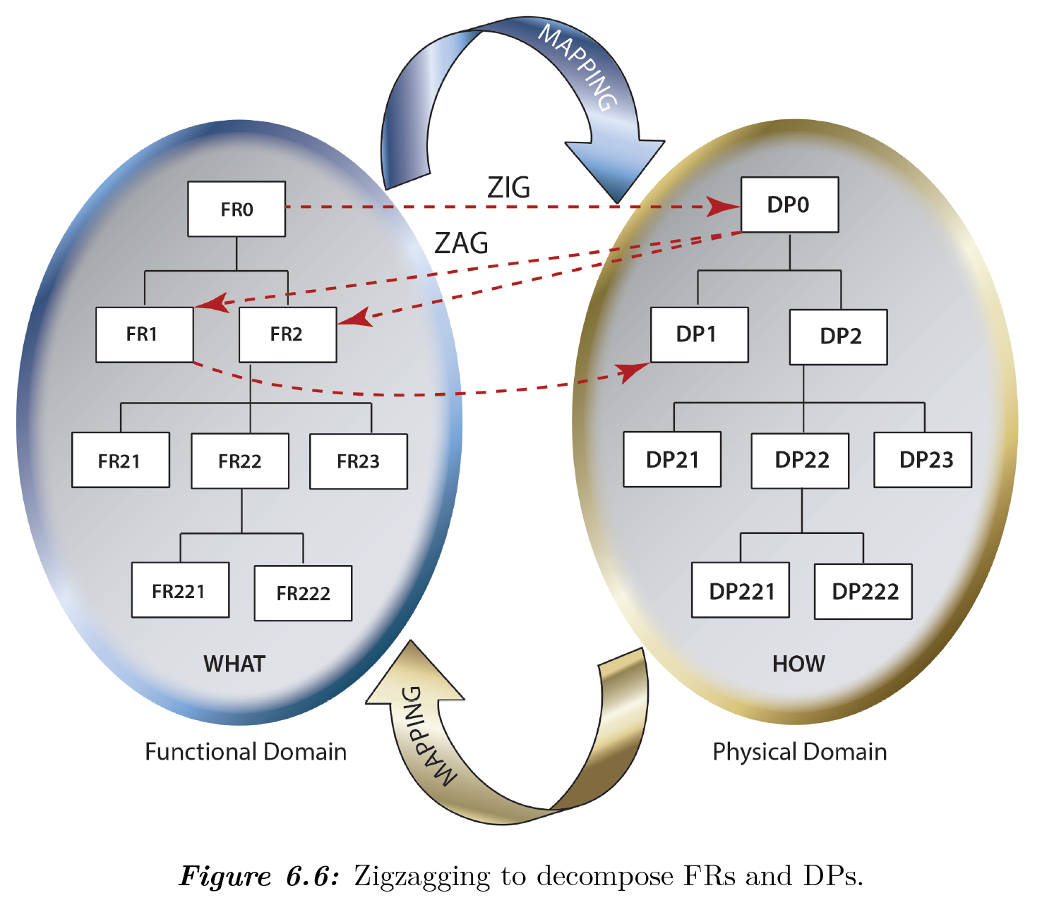
Zigzagging and Decomposition
As shown in Figure 6.6, the decomposing process is performed by “zigzagging” between FR and DP domains. Namely, we start out in the "what" domain and go to the "how" domain.
High-level functional requirements will be the starting point for the further decomposition into additional levels of FRs.

Slide 14
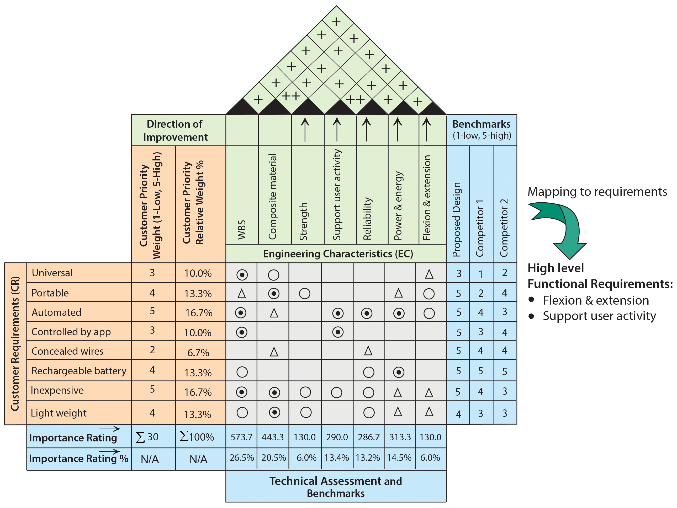
CASE STUDY 6.1
Develop the design parameters (DPs) of the design solution of the finger rehab device shown in Example 7.1 (Figure 7. 16) to satisfy the specified FRs. Use Axiomatic Design principles.
Figure 6.7: New re-build HOQ.

Slide 15
HIGH LEVEL FUNCTIONAL REQUIREMENTS
The product shall be capable of Flexion & extension
The product shall be capable of supporting user activity
As seen from the above top-level FRs, they don’t give us too much information, but this initial step determines the starting point for the further decomposition by using AD zigzag methodology.
Figure 6.8: New re-build HOQ.

Slide 16
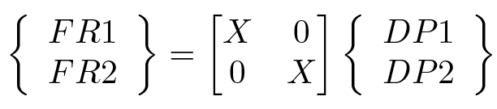
Using high level FRs the following design parameters (DPs) are selected to fulfill each of the FRs:
FR1 Product shall be capable of Flexion & extension
DP1: Soft robotic
FR2 Product shall be capable of supporting user activity
DP2: Activity monitoring tool
Design matrix is shown in Eq. 6.6 should be formulated for each level to avoid violating the Independence Axiom.
(6.6)
Eq. 6.6 reveals that the design is uncoupled at the top level and the independence axiom is not violated.

Slide 17
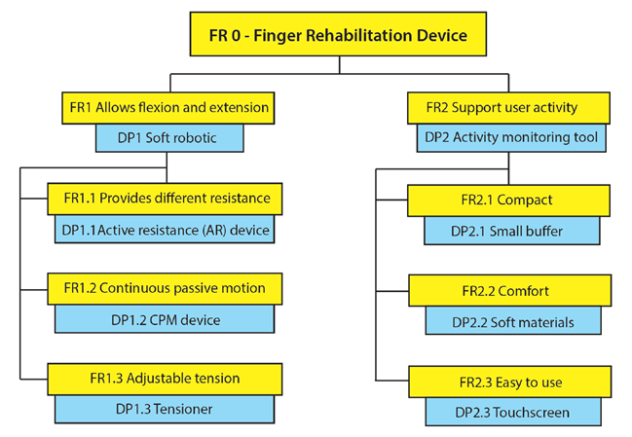
A road map for the levels of decomposition is shown in Figure 6.9.
Figure 6.9: Design rod map.

Slide 18
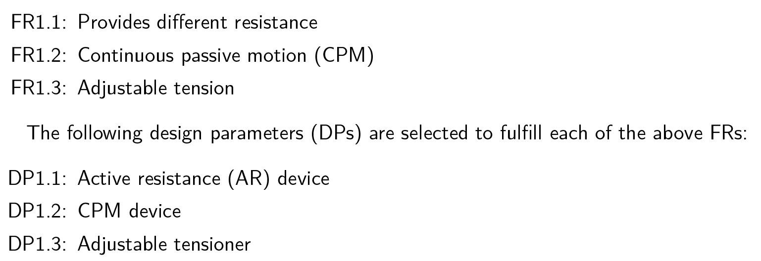
Next, using zigzagging and maintaining independence within each matrix, the additional FR levels were developed. Since all the FRs will follow a similar decomposition format, for briefness, only FR1 (Allows flexion and extension) decomposition will be shown.

Slide 19
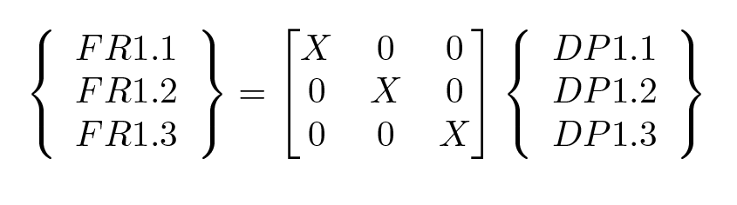
The following design matrix has been developed to ensure the independent axiom is not violated.
(6.7)
Eq. 6.7 shows that the design is uncoupled at the second level and the independence axiom is not violated. Figure 6.10 shows the remaining part of the decomposition of the high-level functional requirement of FR1.

Slide 20
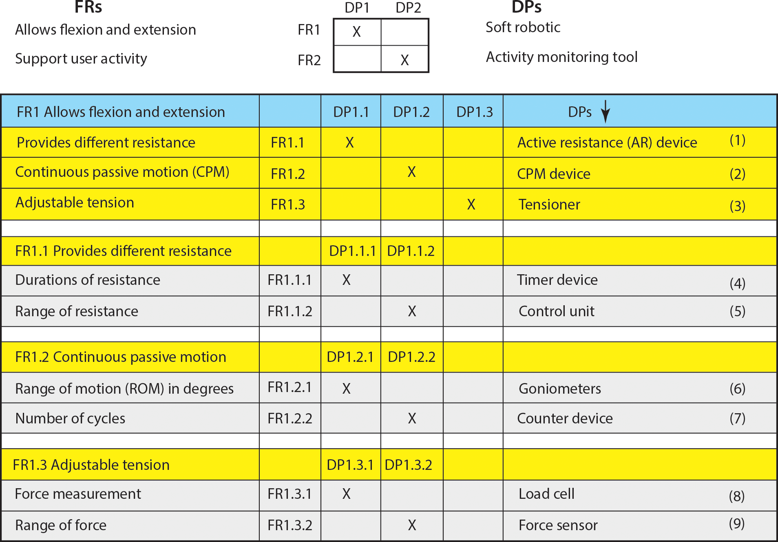
Figure 6.10: Decomposition of FR1.

Slide 21
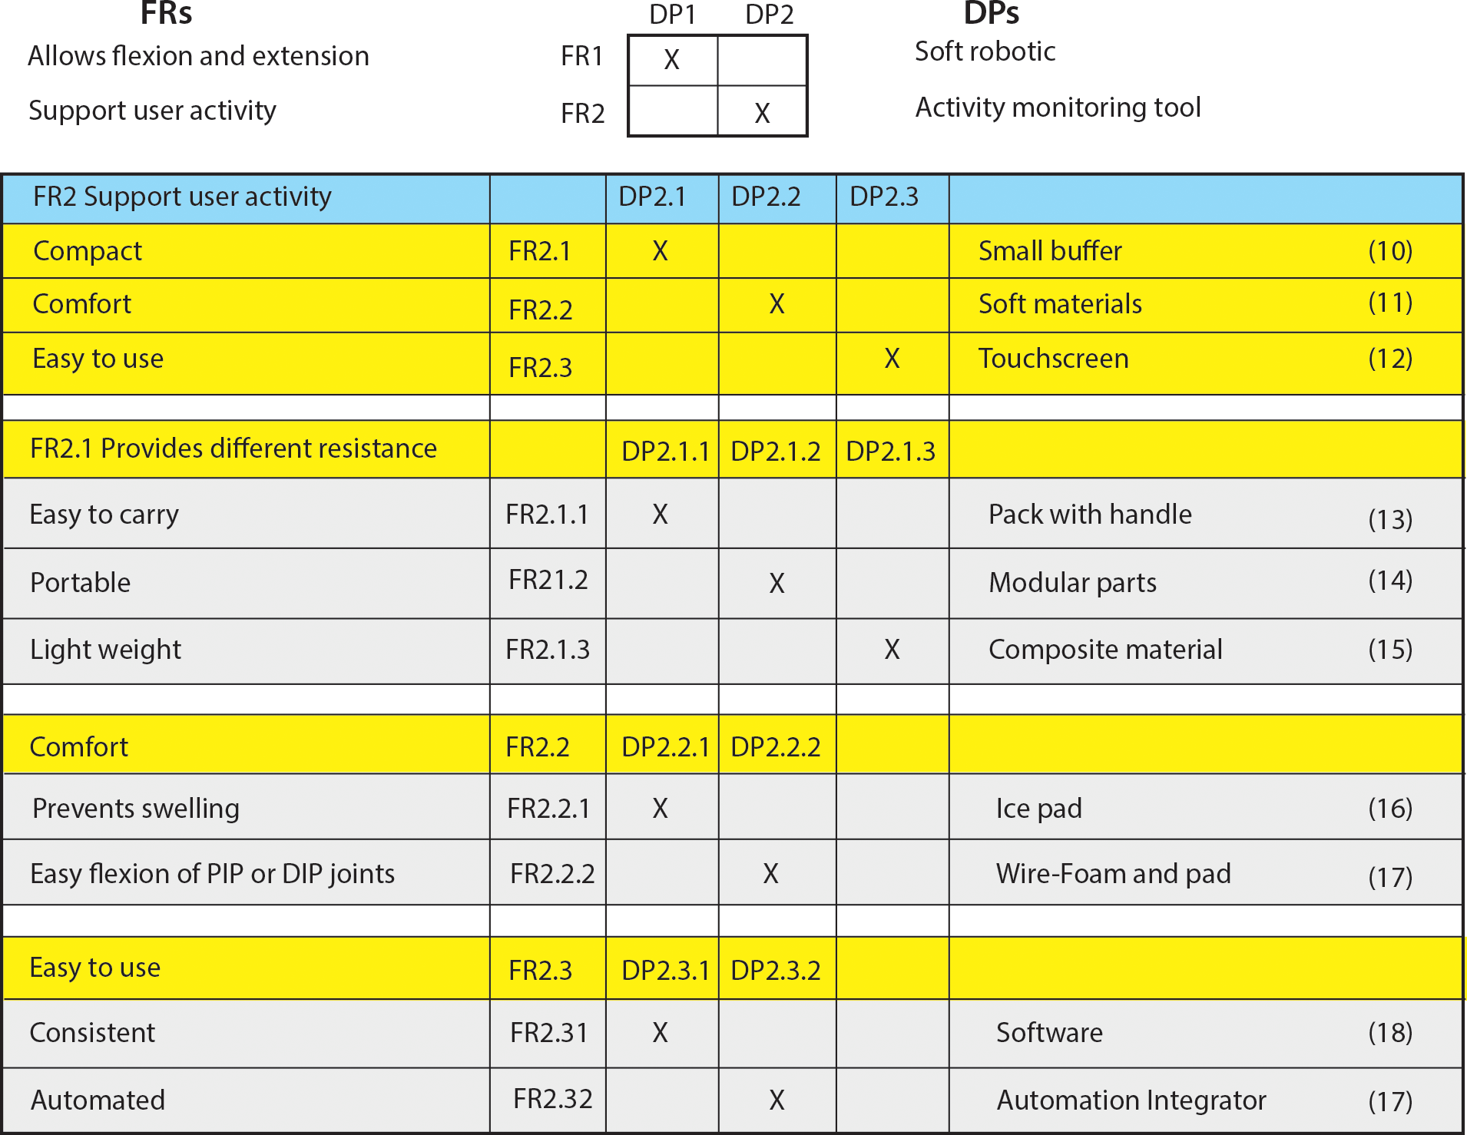
Figure 6.11 shows the decomposition of high-level functional requirement of FR2.
Figure 6.11: Decomposition of FR2.

Slide 22
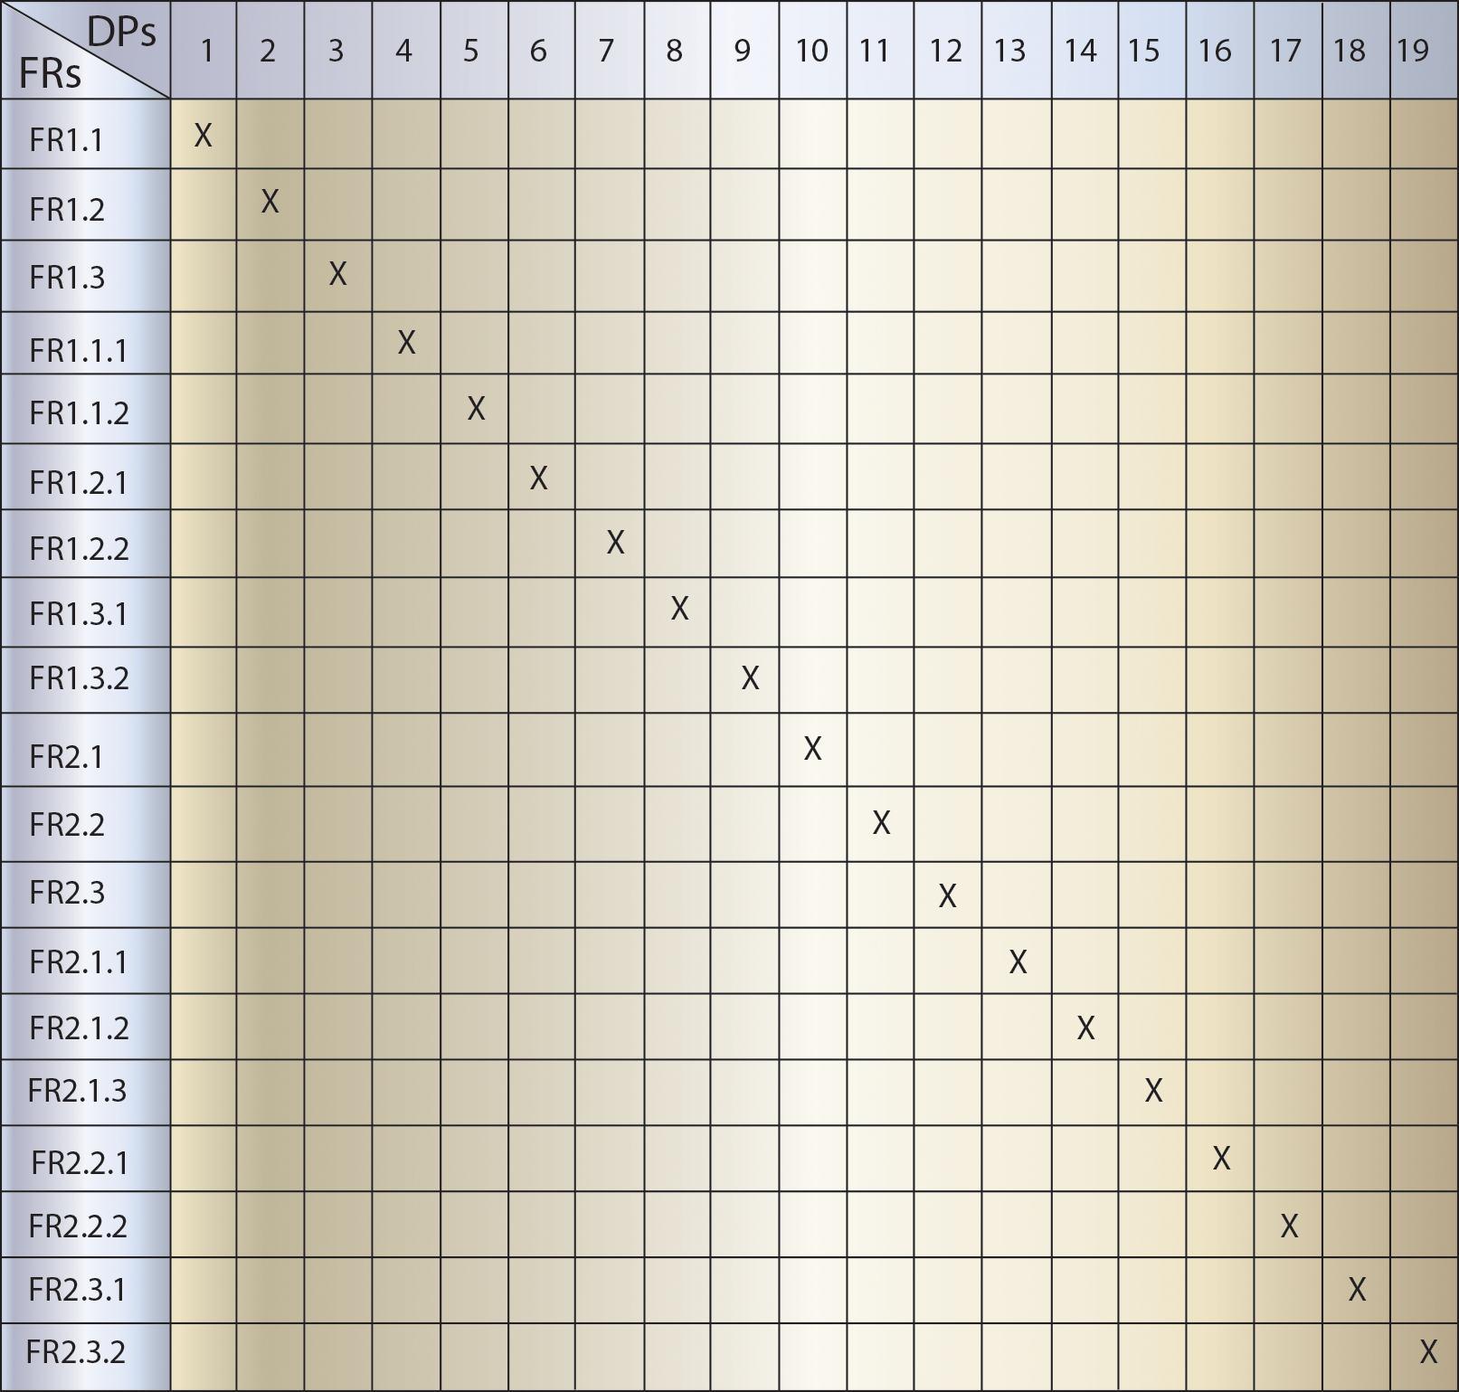
Figure 6.12 shows the combined design matrix of all the levels of FRs and DPs. It represents an uncoupled design. That is, each FR is satisfied by only one DP.
Figure 6.12: Combined design matrix.

