Slide 1


Instructor’s
Title & Name
Course Title….

Slide 2
Copyright © 2021 by the authors (A. Ertas and U. Gulbulak). This is an open access article distributed under the Creative Commons Attribution License (https://creativecommons.org/licenses/by/4.0/), which permits unrestricted use, distribution, and reproduction in any medium, provided the original work is properly cited.

Slide 3
Design Structure Matrix (DSM) is a tool for:
complex systems management
product development
project planning, management, and organizations
system decomposition and integration
Helps project team to agree on the design of a complex product in a timely manner.
Helps to design a complex product to be modular, so that portions of it can be more easily changed or modified.

Slide 4
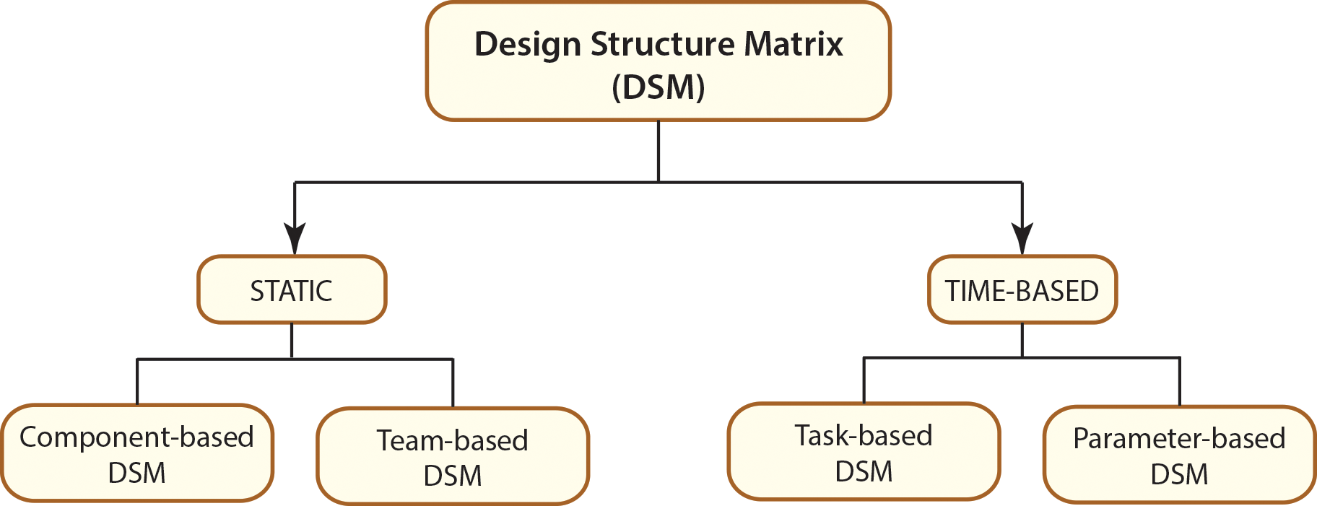
Different DSM Types

Slide 5
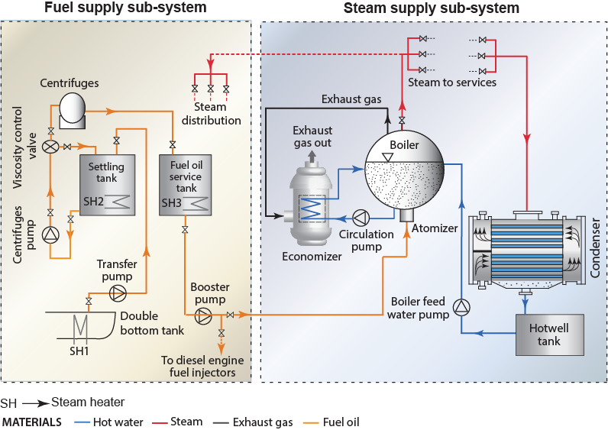
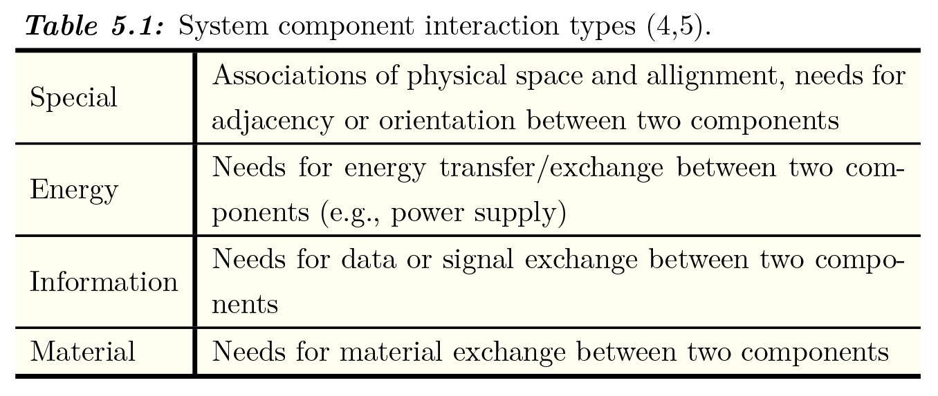
Component-Based DSM
Component-based DSM analyzes relations and interactions among components in complex system architecture. Four types of component grouping is shown in Table 5.1 (Pimmler [4], Tyson [5]).

Slide 6
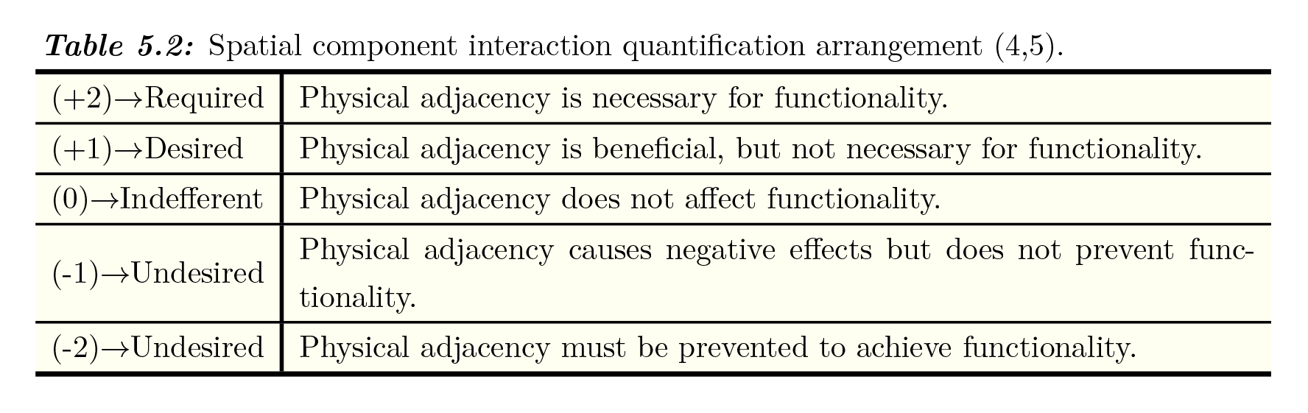
As sown in Table 5.2, a quantification arrangement among the components enables weighting interactions relative to each other (Pimmler [4], Tyson [5]).

Slide 7
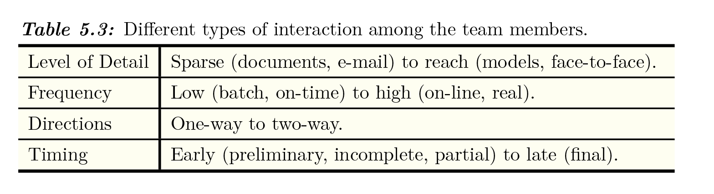
Team-Based DSM
Team-Based DSM: is used for complex organizational analysis to show interactions and information flow among organizational entities, design teams, and team members. Different types of interaction among the team members are shown in Table 5.3 [6].

Slide 8
Task/Activity-Based DSM
Task/activity-based DSM analyzes relations among tasks or activities such as project scheduling and process modeling.
Parameter-Based DSM
Parameter-based DSM analyzes relationships among a set of design parameters in complex system architecture. Building and analyzing a parameter-based DSM is similar to activity-based DSM.

Slide 9
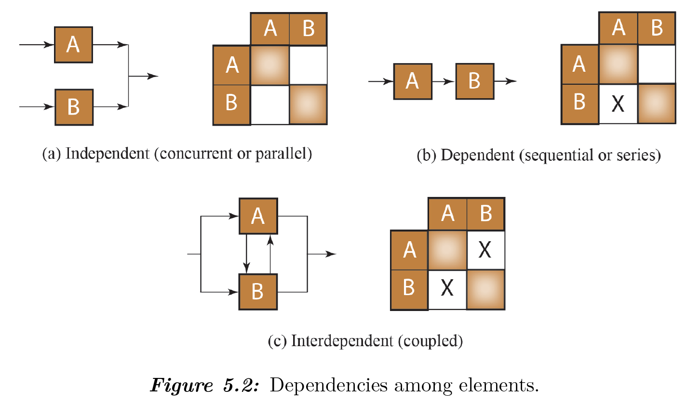
Design Dependencies
Design Structure matrix shows design dependencies where the information flow between activities is visualized. The figure shows three general dependencies among elements in a system.

Slide 10
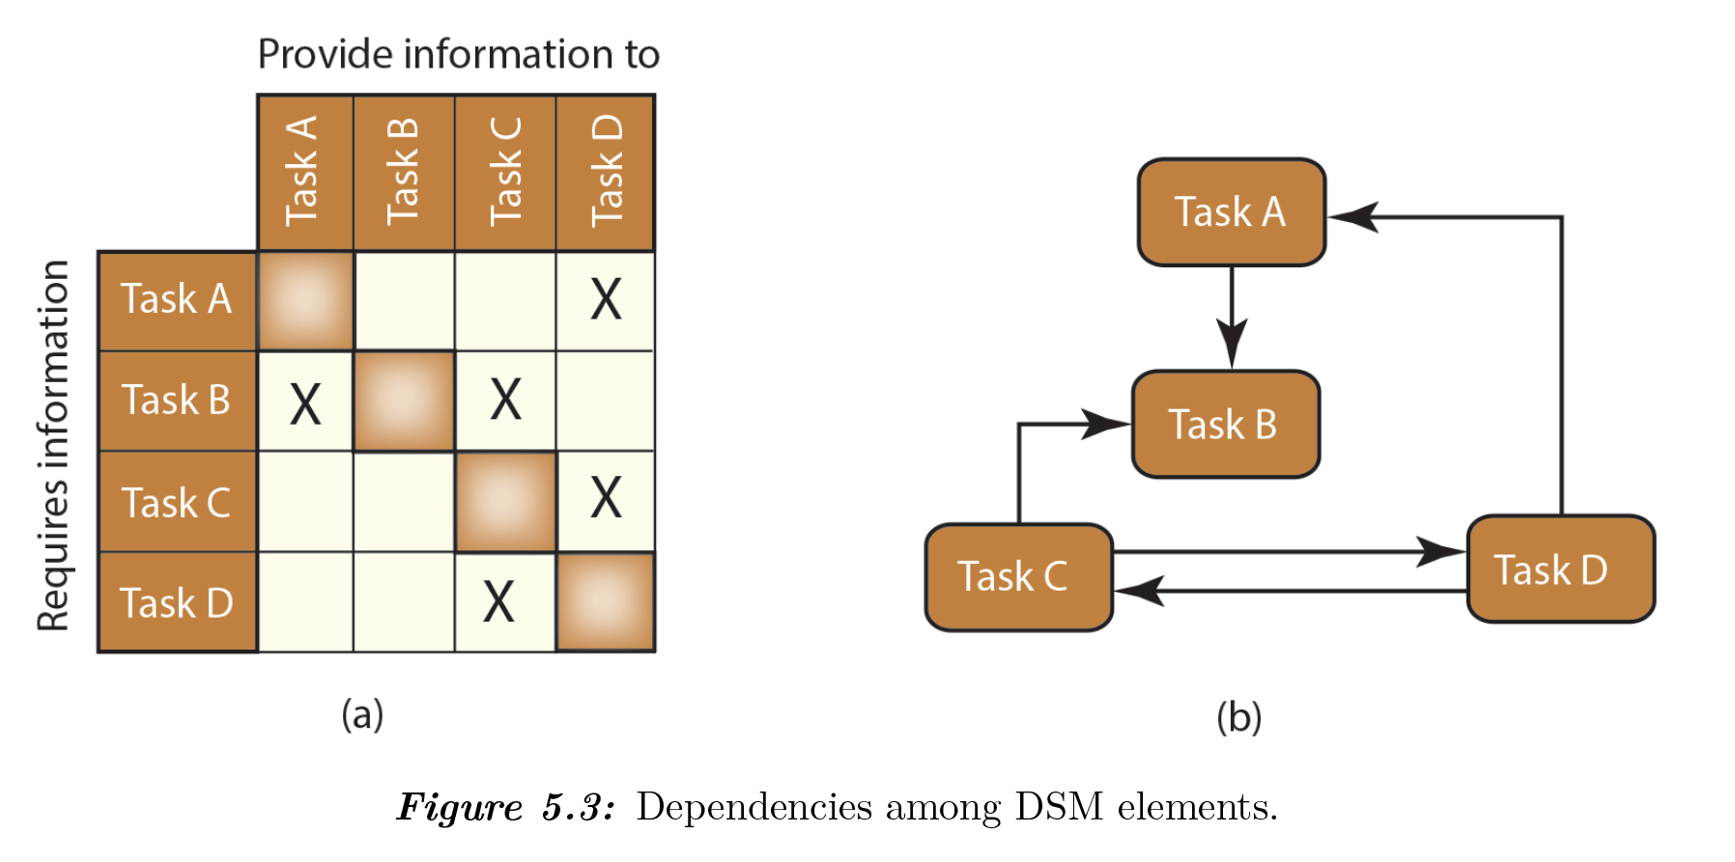
Matrix-Based Systems Modeling
The tasks are listed as close as possible to the order they should be completed.

Slide 11
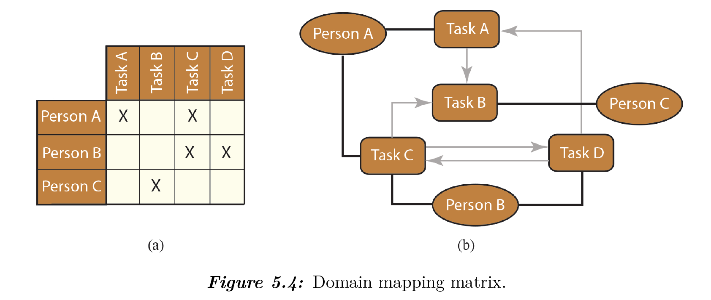
Domain Mapping Matrix (DMM)
DMM represents relations between elements of different domains.

Slide 12
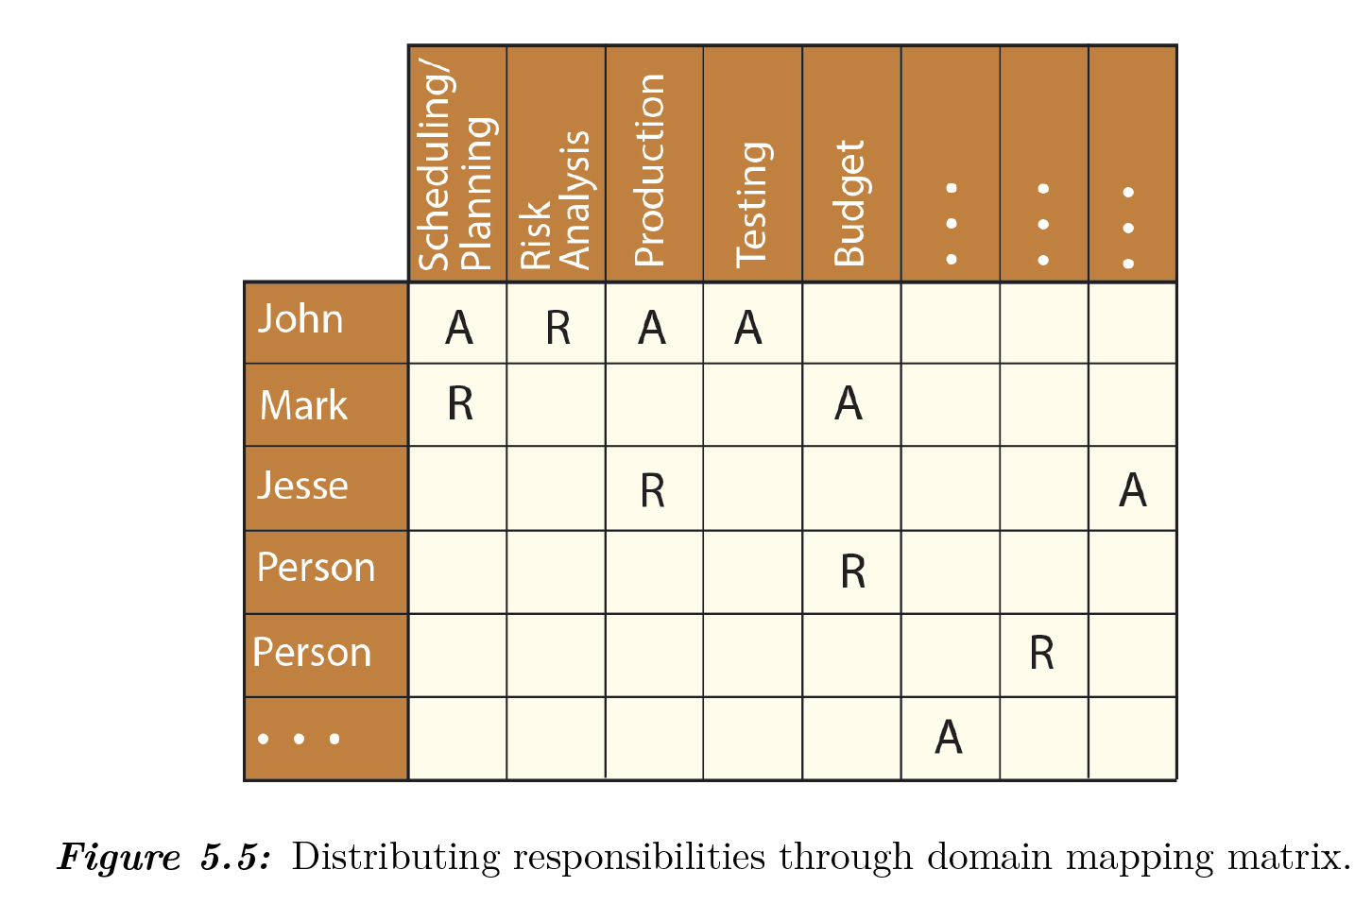
Domain Mapping Matrix (DMM): Example
Responsible (R): Person who does the work to complete the task.
Accountable (Approver) (A): Person finally accountable for the correct and thorough completion of the task (signs and approves the work that responsible provides)

Slide 13
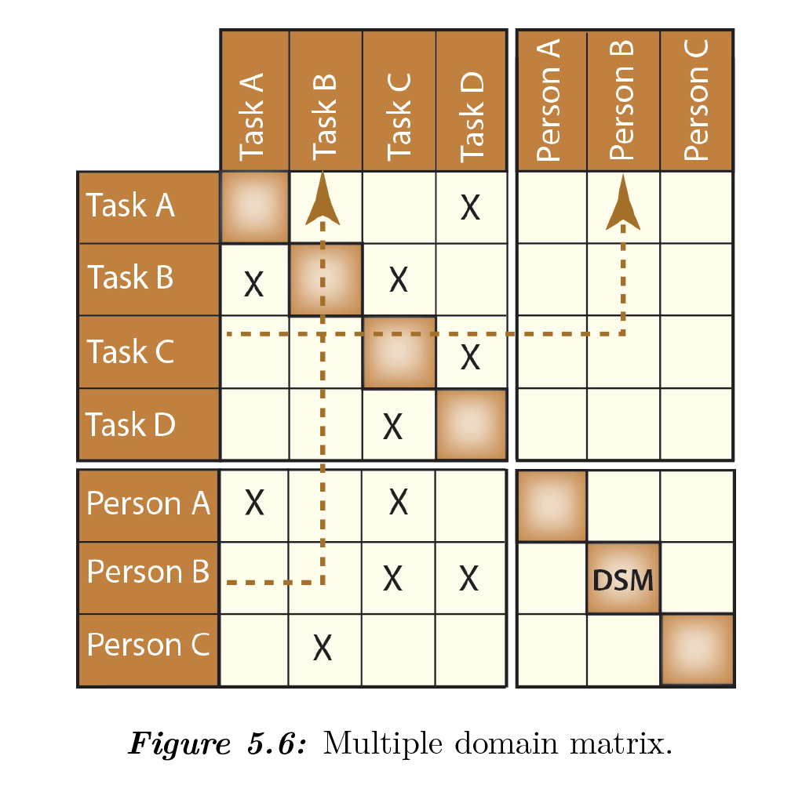
Multiple Domain Matrix
MDM combines DSM and DMM to show the interactions among different types of dependencies and domains.
MDM includes DSMs along its diagonal and DMMs outside the diagonal as shown in Figure 5.6.

Slide 14
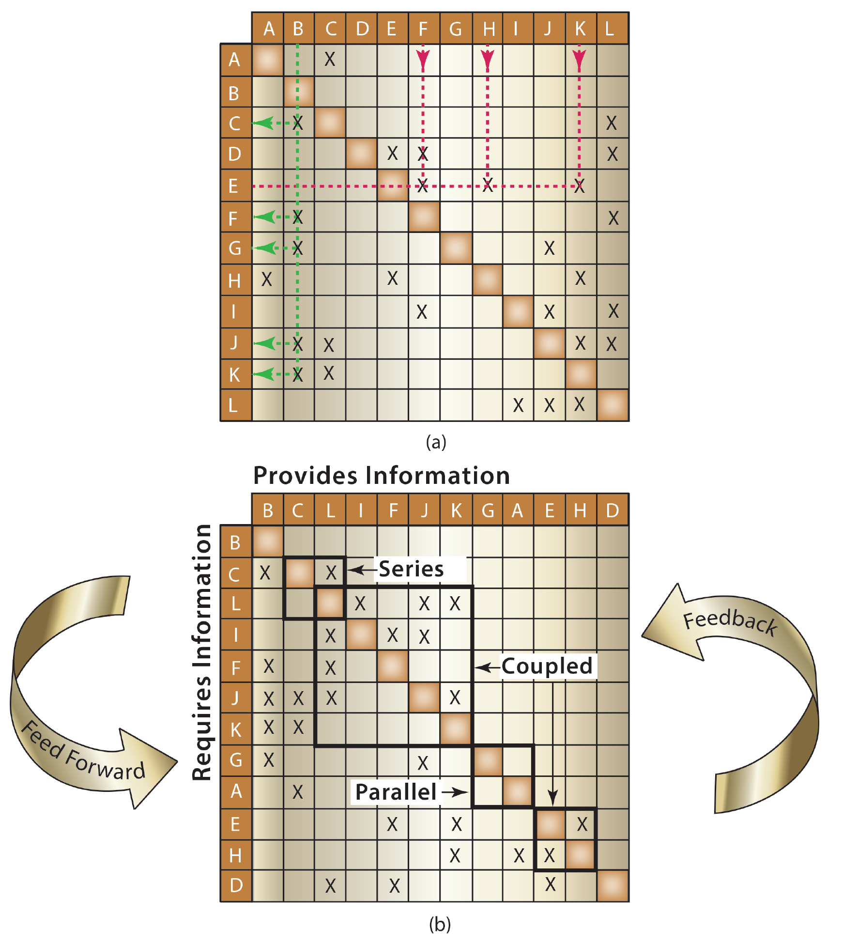
Design Structure Matrix Partitioning
The process of the partitioning of a DSM is performed by reordering DSM rows and columns so that the new DSM turns out to be a block-diagonal matrix (i.e., lower triangular matrix).
Above the diagonal of DSM (upper triangular matrix), marks of feedback or cycles are not desirable – requires time-consuming iterations.
Figure 5.7: (a) Base DSM; (b) Partitioned DSM. (Adapted from: Yassine, A., and Braha, D., 2003.)

Slide 15
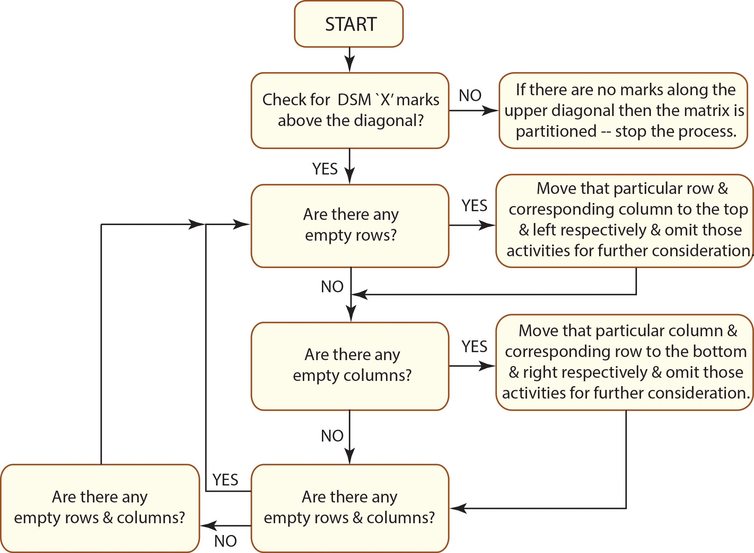
Process of Partitioning

Slide 16
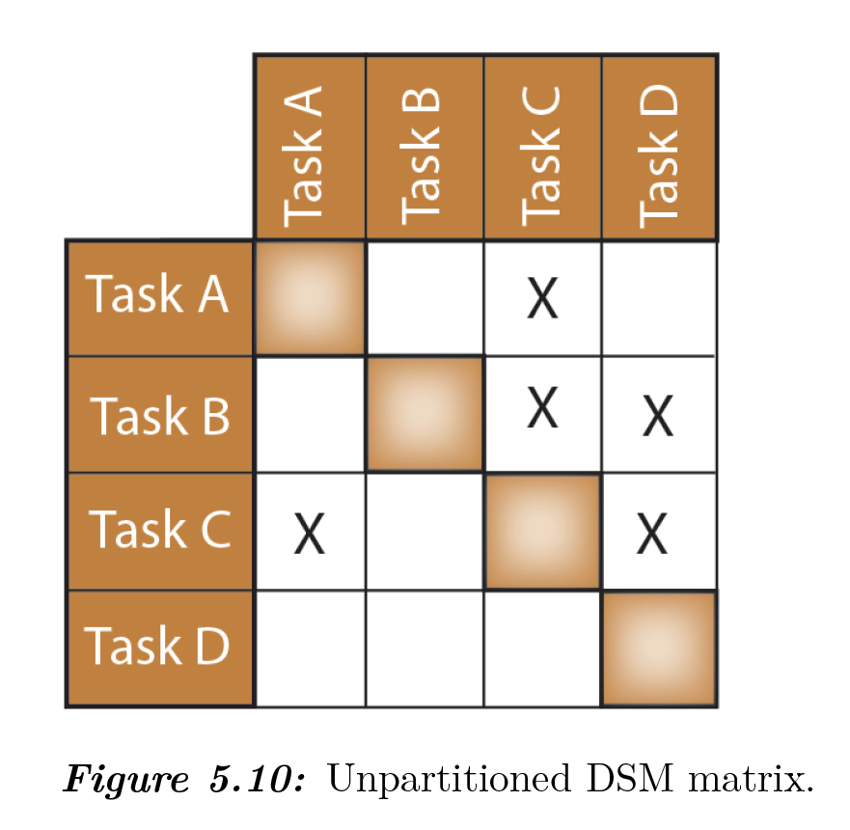
Example 1: Partitioning
Figure 5.10 shows the relationships of four tasks. Using topological sorting and path searching method partition DSM matrix shown in Figure 5.10.

Slide 17
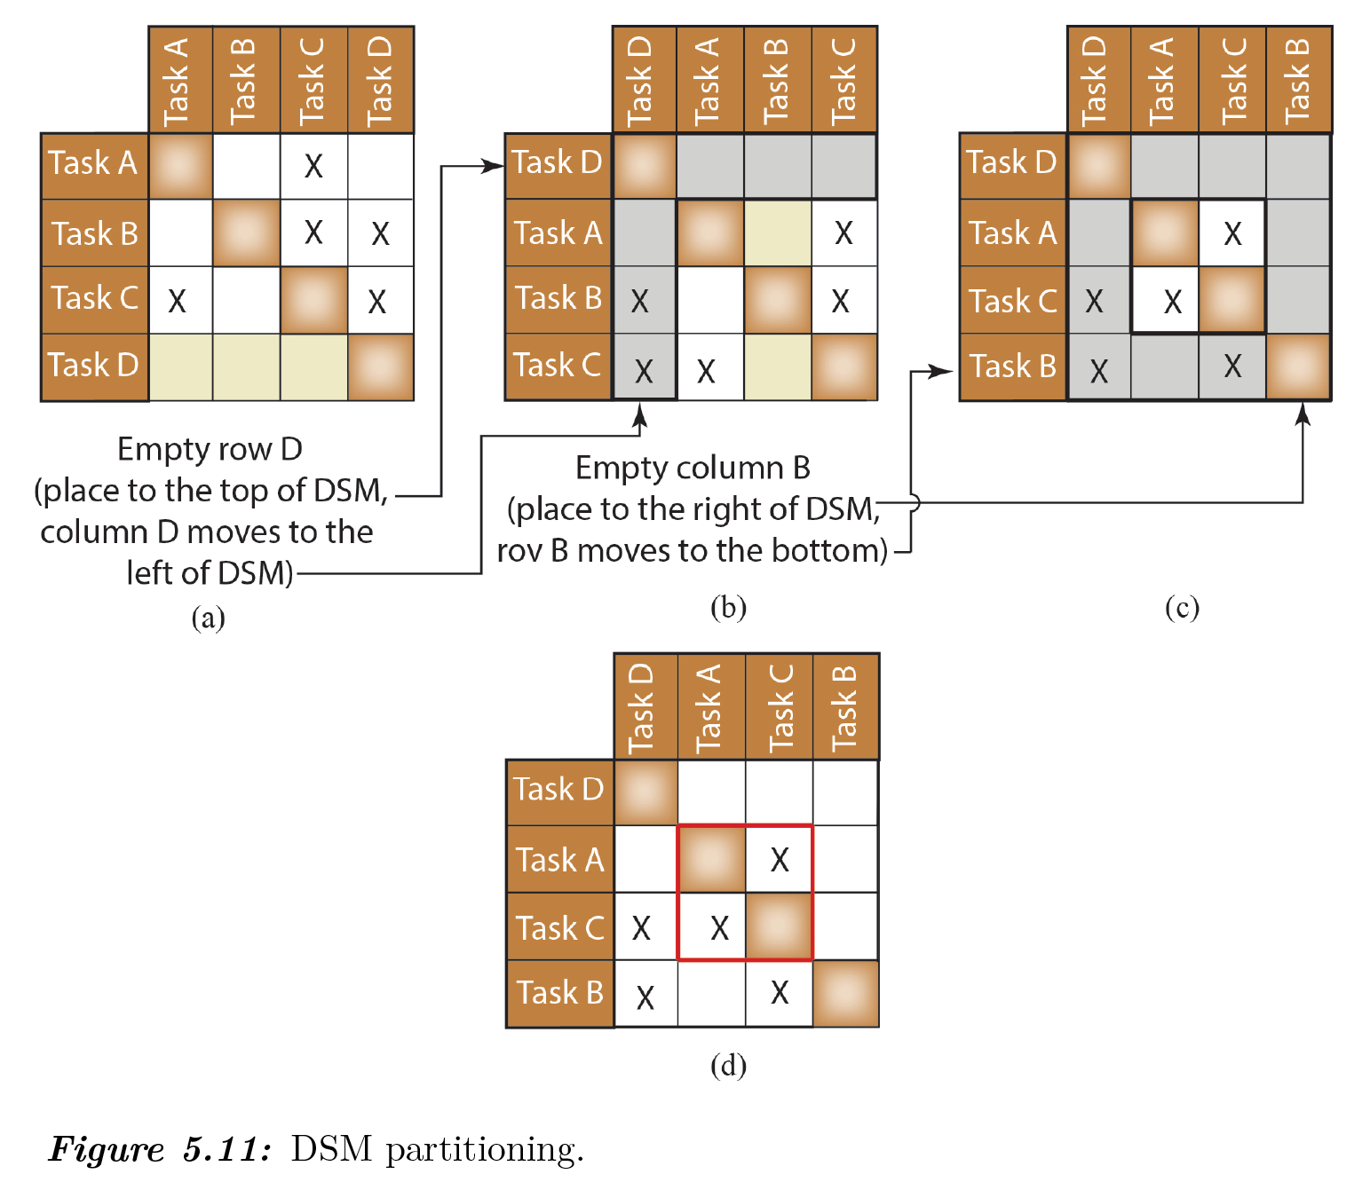
Example 1: Partitioning

Slide 18
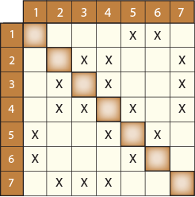
Example 2
Assume that a team of seven students working on a design project. Use team-based DSM to show the information flow between the members within the sub- teams and the information flow (or interactions) among the sub-teams.
Team has following three sub-teams.
Team A = Members 1, 5, and 6
Team B = Members 4 and 5
Team C= Members 2, 3, 4, and 7
Figure 5.14: Rocket competition sub-team.

Slide 19
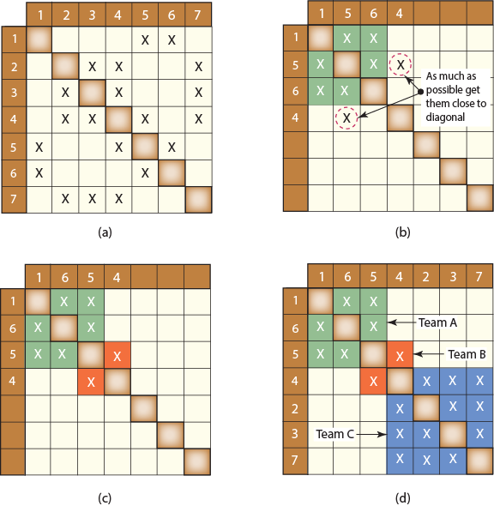
Example 2 (a)
The first step replace rows 2 and 3 with rows 5 and 6 as shown in Figure 5.15(b). This manipulation is logical because we would like to bring members of Team A together.
The second step is to bring coupled entities 4 and 5
close to diagonal (see Figure 5.15(9b)). To accomplish this, swap the places of row 5 and row 6 (see Figure 5.15(c)).
The last step is to include remaining team members 2, 3, and 7 belong to Team C. As seen from Figure 5.15(d), three teams are clustered along the diagonal of the DSM to highlight the inter-team interfaces.
Figure 5.15: Sub-team partitioning.

Slide 20
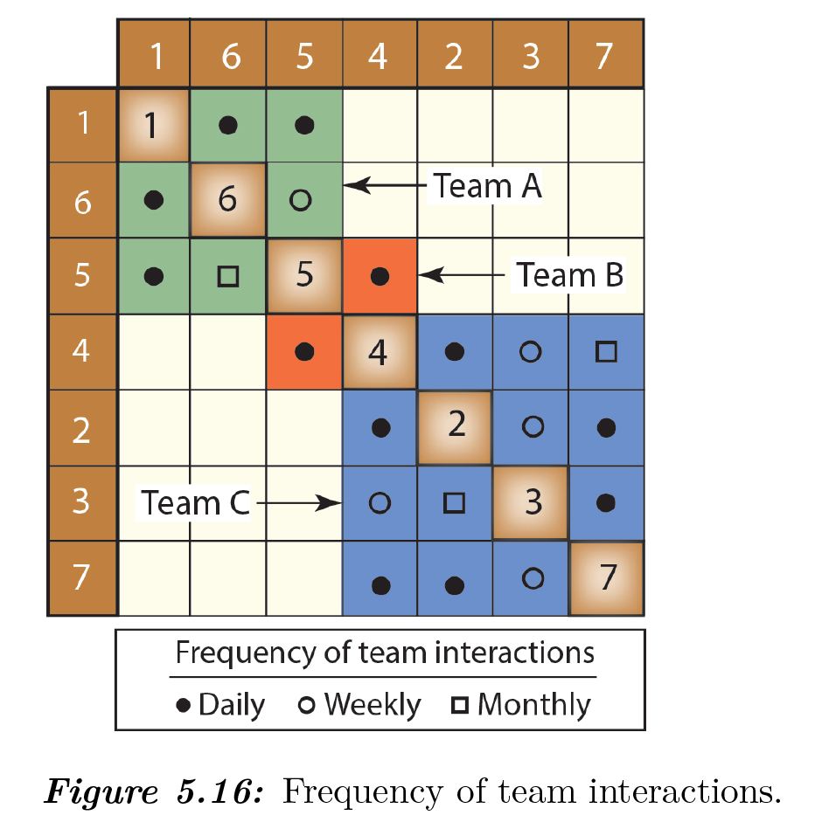
Example 2 (b)
Frequency of Team Interactions
Figure 5.16 shows the frequency of interactions (daily, weekly, and monthly) within the teams and among the teams.
Team members or teams working on different parts of a system or product must integrate their designs by frequent information exchange and communication with those of the other team members to make sure that the entire system or product will function properly as a whole.

Slide 21
Example 2 (b)
Frequency of Team Interactions
Figure 5.16 shows the frequency of interactions (daily, weekly, and monthly) within the teams and among the teams.
Team members or teams working on different parts of a system or product must integrate their designs by frequent information exchange and communication with those of the other team members to make sure that the entire system or product will function properly as a whole.

Slide 22
“This is a story of four people named Everybody, Somebody, Anybody, and
Nobody. There was an important job to be done and Everybody was asked
to do it. Everybody was sure Somebody would do it. Anybody could have
done it, but Nobody did it. Somebody got angry about that because it was
Everybody’s job. Everybody thought Anybody could do it, but Nobody
realized that Everybody wouldn’t do it. It ended that Everybody blamed
Somebody when Nobody did what Anybody could have done.”
Charles R. Swindoll

Slide 23
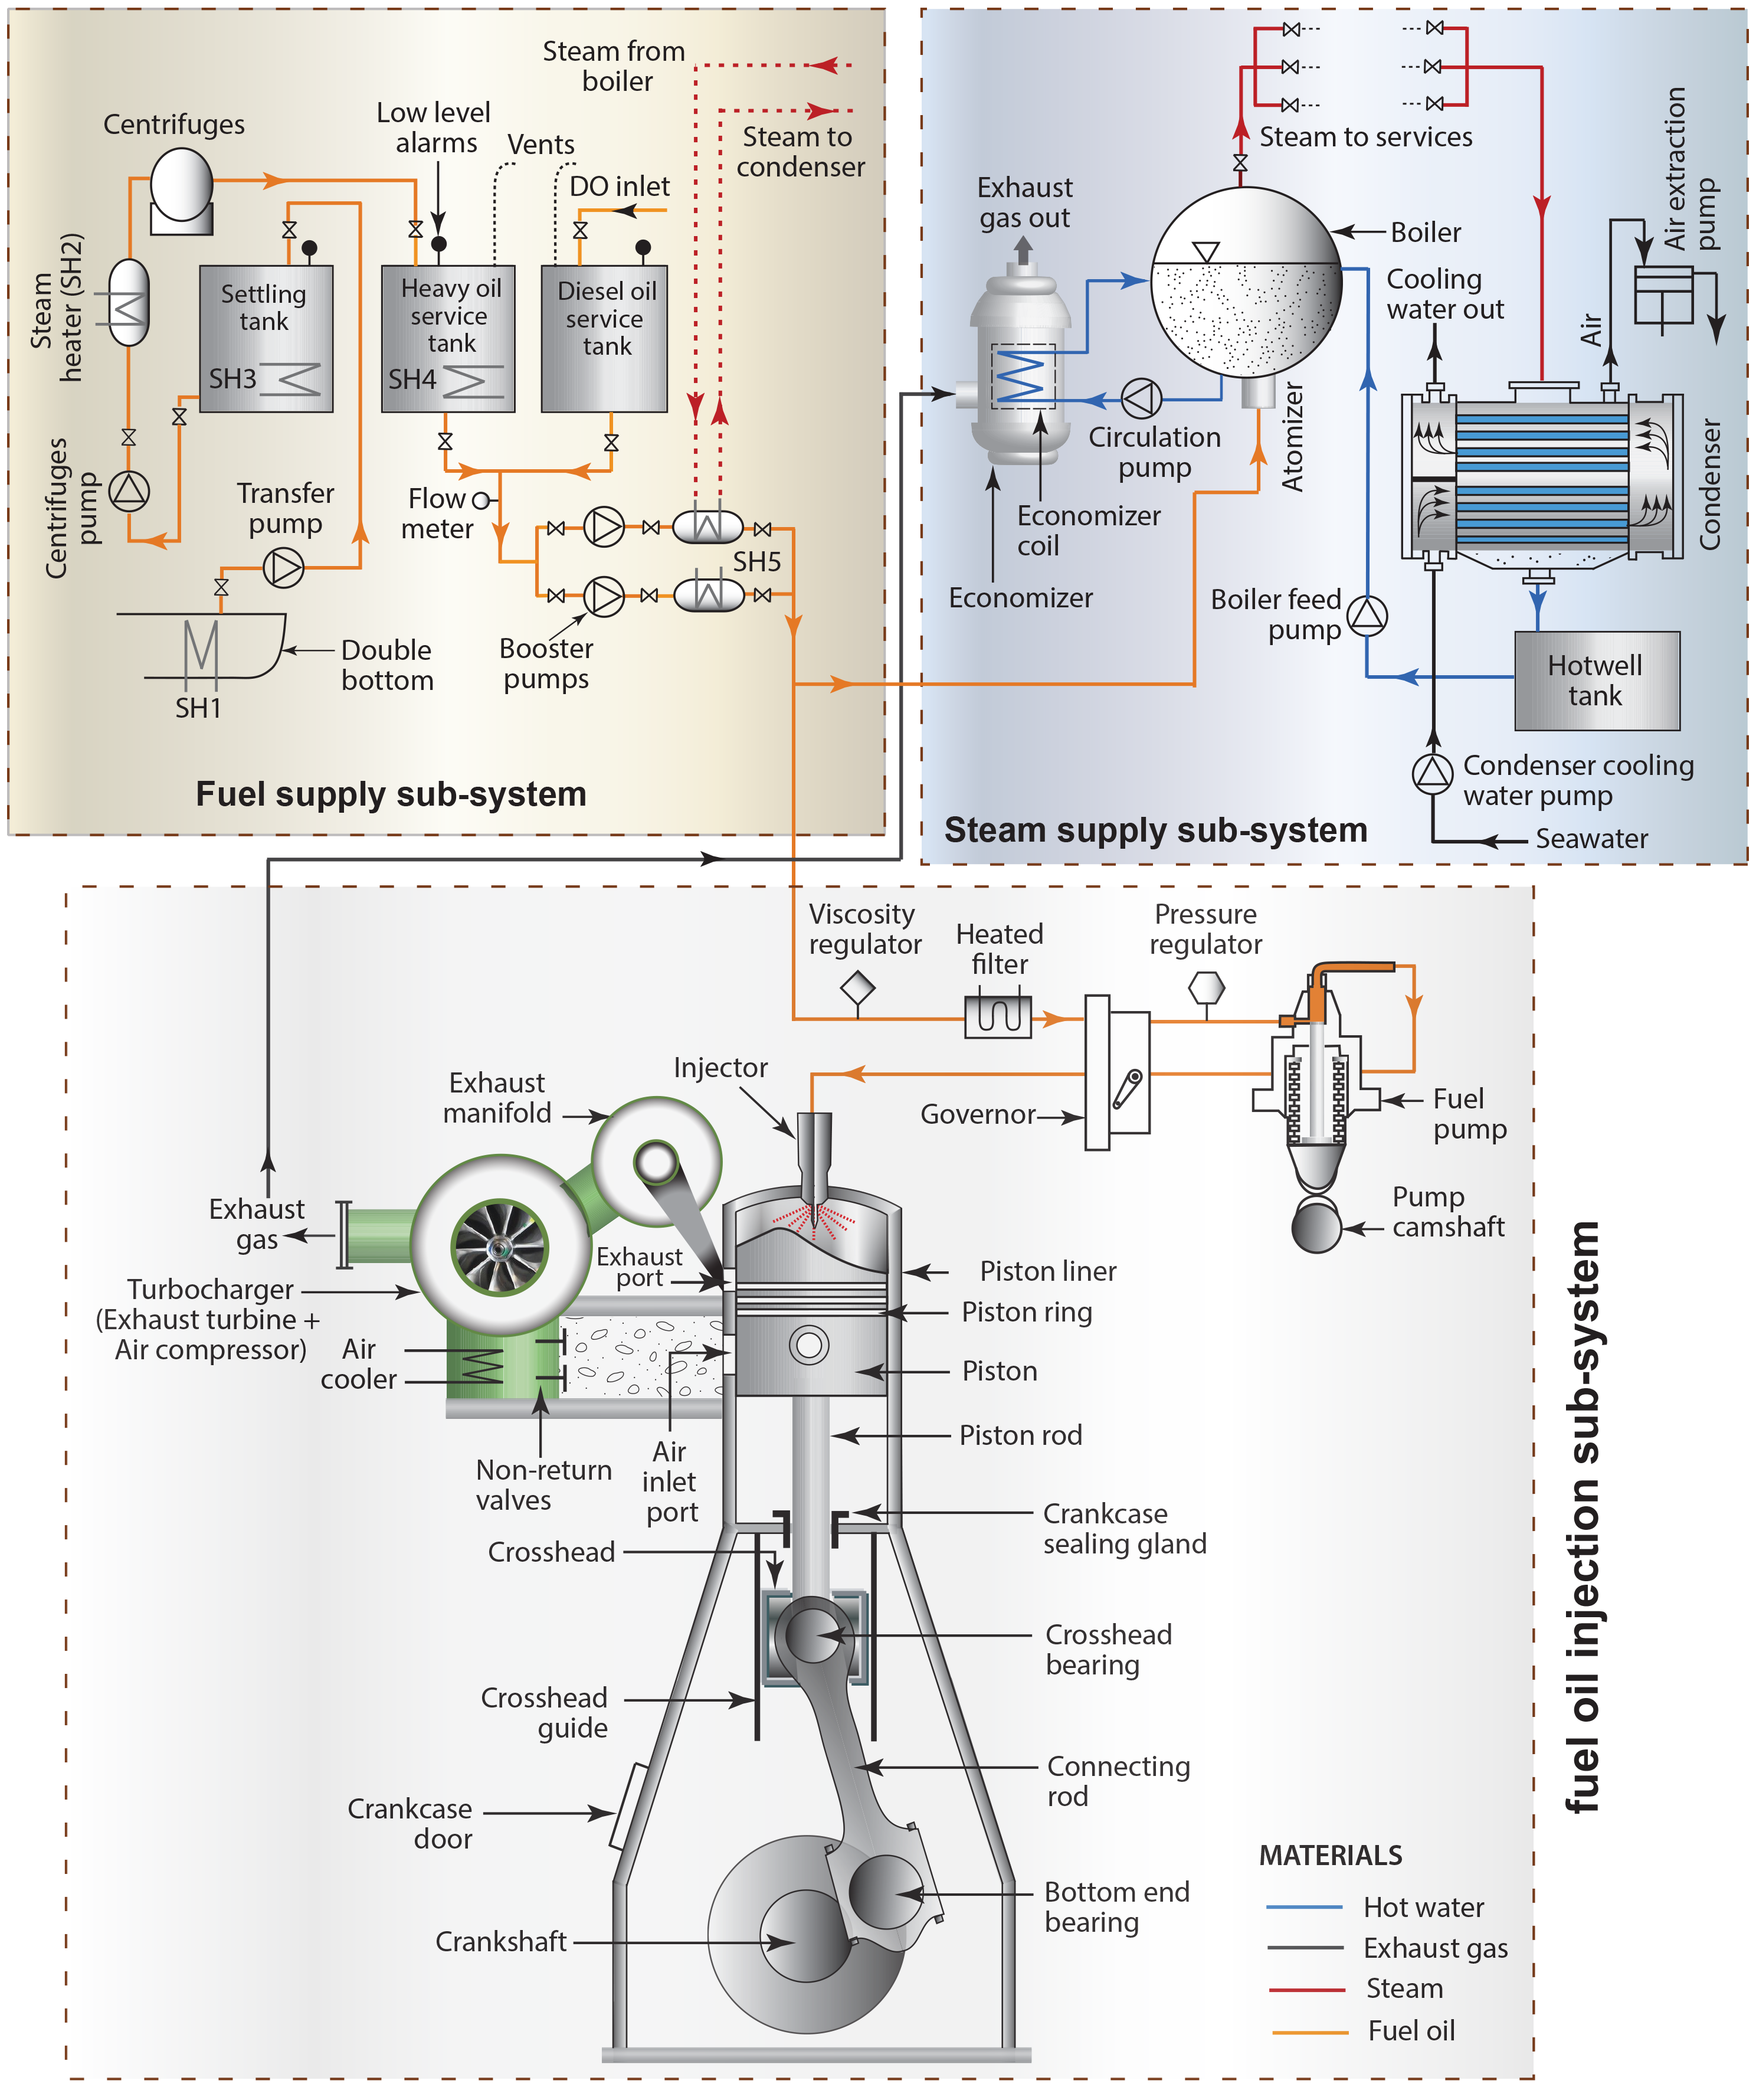
Complex System Design
As seen from Figure 5.18, the 2-stroke marine engine power system has three sub-systems:
fuel supply sub-system
steam supply sub-system, and
fuel oil injection sub-system.
Figure 5.18: Two cycle marine diesel engine power system.

Slide 24
Complex System Design
Figure 5.19 shows a simplified version of two sub-systems:
fuel supply sub-system and
steam supply sub-system.
There are interactions and relationships within the sub-systems and among the subsystems are.
Figure 5.19: Fuel/Oil and boiler sub-systems.

Slide 25
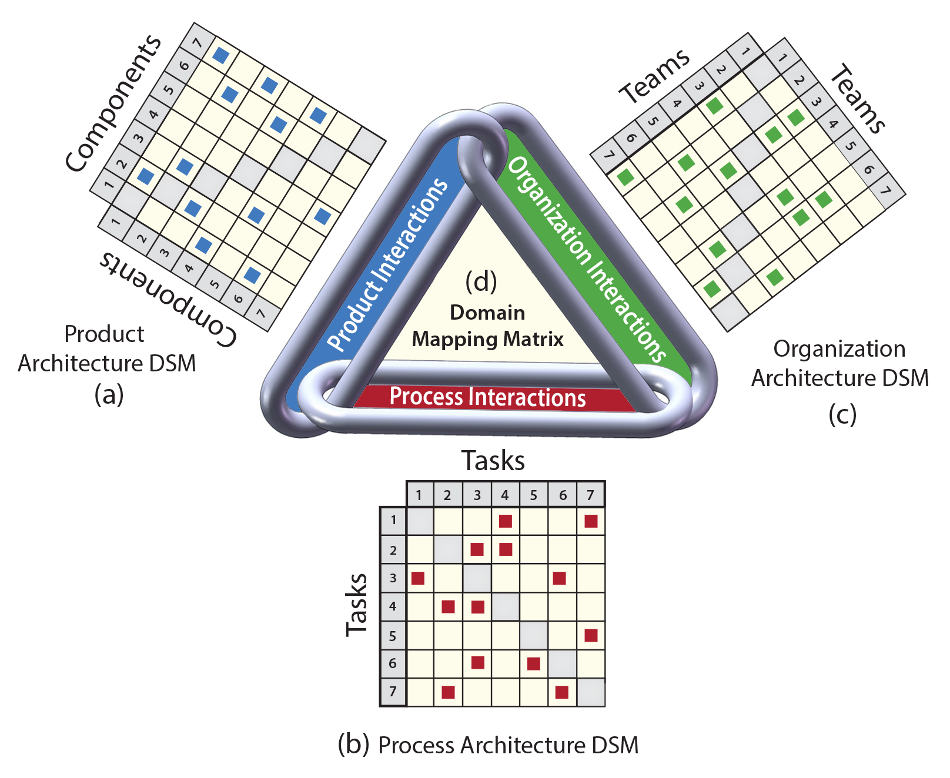
EXAMPLE
Select the proper system components to design and build the sub-systems given in Figure 5.19 and investigate the interactions within and among the sub-systems. Complete the system analysis following Figure 5.20.
Figure 5.20: Creating DMMs from three basic DSMs.(Ref. a, b)

Slide 26
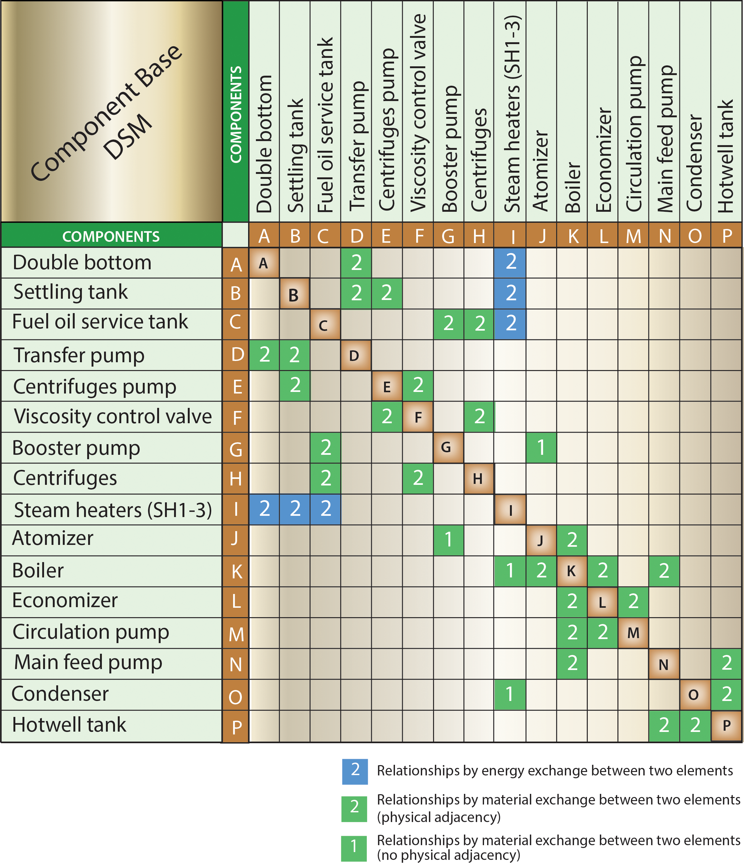
(a) Product (or system) Architecture DSM
Using Figure 5.19, sixteen components that affect the functionality of the subsystems are identified for the analysis. Interactions between the components are designated by “numbers”
in the DSM matrix as shown Figure 5.21.
Figure 5.19: Fuel/Oil and boiler sub-systems.
Figure 5.21: Product architecture DSM (identifies component interactions).

Slide 27
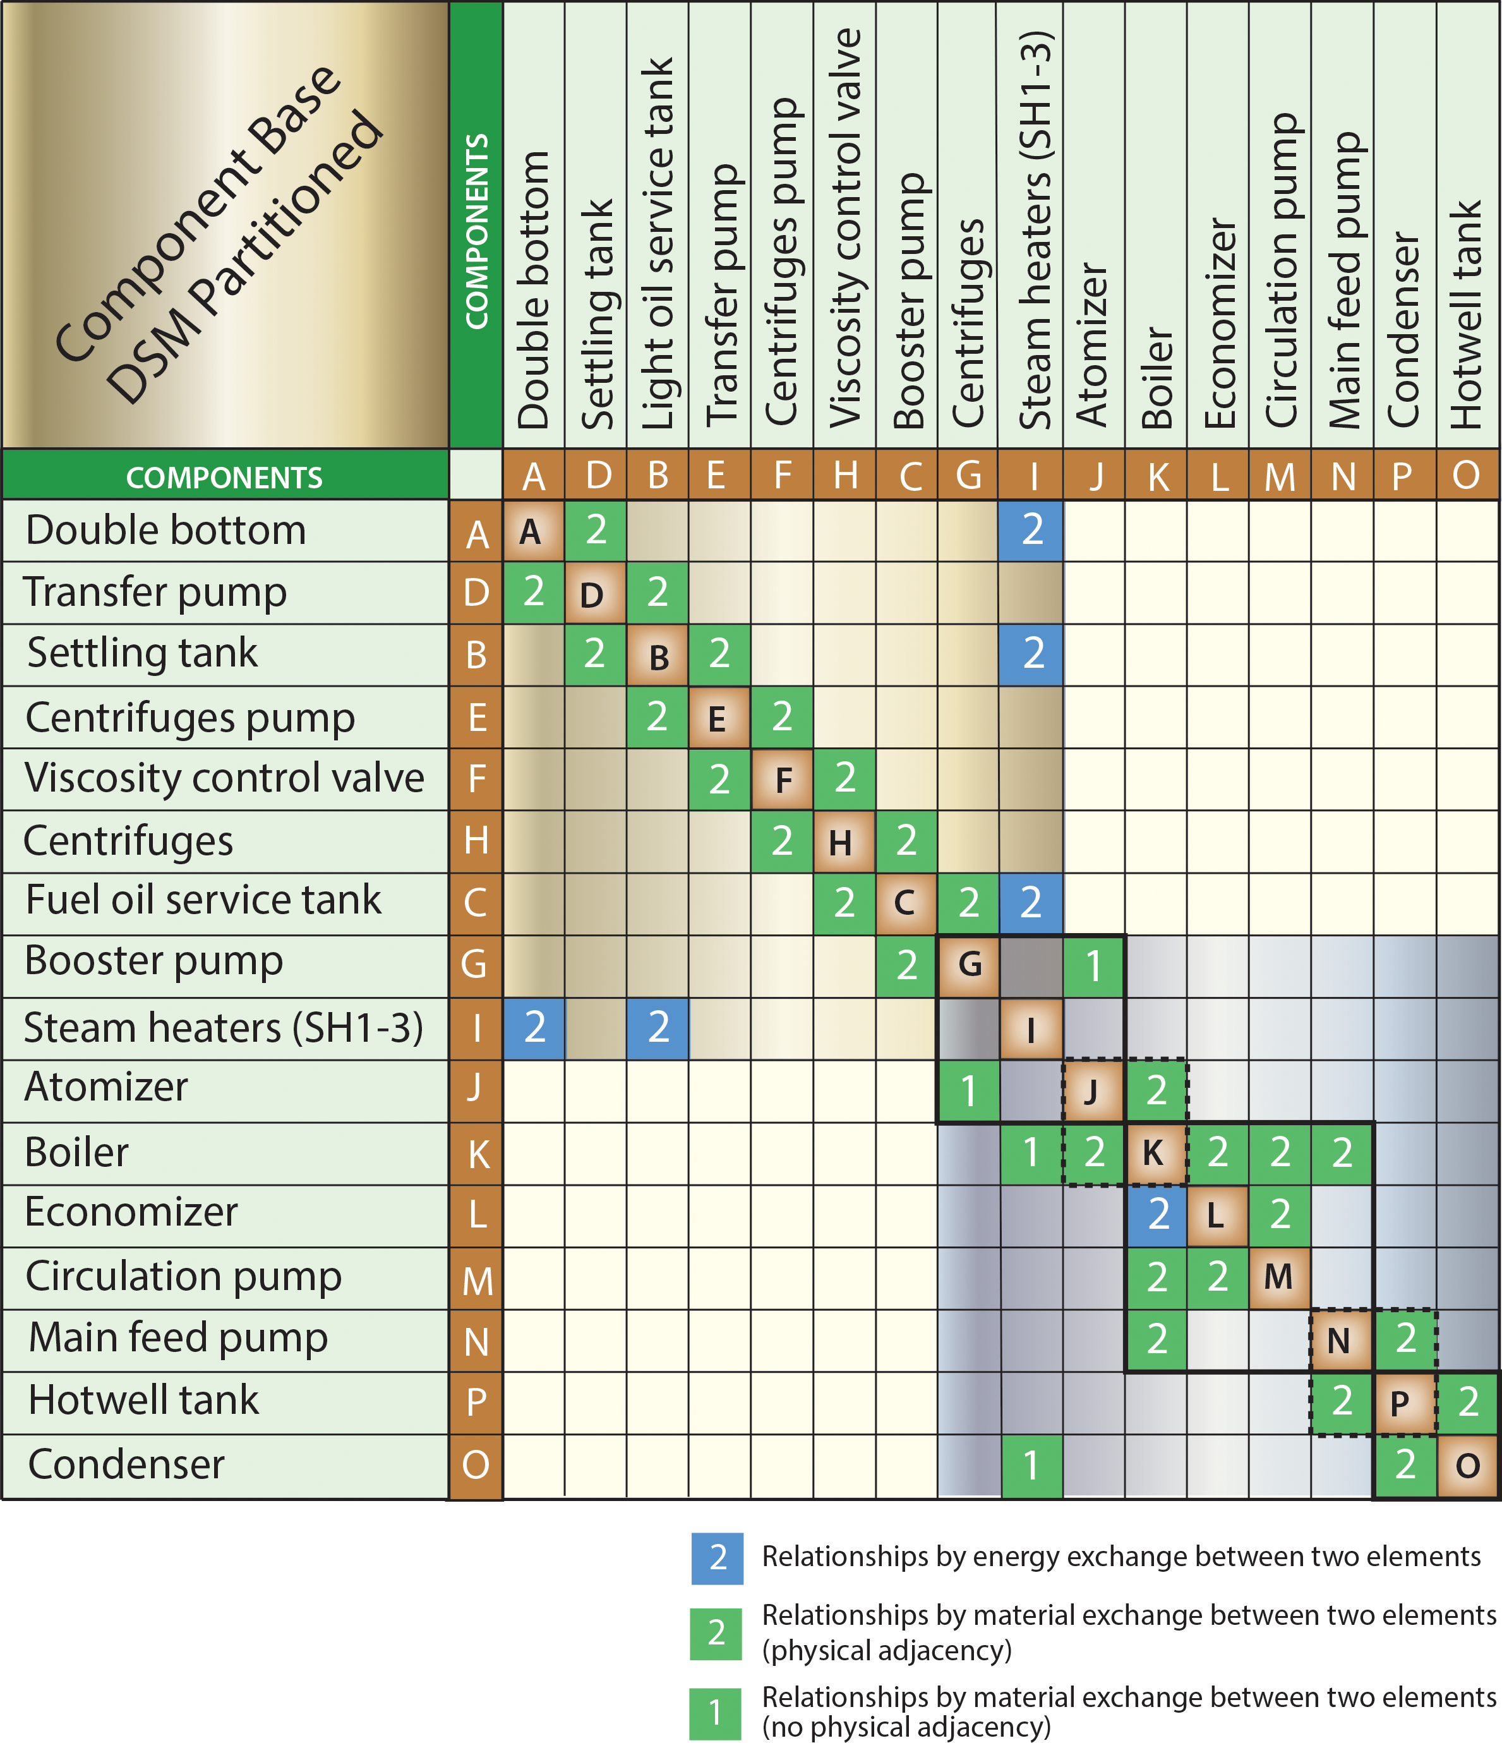
Partitioned Matrix
Using Figure 5.21, a partitioned matrix for the system components was developed (see Figure 5.22. Different types of relationships between the components are defined in the legends of Figure 5.21 and Figure 5.22.
Figure 5.22: Sub-system components partitioned matrix.

Slide 28
(b) Process Architecture DSM
Using Figure 5.19, tasks descriptions and requirements are defined as follows.
TASK DESCRIPTIONS
Component selections: Selection of a preexisting manufactured component or the
selection of a bespoke design (custom-made design) based on the fuel oil and water properties at that point in the system.
Steam Distribution: Determining the percentage of the boiler output that is going to be routed to specific tasks that rely on steam delivery (steam to services and steam distribution from the boiler).
Diesel Engine Requirement: Determining the fuel oil mixture properties that the diesel engine requires for optimum operation.
Viscosity Requirement: The monitoring of the fuel oil viscosity that each individual component needs for optimum performance and how the fuel oil viscosity changes as it travels through the system.
Overall System Efficiency: The determination of the ratio of system output (steam and exhaust) to system input (fuel oil and water) so that running costs can be estimated.
Overall System Flow Rate: The determination of the amount of fuel oil being consumed every hour so that the total time of operation per tank can be estimated. The determination of how much time passes from the commencement of boiler heating to max steam production occurring.

Slide 29
TASK INTERACTION DESCRIPTIONS (INFORMATION REQUIREMENTS)
1. Steam Distribution: None: The volume of steam needed by each service in the
engine compartment and the steam heaters of the system is assumed to be known.
2. Diesel Engine Requirement: None: The fuel oil properties required for the engine
to combust optimally are assumed to be known.
3. Boiler Selection
  Steam Distribution: The volume of steam required by each steam dependent
  service dictates the output capability of the boiler.
  Atomizer Selection: The heat generation capability of the atomizer will dictate
  the water volume of the boiler required so that an acceptable time interval passes
  from heat production to steam production.
4. Steam Heater Selection
  Steam Distribution: The higher the volume of steam output from the boiler not
  being sent to the steam heaters will increase the time interval from steam leaving
  the boiler to the steam heaters reaching their operating temperatures.
  Boiler Selection: The performance of the boiler will dictate what kind of steam
  heaters must be selected; a good boiler will require cheaper steam heaters while the
  poor boiler will require more expensive steam heaters to make up for the boiler’s
  shortcomings.

Slide 30
TASK INTERACTION DESCRIPTIONS (INFORMATION REQUIREMENTS)
5. Atomizer Selection
  Diesel Engine Requirement: The atomizer is fed fuel/oil in parallel with the diesel engine therefore the properties of the fuel/oil required by the diesel engine are going to dictate the combustion of the atomizer.
  Boiler Selection: The size and shape of the boiler is going to dictate what kind of atomizer design will most efficiently heat the boiler through combustion.
6. Fuel Oil Pump Selections
  Diesel Engine Requirement: The diesel engine will require the fuel oil at a certain pressure for optimum combustion and efficiency.
  Centrifuge Selection: The centrifuges will need to be supplied with fuel oil at a certain pressure for optimum separation to occur in a timely manner.
  Fuel Oil Tank Selection: The fuel oil must be pressurized enough to flow
  through the viscosity control valve, centrifuges, and still fill the light oil service tank at the same rate fuel/oil leaves the tank to supply the diesel engine and atomizer.
  Settling Tank Selection: The transfer pump selection is dictated by the settling rate of the highly viscous fuel/oil pumped out of the double bottom and must keep the tank full.

Slide 31
TASK INTERACTION DESCRIPTIONS (INFORMATION REQUIREMENTS)
7. Centrifuge Selection
  Fuel Oil Pump Selection: The centrifuges selected must be designed to operate at the incoming pressure and velocity of the fuel oil being pumped by the centrifuge pump for the optimum removal of impurities to occur.
  Viscosity Requirement: The centrifuges must be selected to work with the
  viscosity of the fuel/oil at that point in the system because the viscosity of
  the fuel/oil will determine how fast they operate and how much wear they will
  experience.
8. Fuel Oil Tank Selection
  Diesel Engine Requirements: The fuel oil requirements of the diesel engine
  with respect to viscosity and flow rate will dictate the size of the light oil tank to
  ensure that the fuel oil supply is constant. If the tank is too large the steam heater
  will not be able to maintain the fuel oil temperature needed for the required
  viscosity.
  Atomizer Selection: The fuel oil tank will need to supply fuel oil to the atomizer
  at a constant flow rate and must be taken into consideration when selecting the
  size of the tank.
  Viscosity Requirement: The viscosity of fuel oil entering the light oil tank must
  be within the allowable range for the steam heater to lower the viscosity further
  during the time interval until it is pumped out to the diesel engine and atomizer.

Slide 32
TASK INTERACTION DESCRIPTIONS (INFORMATION REQUIREMENTS)
9. Settling Tank Selection
  Diesel Engine Requirement: The settling tank must yield a high enough percentage of lowered viscosity fuel oil, from the double bottom, allowed through the viscosity control valve to continue to the diesel engine to meet the max requirement of the diesel engine. The volume of the tank and the flow rate must be large enough that the diesel engine receives its fuel oil requirement.
  Fuel Oil Tank Selection: The fuel oil tank must maintain a level of fuel oil
  to allow for constant running for a specified number of hours and as such the
  settling tank must keep up with the discharge rate of the light oil tank.
  Viscosity Requirement: The viscosity of the fuel oil being pumped to the
  viscosity control valve must be low enough that an allowable minimum must be forwarded to the centrifuges to keep up with the flow rate demands of the diesel engine and atomizer.

Slide 33
TASK INTERACTION DESCRIPTIONS (INFORMATION REQUIREMENTS)
10. Economizer Selection
  Boiler Selection: The economizer is used to increase the efficiency of the boiler and decrease the time needed for max steam production to occur by utilizing the atomizer exhaust gas to preheat the water in the boiler. The size of the economizer shall be determined by the size of the boiler since the economizer is supplementary to the boiler.
  Atomizer Selection: The choice of atomizer dictates the flow rate and quality of heat to transfer via the exhaust gases following the combustion process that the economizer will utilize.
11. Condenser Selection
  Steam Distribution: The amount of steam that the condenser will receive from the boiler will dictate its flow rate, size, and type needed to preserve as much heat in the water after the phase change process to maintain high efficiency.
  Boiler Selection: The steam output properties from the boiler will dictate what type of condenser will be required to phase change the water back into liquid without overcooling it.

Slide 34
TASK INTERACTION DESCRIPTIONS (INFORMATION REQUIREMENTS)
12. Hotwell Tank Selection
  Boiler Selection: The volume of the boiler will dictate the size of the hotwell
  tank that is required. A smaller hotwell tank is desirable so less cooling will
  occur following condensation and more heat will be retained in the water as it is
  pumped back to the boiler.
  Condenser Selection: The condenser limits the flow rate into the hotwell tank.
13. Feed Water Pump Selections
  Boiler Selection: The circulation pump and main feed water pump control the
  volume of water present in the boiler. To regulate the temperature of the water
  in the boiler these two pumps need to work together to maintain a constant
  volume while steam leaves the boiler. The flow rate of steam leaving the boiler
  must be matched by the pumps feeding water to the boiler.
  Economizer Selection: The economizer will require a certain flow rate of water
  from the circulation pump to raise the temperature of the water with the available heat from the exhaust gases.
  Hotwell Tank Selection: The heat of the water pumped by the main feedwater
  pump from the hotwell tank may cause damage to pumps not designed to handle it and that must be considered.

Slide 35
TASK INTERACTION DESCRIPTIONS (INFORMATION REQUIREMENTS)
14. Viscosity Requirement:
  The viscosity of the fuel oil being pumped to the viscosity control valve must be low enough that an allowable minimum must be forwarded to the centrifuges to keep up with the flow rate demands of the diesel engine and atomizer.
15. Overall System Efficiency
  Steam Distribution, Diesel Engine Requirement, Steam Heater Selections,
  Atomizer Selection, Economizer Selection, and Condenser Selection:
  To estimate the efficiency of the complete system, the amount of fuel oil
  harvested from the double bottom minus the amount used by the diesel engine
  through the atomizer must be known. The exhaust gas volume and temperature
  from the combustion process used by the economizer and boiler must be
  known. The boiler and economizer water volume must be known as well as the
  heat transfer from the atomizer exhaust into those two volumes. The amount of
  steam produced by the boiler and sent to the steam heaters and the condenser
  must be known.

Slide 36
TASK INTERACTION DESCRIPTIONS (INFORMATION REQUIREMENTS)
16. Overall System Flow Rate
  Steam Distribution, Diesel Engine Requirement, Boiler Selection, Steam
  Heater Selections, Atomizer Selection, Fuel Oil Pump Selections, Centrifuge Selection, Viscosity Requirement, Economizer Selection, Condenser Selection, and Feed Water Pump Selections:
  To estimate the flow rate of fuel oil the selections of all fuel oil components must be known because the velocity, pressure, and viscosity of the fuel/oil will vary as it moves away from the double bottom. The flow rate at each component will enable the flow rate of the fuel oil from the double bottom to the atomizer to be calculated. The water flow rate will be determined in a similar manner using the water components so that the flow rate of water from the boiler to the steam heaters will be calculated.

Slide 37
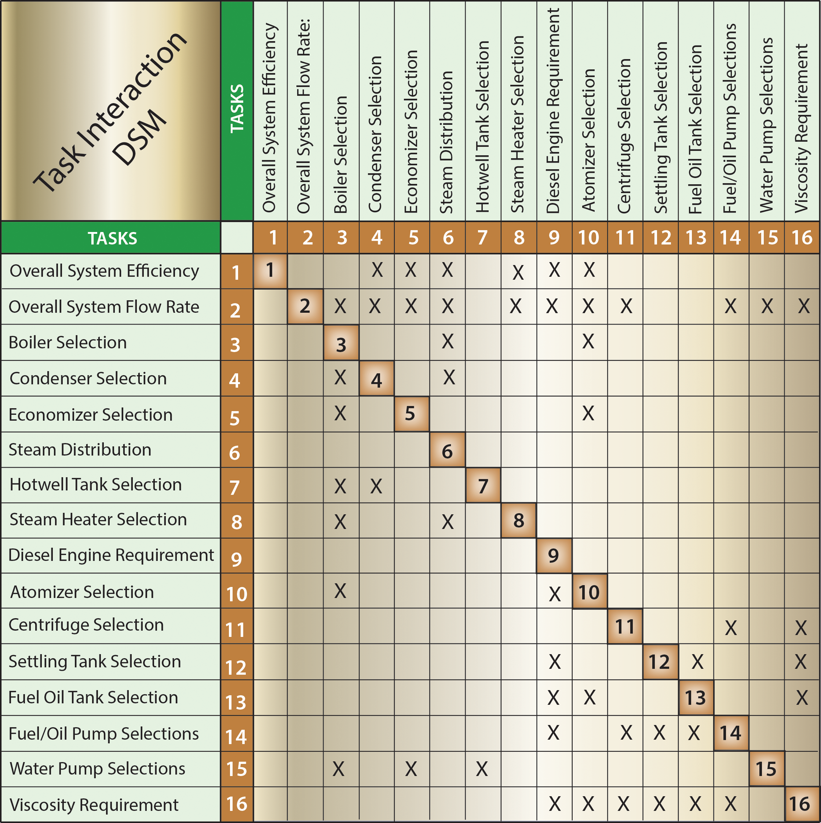
(b) Process Architecture DSM
To develop the interaction matrix shown in Figure 5.23 define tasks descriptions and requirements (see Chapter 5).
Figure 5.23: Process architecture DSM (identifies tasks interactions).

Slide 38
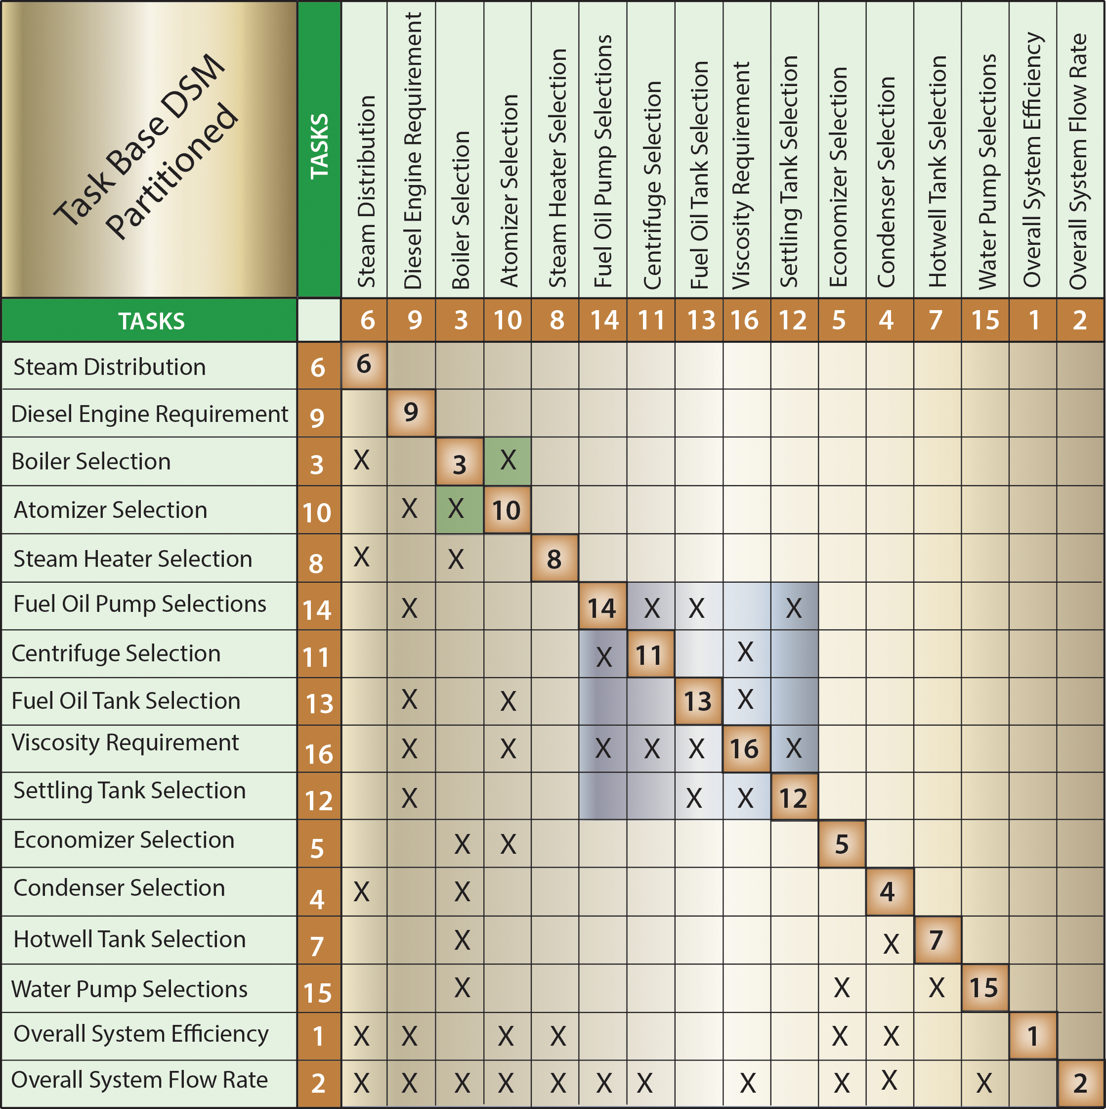
Partitioned form of Figure 5.23 is shown
in Figure 5.24
Tasks 3 and 10 are interdependent or coupled therefore constant communication must occur
between these two tasks. Multiple iterations may be required to complete both tasks after
an initial assumption about one of them is made. The cluster loop of coupled tasks 14, 11,
13, 16, and 12 is the most complex and tedious part of the project. The highest number of
iterations is going to occur with this cluster because of its size.
Figure 5.24: Partitioned tasks interaction matrix with loops clustered

Slide 40
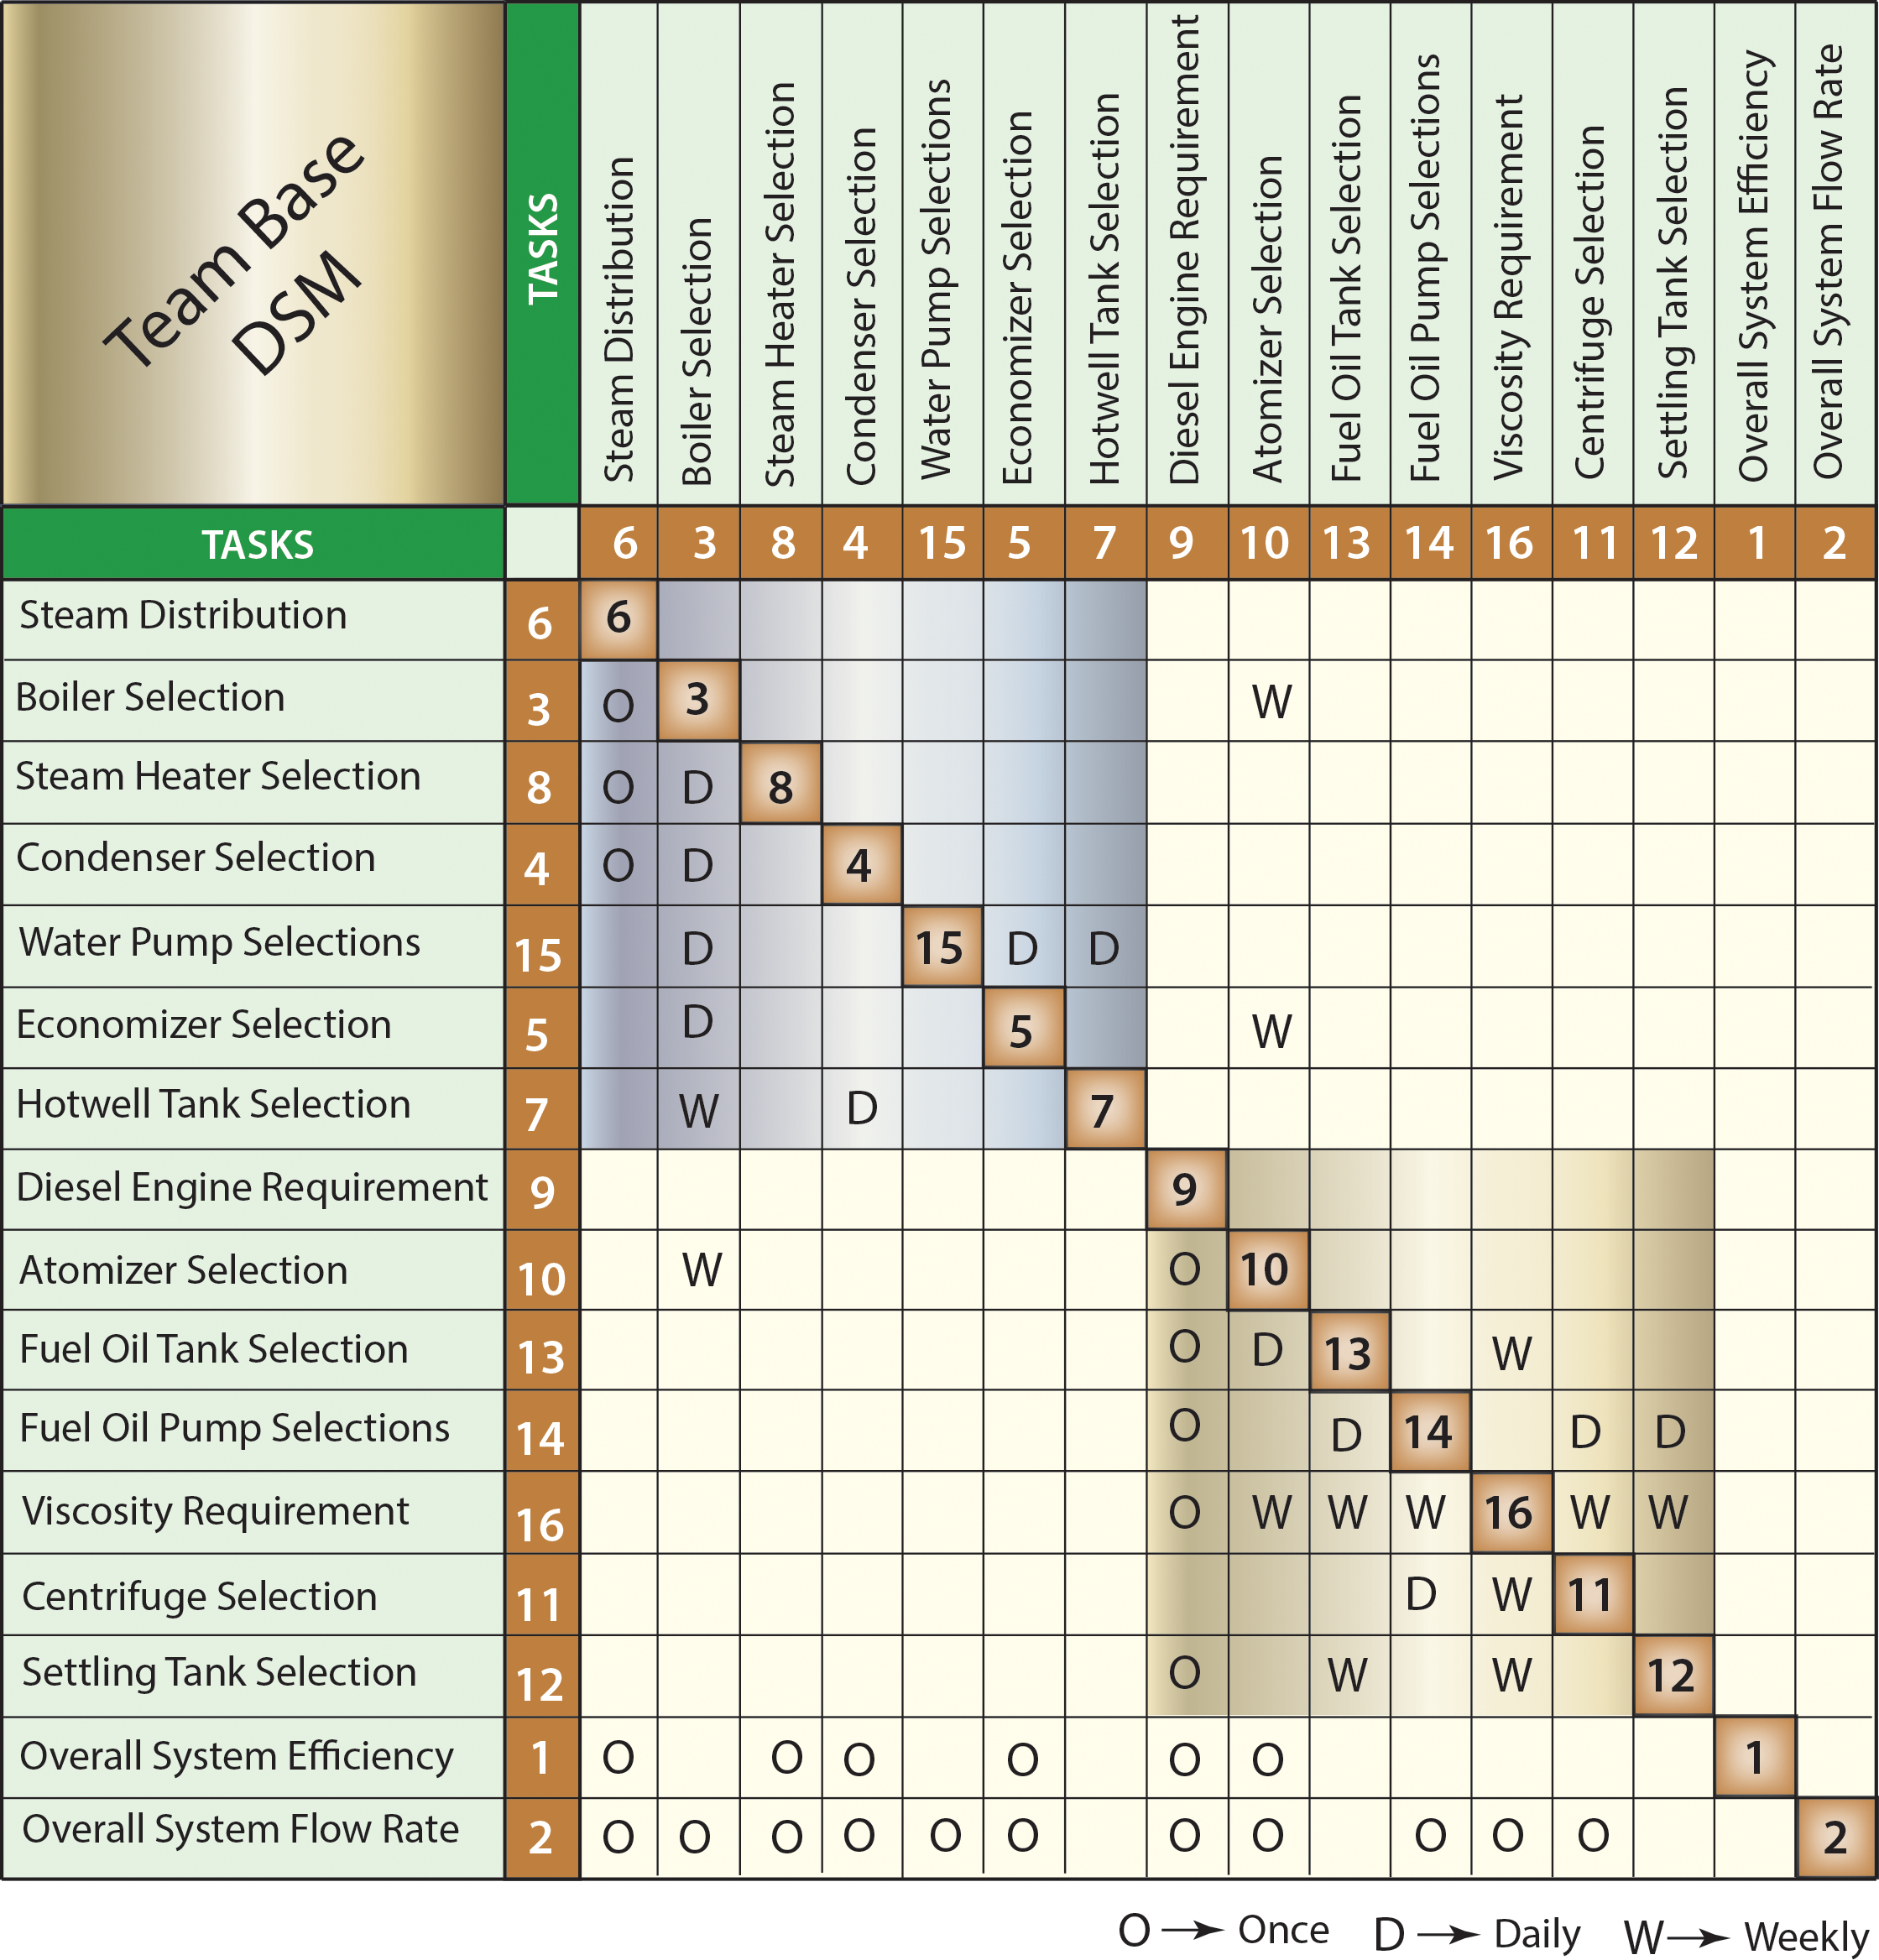
(c) Organization Architecture DSM
Once the task interactions and sequencing has been completed the research team(s) will be created to take responsibility of the tasks to be executed.
The interactions between components and tasks are used to construct the team matrix.
Fuel oil (orange) and water (blue) component interactions can form two meta-teams quite easily.
The nature of the interaction of the teams will be divided into daily, weekly, and once. The interaction between the teams will be information exchange about the project tasks.
Figure 5.25: Organization (team) interactions matrix.

