Slide 1


Instructor’s
Title & Name
Course Title….

Slide 2
Copyright © 2021 by the authors (A. Ertas and U. Gulbulak). This is an open access article distributed under the Creative Commons Attribution License (https://creativecommons.org/licenses/by/4.0/), which permits unrestricted use, distribution, and reproduction in any medium, provided the original work is properly cited.

Slide 3
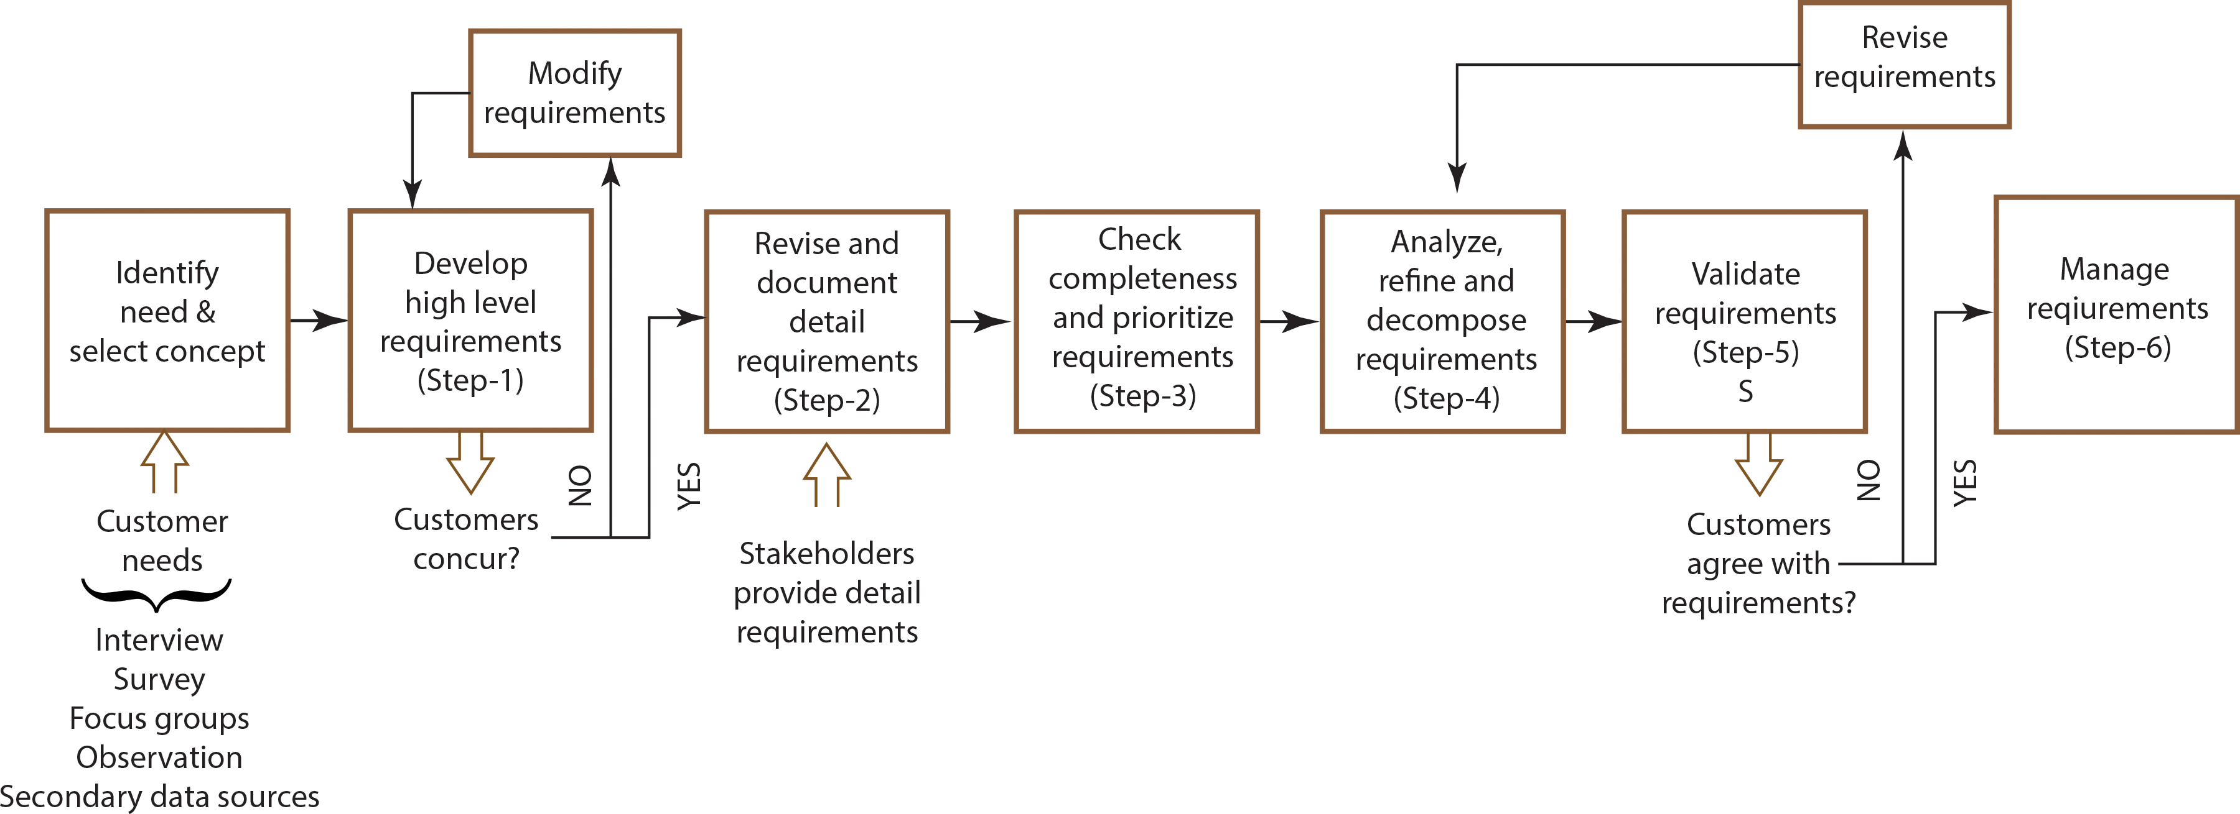
Requirements Development Process
The requirement is specific documented physical and functional capabilities and attributes that a particular design, product, or process must be able to perform.
Figure 2.1: Requirements development process.

Slide 4
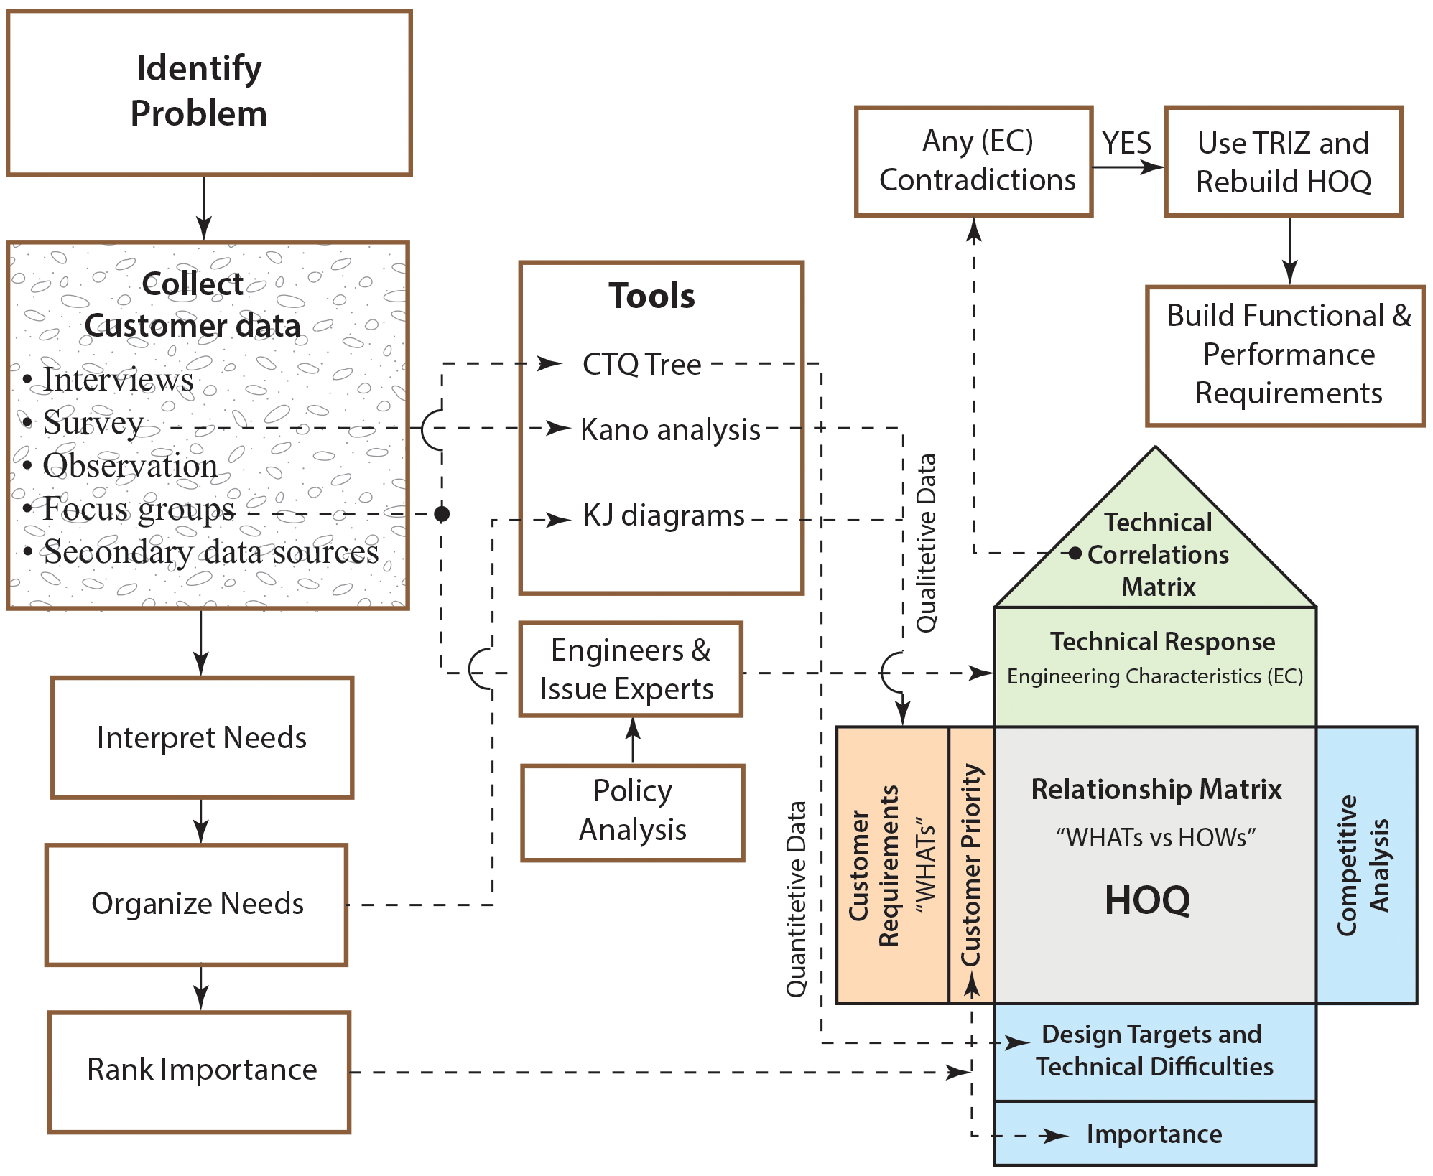
Process of Defining
Requirements and
Customer Needs
Figure 2.2: Process of defining requirements and customer needs

Slide 5
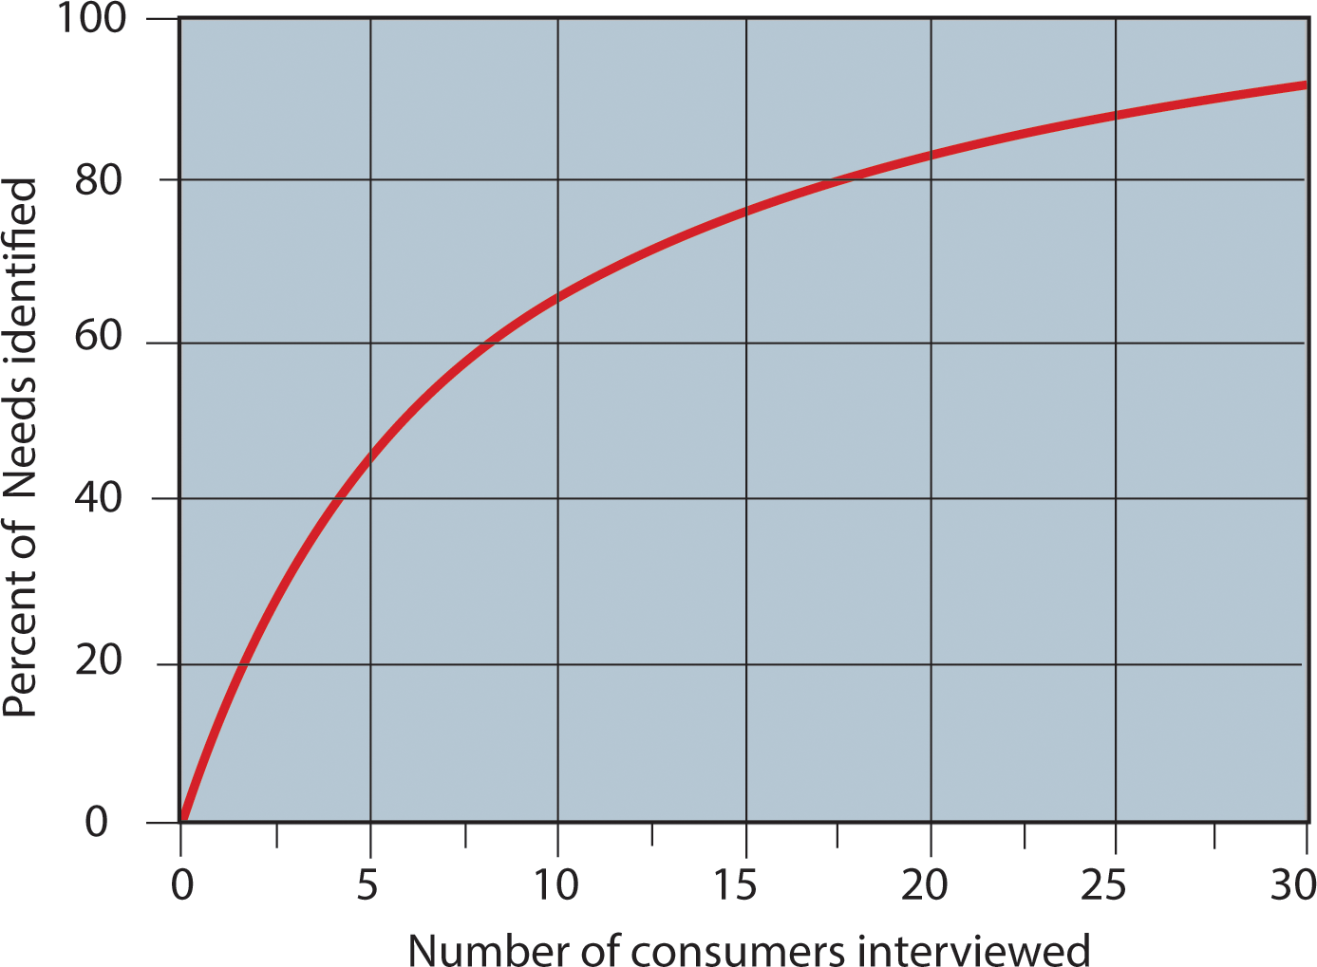
Survey Development
Figure 2.3: Survey result for customer need (Griffin, Abbie and John R. Hauser, 1993).

Slide 6
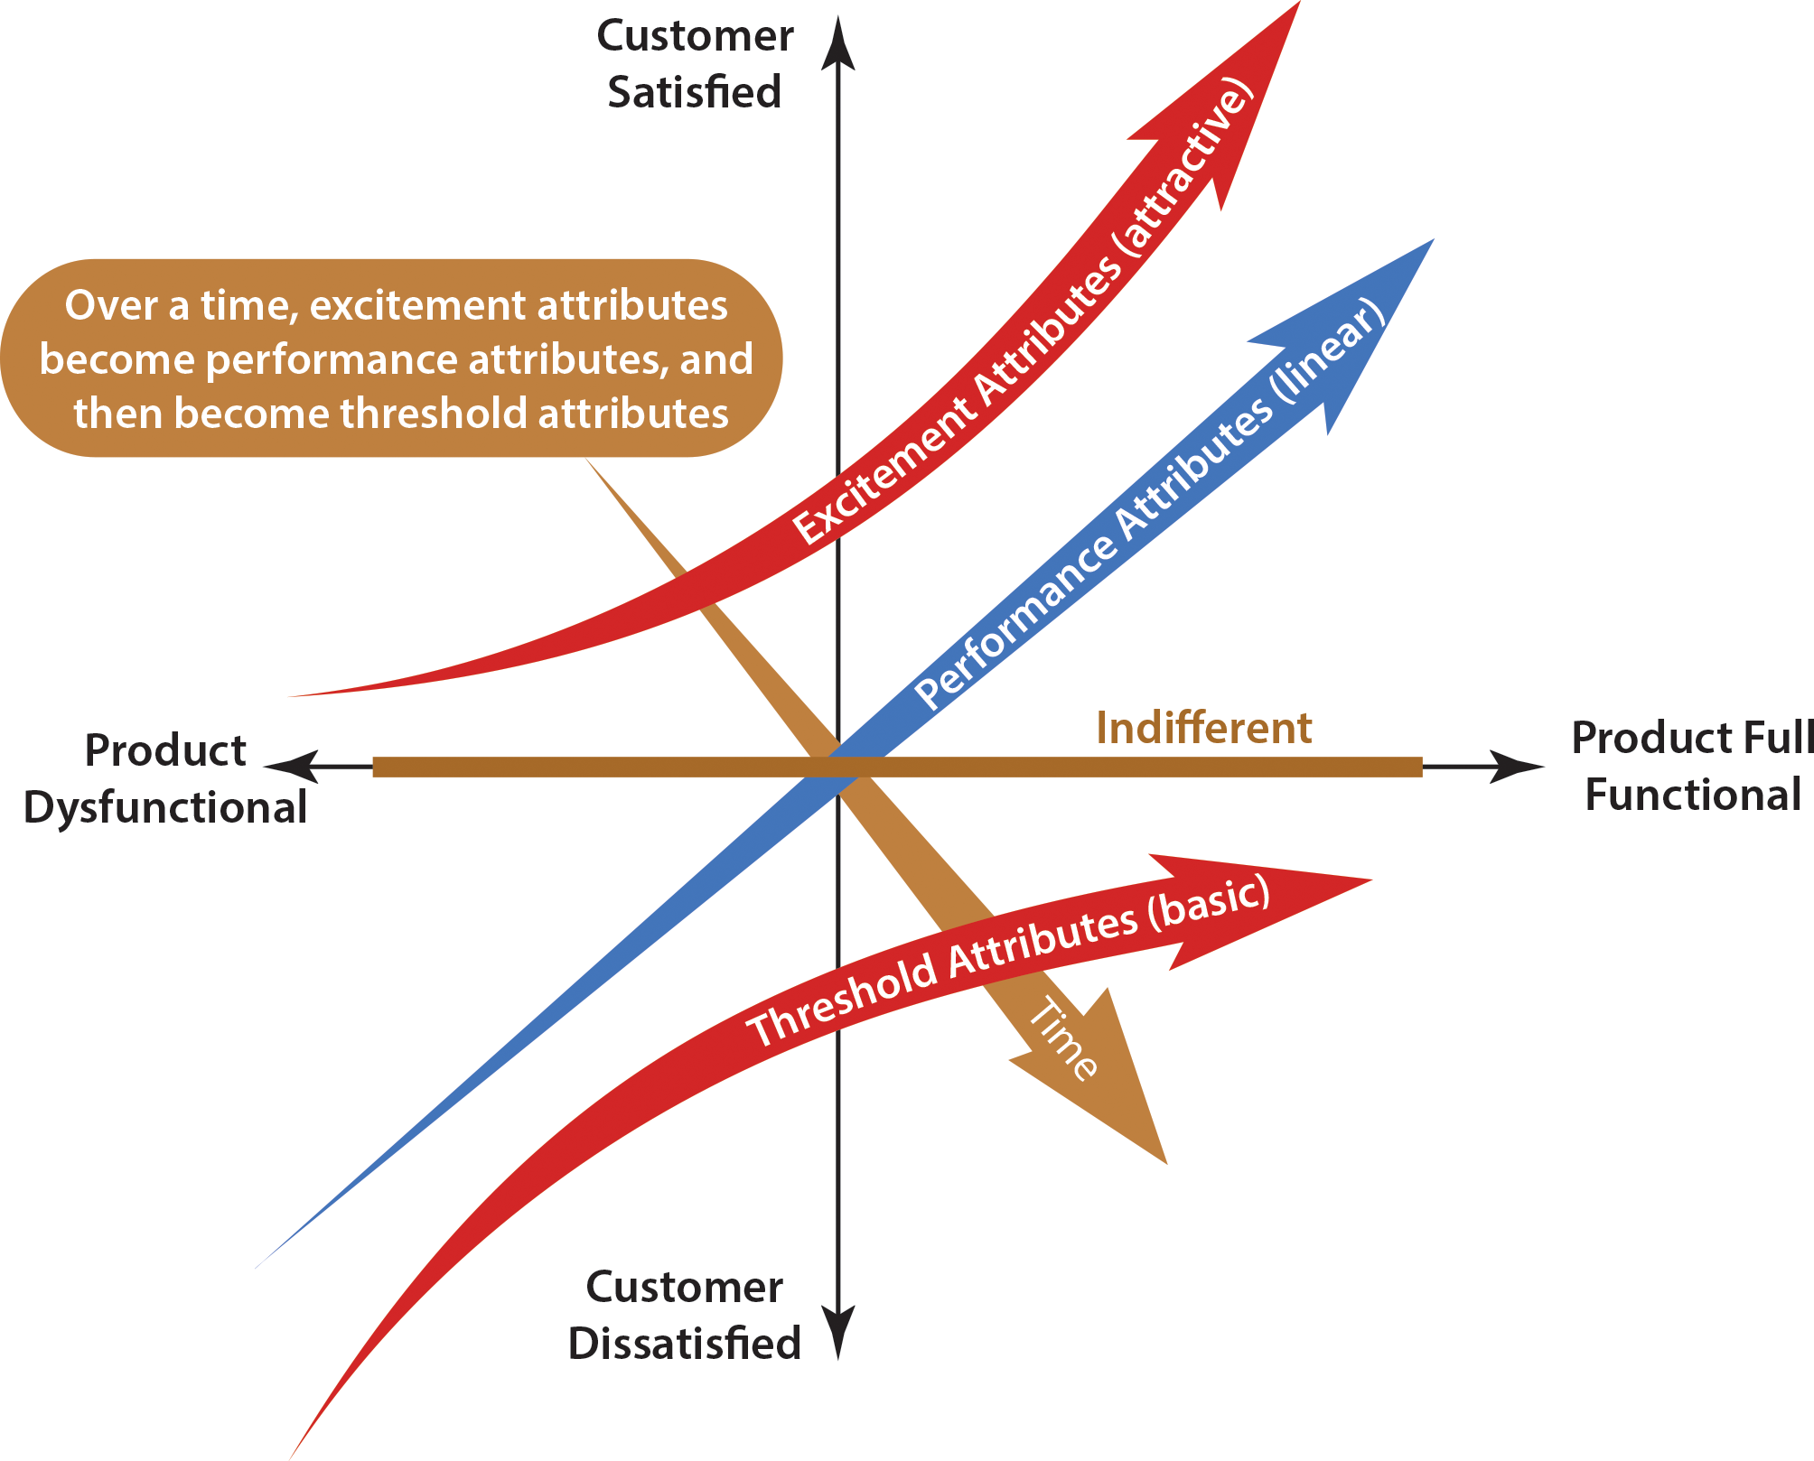
Kano Model: Understanding Customer Needs
The main objective of the Kano method is to help research teams uncover and classify customer needs and attributes into five categories.
Threshold Attributes (Must be Requirements)
Performance Attributes (Linear Requirements)
Excitement Attributes (Attractive Requirements)
Figure 2.4: Kano model.

Slide 7
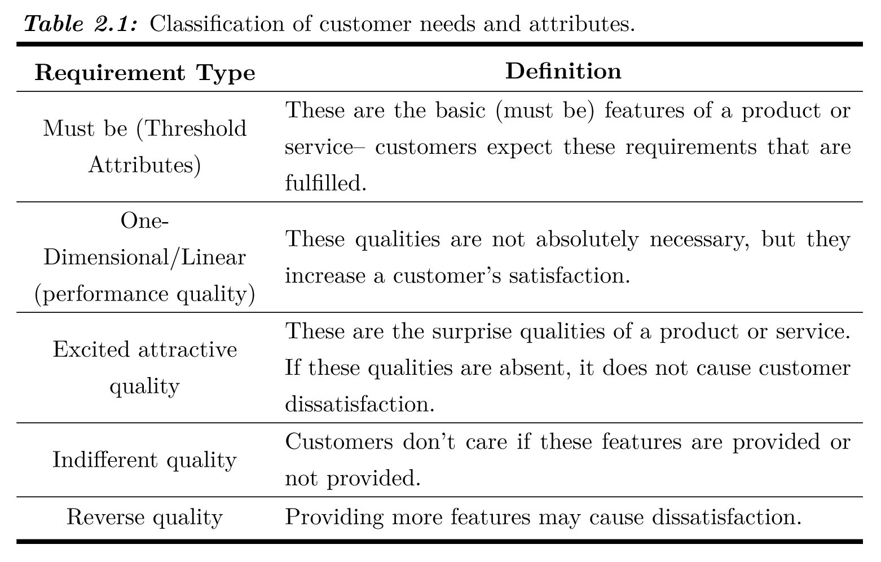

Slide 8
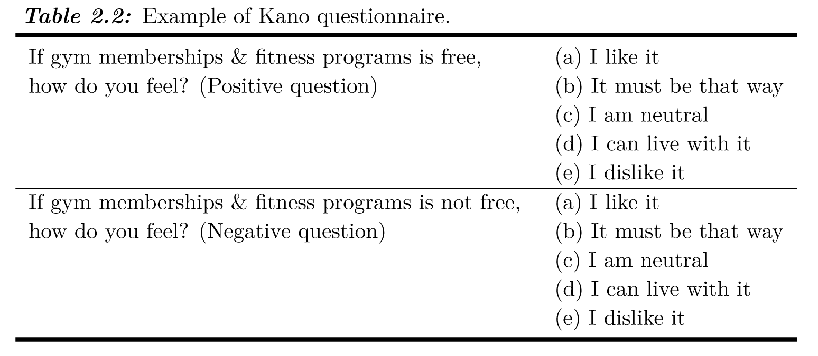
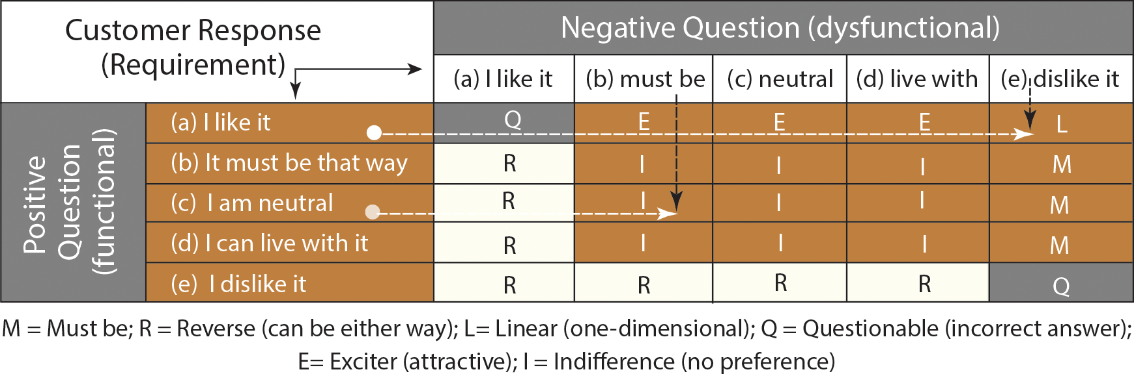
Figure 2.5: Kano model questionnaire evaluation.

Slide 9
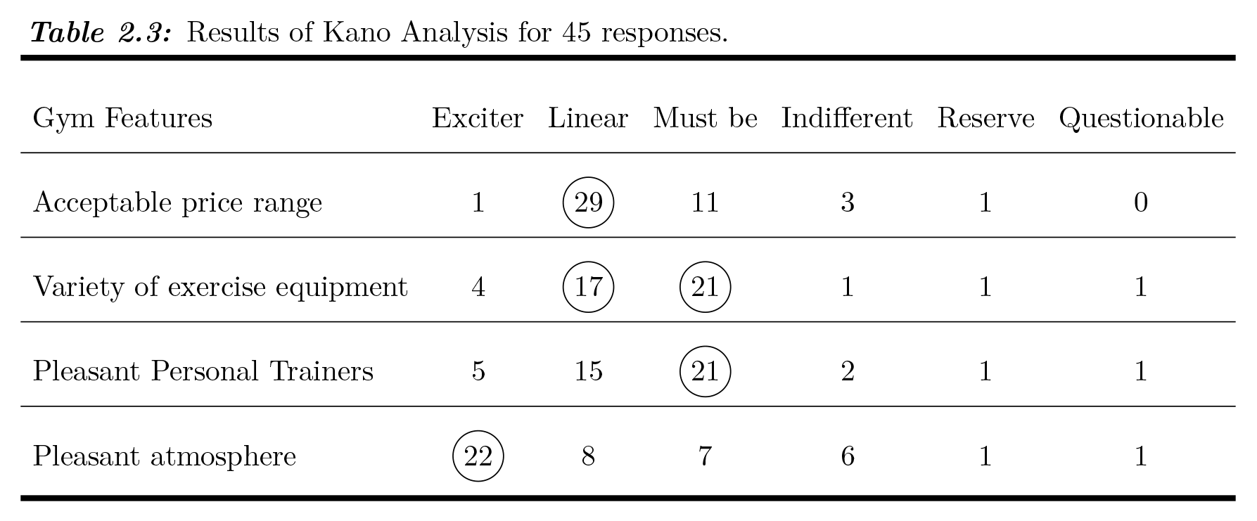

Slide 10
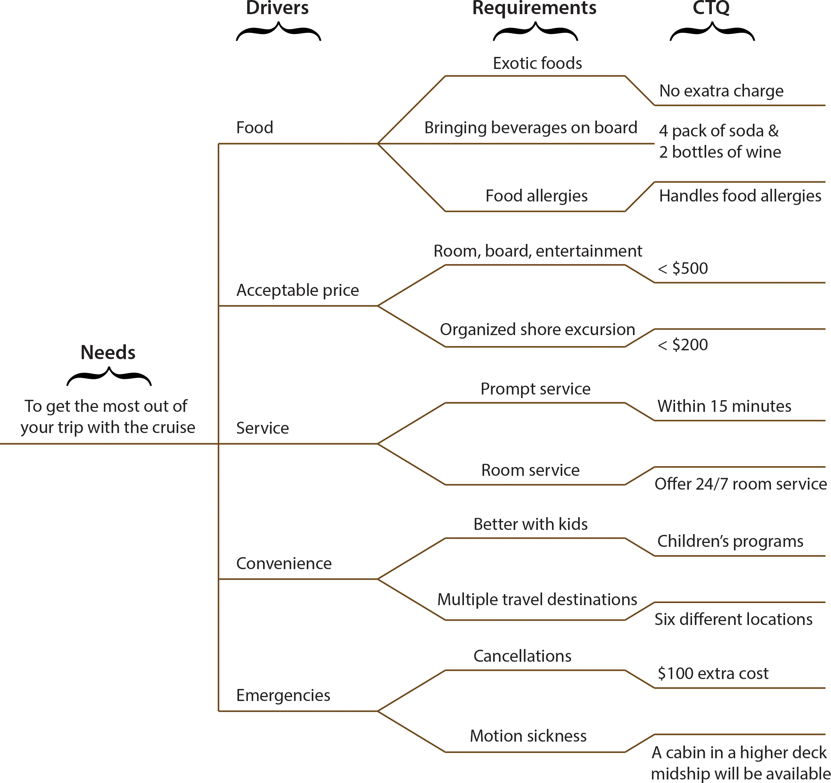
Critical to Quality (CTQ) Trees
When developing new products, quality is important.
CTQ is a measurable characteristic of a product or service that is provided to customers.
Critical to Quality (CTQ) trees help the customer of any company or business to translate the most important needs on products or processes into requirements to ensure their quality.
Figure 2.6: CTQ tree.

Slide 11
KJ Diagram: Organize Needs
The KJ concept is a simple but effective method for gathering and organizing ideas, opinions, and issues regarding a given specific problem. The tool is especially helpful when working in a team. The goal of the KJ method in concept engineering is to group the qualitative data (in the form of hundreds of voices and images) and extract a useful set of customer requirements. The following simple steps can be used for the KJ analysis:
Collect all ideas without considering their rationality
Group the ideas in a manner appropriate to the topic
Form hierarchies of groups and subgroups
Evaluate the ideas by ranking, sequencing -- find the best solutions chosen from the groups

Slide 12
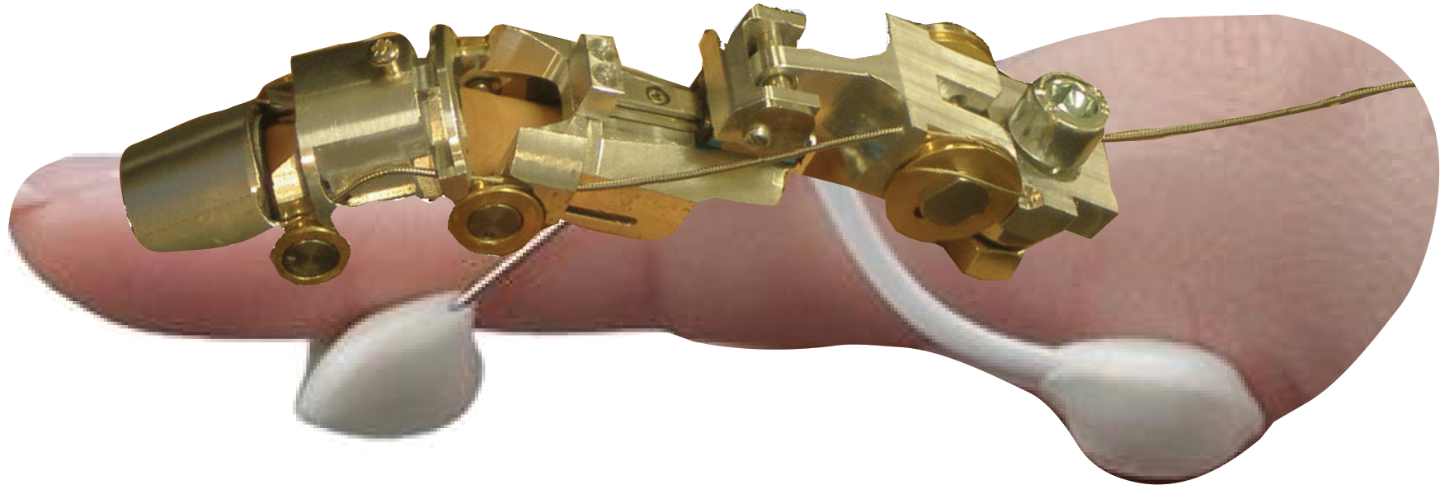
Example
To design a new finger rehab device as shown in the figure, following positive and negative survey questions were sent to a group of customers to define their needs. The survey questions were as follows:
Figure 2.7: Finger rehab device.

Slide 13
Example (continued)
Positive Questions (functional):
1. How would you feel if the rehabilitation device function (flexion & extension) is automated?
2. How would you feel if the rehabilitation device is designed for patient comfort?
3. How would you feel if the rehabilitation device is lightweight?
4. How would you feel about the rehabilitation device low cost?
5. How do you feel about the rehabilitation device being controlled by an app?
6. How do you feel about the battery being rechargeable?
7. How do you feel about the rehabilitation device with concealed wires?
8. How do you feel about the rehabilitation device is portable?
9 How do you feel about if the product prevents swelling?
10. How do you feel about if the device has continuous passive motion.
11. How do you feel about if the device meets the medical device regulations.
12. How do you feel about if the device supports user activity.

Slide 14
Example (continued)
Negative Questions (dysfunctional):
1. How would you feel if the rehabilitation device function (flexion & extension) is not automated?
2. How would you feel if the rehabilitation device is not designed for patient comfort?
3. How would you feel if the rehabilitation device is not light weight?
4. How would you feel about the rehabilitation device is not low cost?
5. How do you feel about the rehabilitation device is not controlled by an app?
6. How do you feel about the battery not being rechargeable?
7. How do you feel if the rehabilitation device has exposed wires?
8. How do you feel about the rehabilitation device is not portable?
9. How do you feel about if the rehabilitation device doesn’t prevent swelling?
10. How do you feel about if the device doesn’t have continuous passive motion. 11. 11. How do you feel 11. How about if the device doesn’t meet the medical device regulations.
12. How do you feel about if the device doesn’t support user activity.

Slide 15
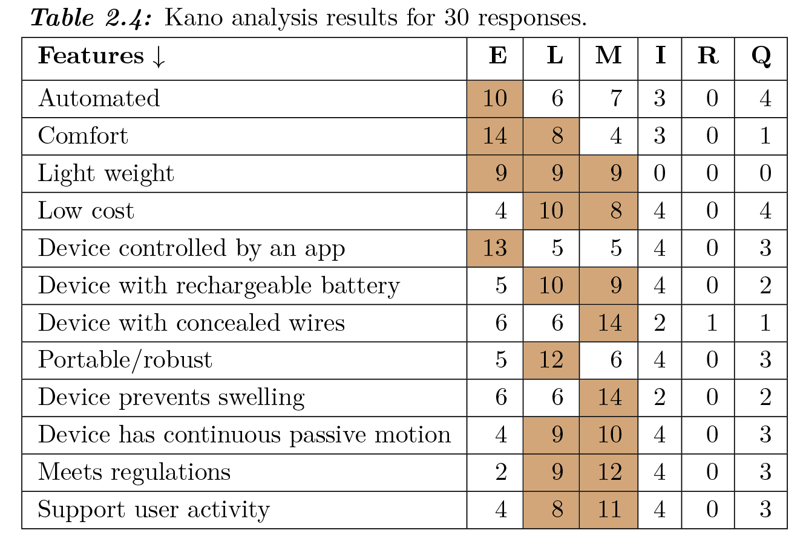
Example (continued)
KANO ANALYSIS
The survey was sent to approximately 40 people and 30 responses were received. Raw data from customer responses were analyzed and customers’ need statements were extracted from each response. Using survey results and Figure 2.5, each positive question was compared against each negative question for every respondent to determine appropriate letters shown in Table 2.4.
Figure 2.5: Kano model questionnaire evaluation.

Slide 16
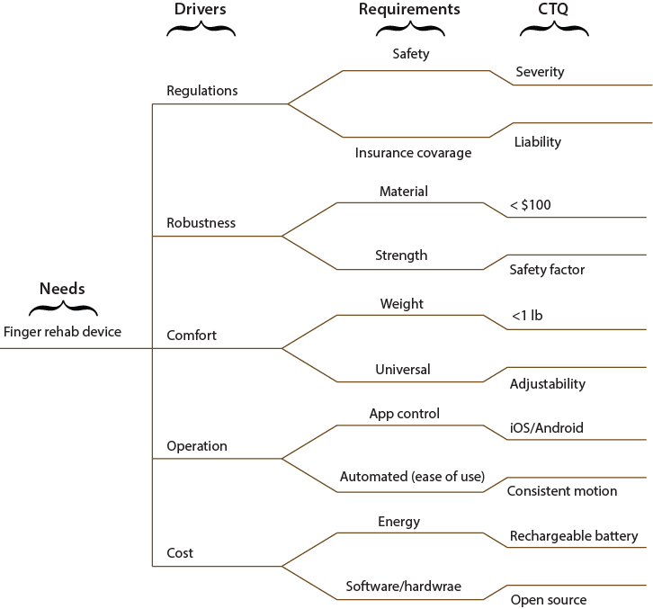
Example (continued)
Critical to Quality (CTQ) Tree
From the Kano analysis results, we can define the most important design categories to include in the final customer needs and engineering requirements. In Figure 2.8, the driving design categories are expanded more in a rehab device CTQ tree to allow a more specific idea of what is needed for the design requirements to be developed.
Figure 2.8: CTQ of finger rehabilitation device.

Slide 17
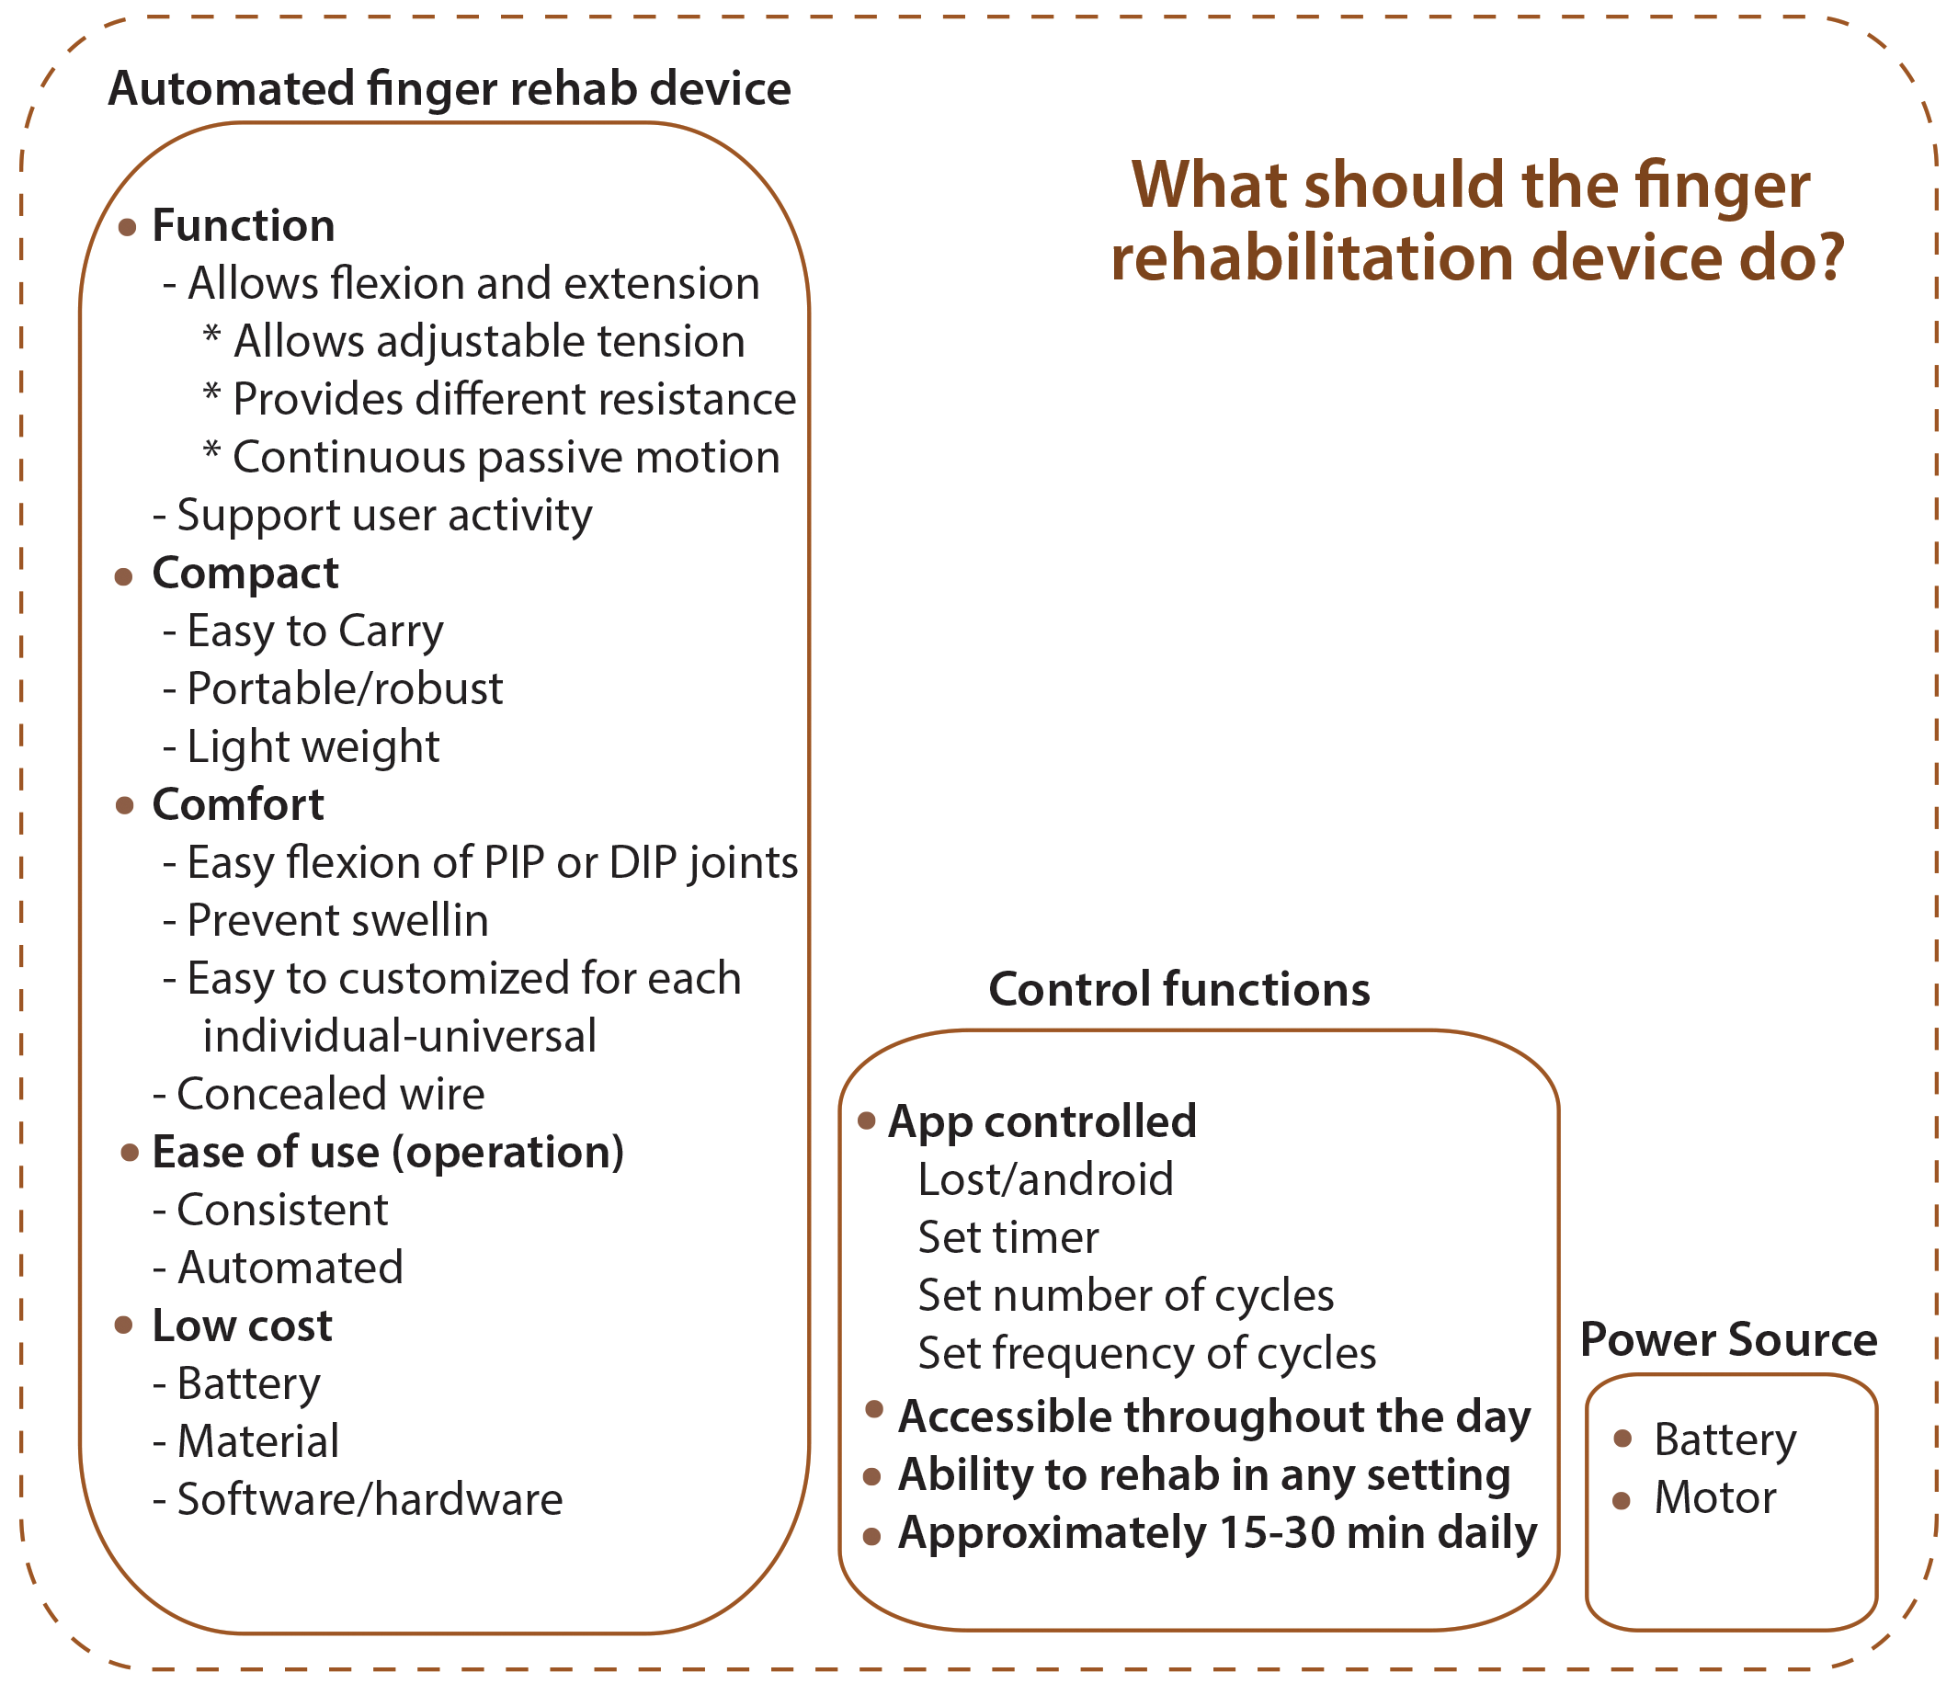
Example (continued)
KJ Diagram
This process allows us to easily
transition into forming a KJ diagram shown in Figure 2.9.
Figure 2.9: KJ diagram of finger rehabilitation device.

Slide 18
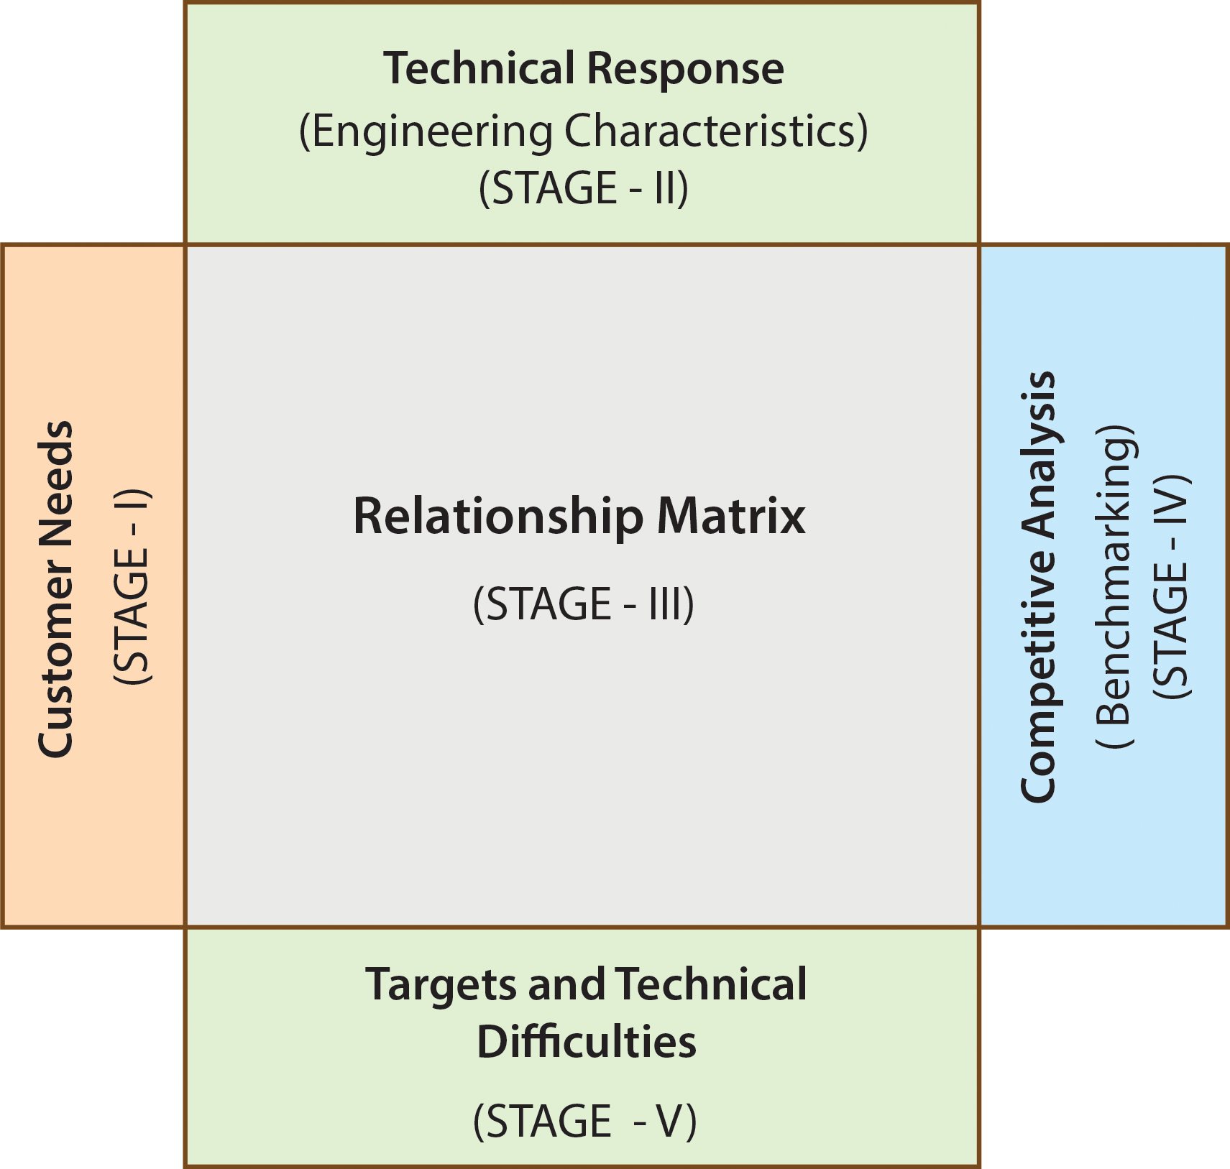
Quality Function Deployment (QFD)
Quality Function Deployment (QFD) was developed in Japan in the early 1970s and has been effectively used in the United States since the 1980s.
QFD is a method for identifying customer needs and making sure that the voice of the customer is included in the design process for product development.
Figure 2.10: QFD matrix.

Slide 19
Example
Using Kano analysis results, CTQ (given in Figure 2.8), and KJ diagram (given in Figure 2.9)
develop Quality Function Deployment for the finger rehab device.
SOLUTION
Using the results of Kano, KJ, and QTC, the student research team developed the following customer needs.
Universal: The design of the finger rehab device will be usable by all people, to the greatest extent possible.
Portable: The next customer need is “ the device must be portable” - lightweight, compact, and small enough
to fit on a finger.
Automated: Automation is an important aspect of this design. The purpose of designing an automated device
is to mobilize the finger in a safe and repetitive way, so that users achieve their highest level of recovery.
Controlled by app…
Concealed Wires…
Rechargeable Battery…
Cost…
Light Weight…

Slide 20
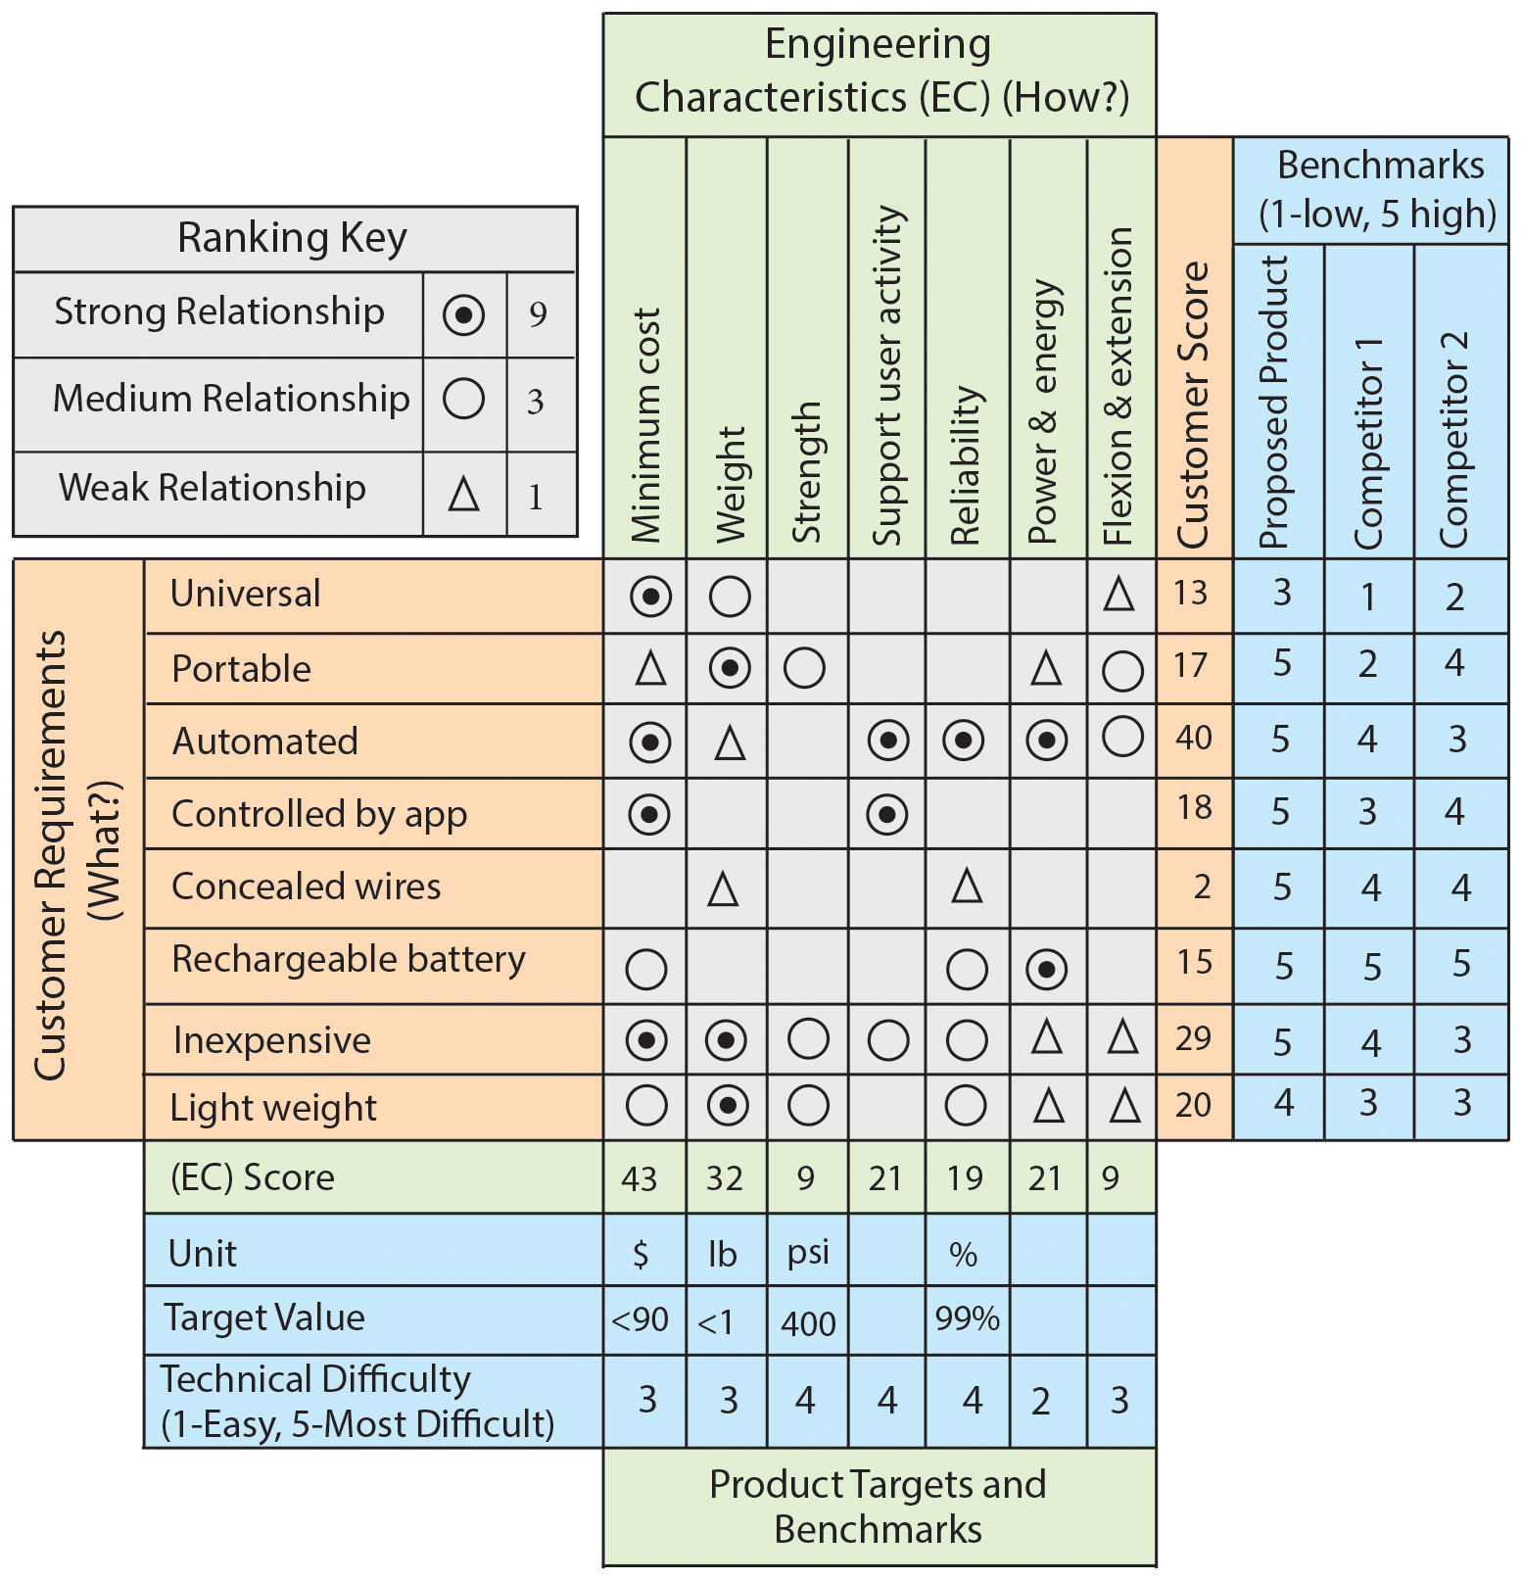
Example (continued)
Engineering characteristics are what you control, performance criteria are what your customer cares
about. A `target value'' refers to the planned value
for an ``engineering characteristic'' in the final design that you have certain control over. For example, weight, size, shape, speed, cost, etc.
Figure 2.11: Quality Function Deployment (QFD).

Slide 21
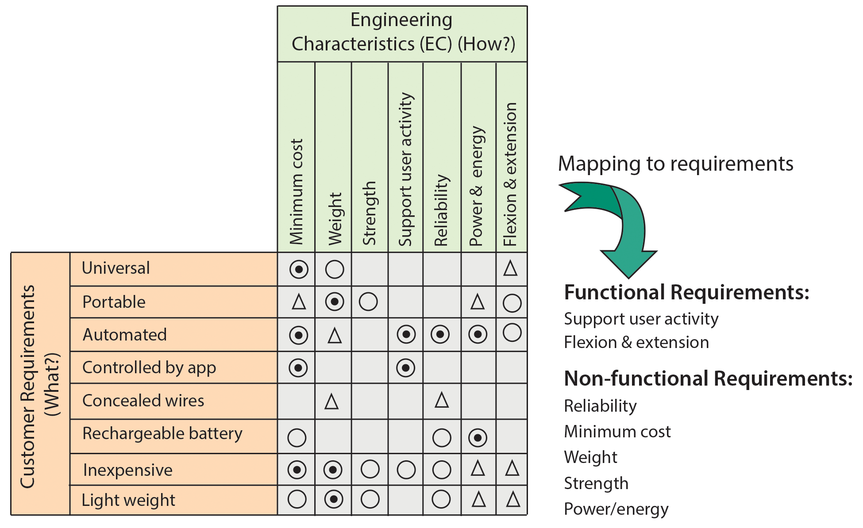
Example (continued)
Figure 2.12: Mapping to requirements.

Slide 22
Requirement Categories
There are three main requirement categories.
Functional/Non-functional Requirements
A functional requirement (FR) describes “what” the system/product must do without describing them in quantitative terms. For example, “the finger rehab device shall be capable of flexing and extending the hand fingers, repetitively.”
Non-functional requirements (NFR) serve as constraints or restrictions on the design of a system. For example, security, reliability, maintainability,
lightweight, strength, etc.

Slide 23
Requirement Categories
b) Performance Requirements
Performance requirements describe “how well” the system/product must perform certain functions under specific conditions. They are quantitative requirements and are verifiable. For example, “the finger rehab device shall be capable of exerting 3-axis forces at each fingertip with output force ranges up to 3.5 N, having 0.5 second response time during each cycle, in order to open the fingers.” As seen from this example, there is more than one performance requirement associated with a single functional requirement.

Slide 24
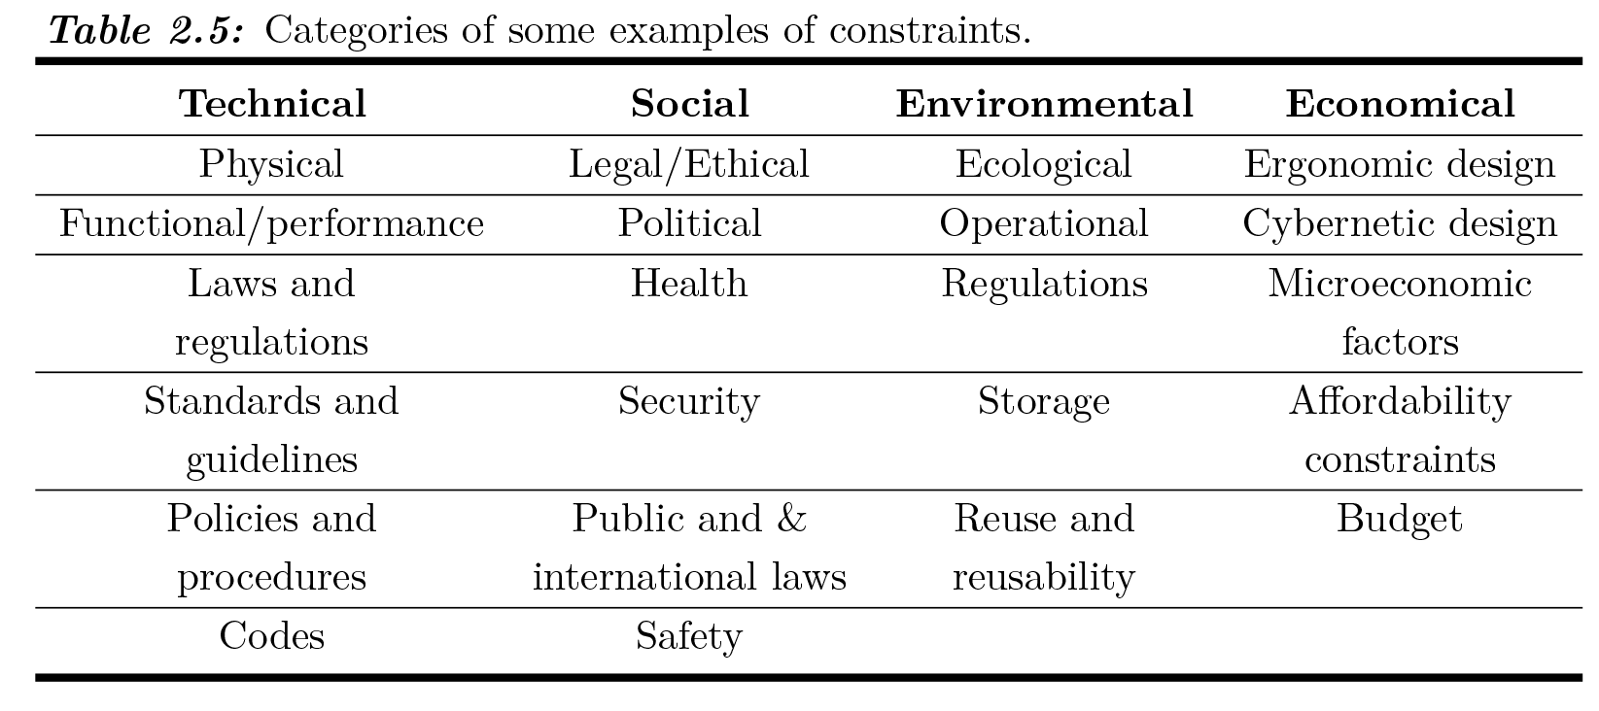
Requirement Categories
c) Design Constraints
Constraints determine the performance limits of the system/product such as acceptable range of frequency, temperature range, operation range, weight, size, etc. – what is expected of the product. For example, “The finger rehab device weight shall not exceed 0.5 lb”. Categories of some examples of constraints are shown in Table 2.5.

Slide 25
How to Write Good Requirement
Writing good requirements is not an easy task.
As mentioned by Albert Einstein, “When you are out to describe the truth, leave elegance to the tailor.”
This quote tells us that elegant and entertaining requirement writing style is not necessary – don’t use buzzwords.

Slide 26
How to Write Good Requirement
Followings are the summary of essential points to write a good requirements:
Define requirements as clear as possible – uncertainty leads to confusion and unhappiness.
Define one requirement one at a time - each requirement should be short. To avoid confusion try not to use conjunctions like and, or, also, with and the like.
If extensive conjunctions are necessary for clarity, the sentence should be decomposed into shorter sentences.

Slide 27
How to Write Good Requirement
Each requirement should have a complete sentence with no buzzwords or acronyms.
Don’t use vague and unverifiable terms. For example: user-friendly, versatile, robust, approximately, minimal impact, easy, sufficient, flexible, adequate, fast, large, small, etc. This will cause difficulties to define their test cases.
Each statement that defines a requirement must contain the word “SHALL”. Use positive statements such as “the system shall…”, instead of “the system shall not…”

Slide 28
How to Write Good Requirement
Examples Using Correct Terms
The finger rehab device shall be capable of exerting 3-axis forces at each fingertip with output
force ranges up to 3.5 N.
The buildings shall withstand wind loads of 150 mph.
The scooter shall have a maximum speed of 10 mph.
Examples Using Incorrect Terms
The finger rehab device shall not be capable of exerting 3-axis forces at each fingertip with output force ranges up to 3.5 N.
The buildings will withstand wind loads of 150 mph.
The scooter should have a maximum speed of 10 mph.

Slide 29
How to Write Good Requirement
“Will” should be used only for statements that provide information; and “Should” be used to represent a goal to be achieved.
Requirements must be realistic and allow acceptable solutions (what not how). Requirements should state WHAT is needed, not HOW to provide it.
Requirements must be quantifiable, testable, and verifiable.
Do not use “To Be Determined” (TBD) and “To Be Resolved” (TBR). Use the current best estimate within brackets [value] in the requirement and state your basis for why the value is still an estimate.
State tolerances for qualitative values. For example, less than; greater than or equal to; plus or minus; root mean squares.

Slide 30
How to Write Good Requirement
Check Requirements Reliability & Correctness
Is each requirement correct and as clear as possible?
Are the requirements technically feasible and realistic?
Are the requirements measurable, testable, and verifiable?
Are the reliability requirements specified?

Slide 31
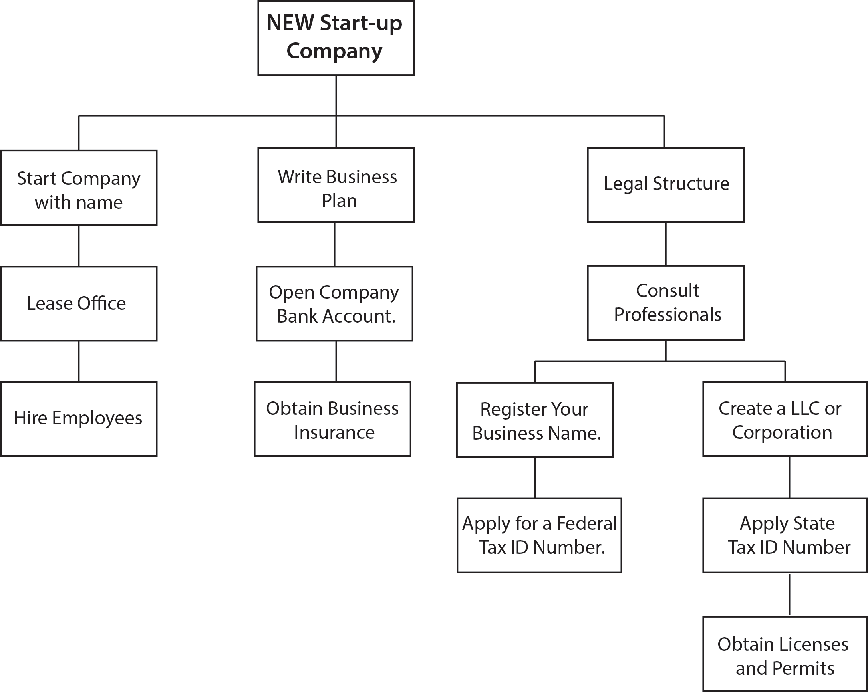
Requirement Decomposition
Requirement decomposition is a complex system engineering task. When developing large systems
it is important that the requirement decomposition process is performed.
Figure 2.13: Requirement decomposition of a new start-up company.

Slide 32
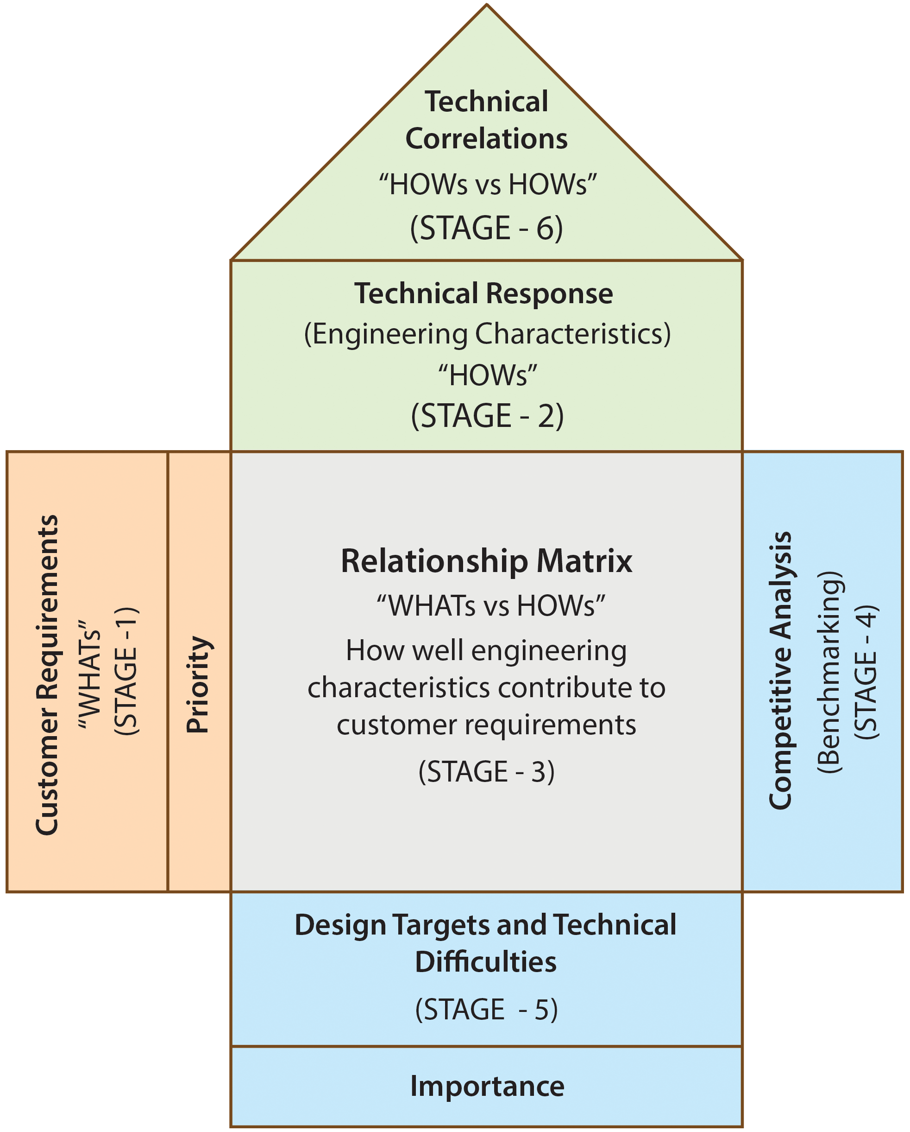
House of Quality (HOQ)
Afterward, Toyota improved the QFD and
introduced the House of Quality (HOQ).
Figure 2.14: House of Quality (HOQ).

Slide 33
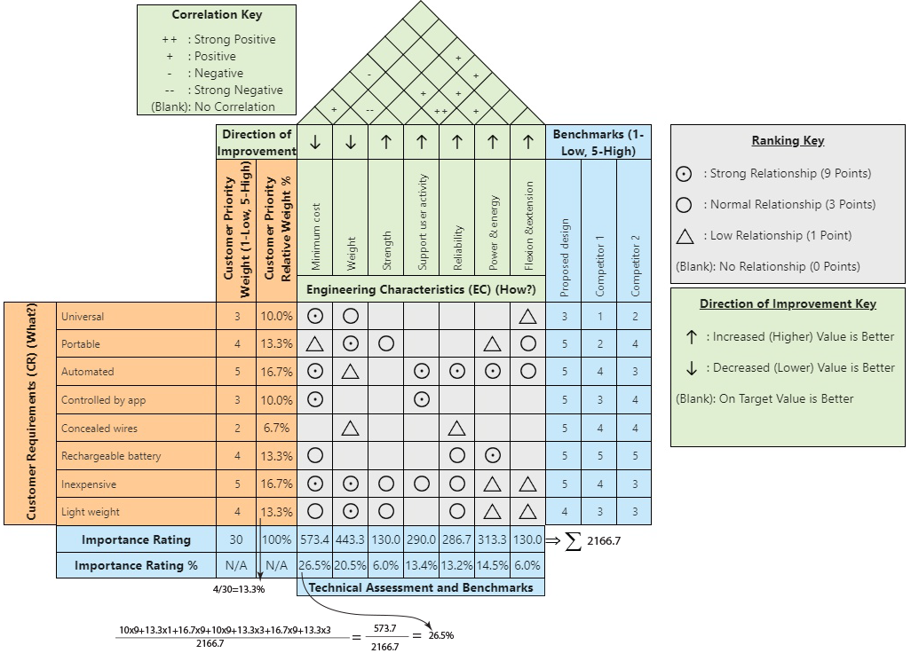
Figure 2.15: HOQ for the finger rehab device.

Slide 34
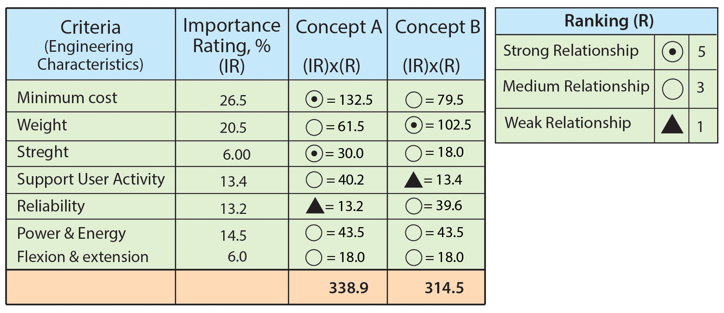
Concept Development
The importance rating of engineering characteristics from HOQ analysis can be used for concept development.
Figure 2.16: Concept selection matrix.

Slide 35
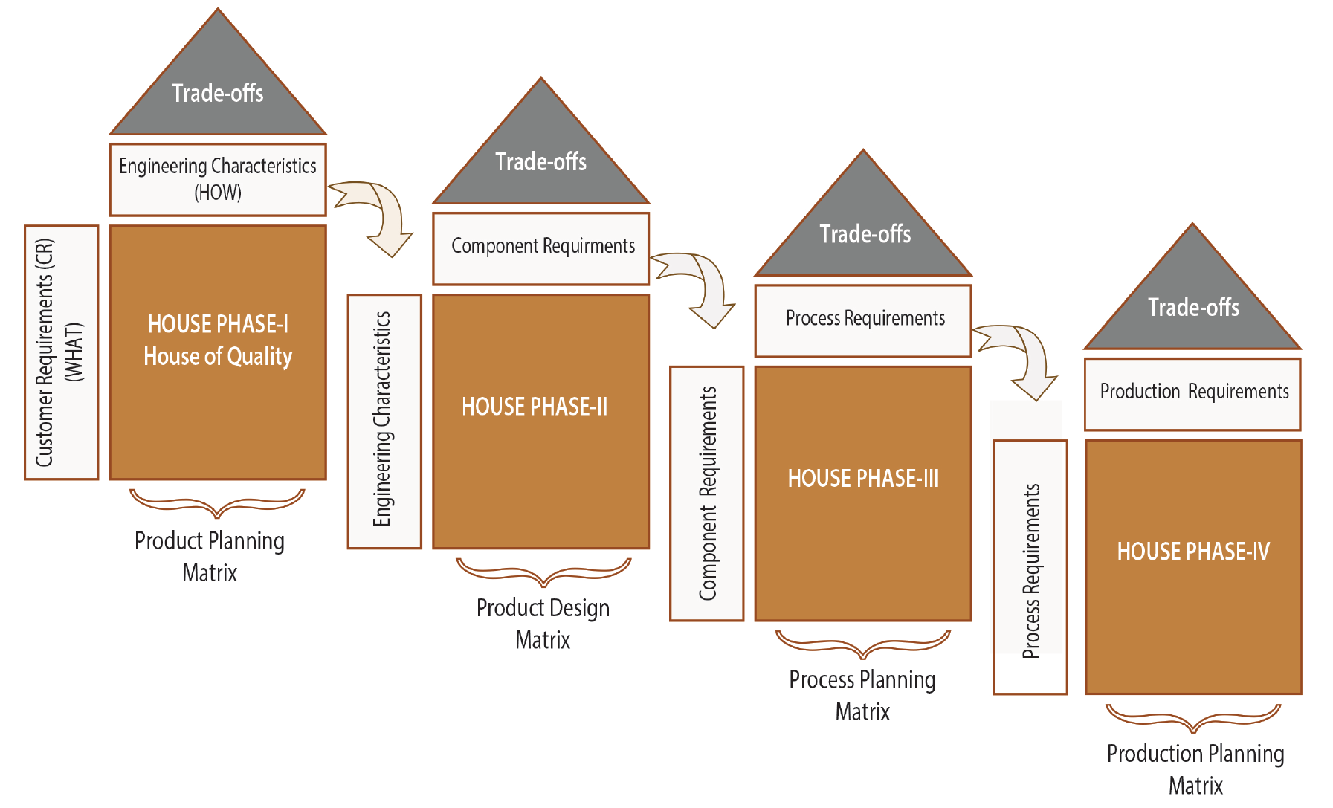
Cascading QFD Analysis
Usually, one QFD may not be sufficient to explain the customer requirements down to actual production. As shown in Figure 2.17, there are four phase processes to develop a product which includes four cascaded House of Qualities (HOQ). This figure shows that QFD is an integrative process for connecting customer requirements to production -- HOWs are refined until the detailed level of production requirements is reached. As seen from this figure, HOWs of phase-I become the WHATs of phase-II.
Figure 2.17: Connecting customer requirements to production

