Slide 1

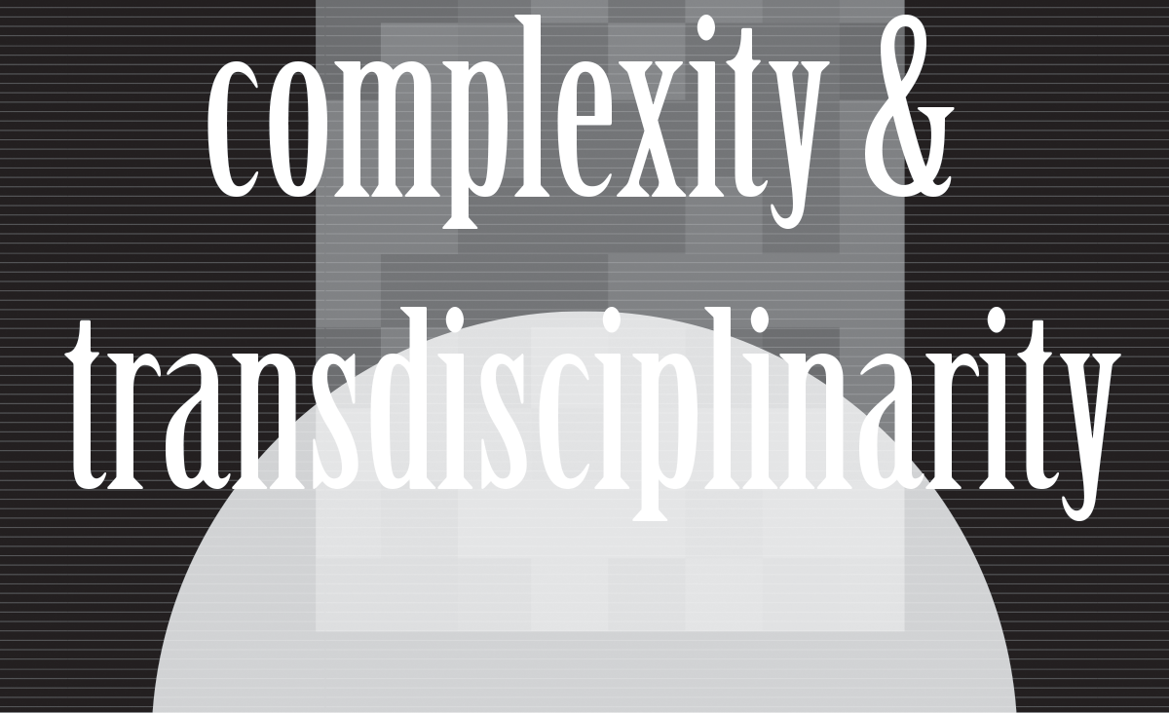
Instructor’s
Title & Name
Course Title….

Slide 2
Copyright © 2021 by the authors (A. Ertas and U. Gulbulak). This is an open access article distributed under the Creative Commons Attribution License (https://creativecommons.org/licenses/by/4.0/), which permits unrestricted use, distribution, and reproduction in any medium, provided the original work is properly cited.

Slide 3
When you first start off trying to solve a problem, the first solutions you come up with are very complex, and most people stop there. But if you keep going, and live with the problem and peel more layers of the onion off, you can often times arrive at some very elegant and simple solutions. (Steve Jobs)

Slide 4
Complex Problems & Transdisciplinarity
A number of complex problems have begun to stand out as major concerns in the 21st century.
As: environment, climate change, immigration, hunger, water crises, the world’s population, disease, and energy are some of the most serious issues affecting the world today.
These issues that transcend disciplinary boundaries cannot be addressed by anyone discipline alone: Transdisciplinary approaches can offer solutions to these challenges by providing new skills and tools aimed at creativity, innovation, and collaboration across knowledge fields.

Slide 5
What is Complexity
Complexity is difficult to understand due to the range of opposing proposed solutions and explanations for what creates complexity.
“Complexity is that sensation experienced in the human mind when, in observing or considering a system, frustration arises from lack of comprehension of what is being explored.” With this theory, complexity is dependent on the individual judge of a system, not the system itself. (Pierce)

Slide 6
Characteristics of Complex Systems
Complex systems are frequently hierarchical.
The structure of complex systems emerges through evolutionary processes and that hieratic system will evolve much more rapidly than non–hierarchic systems.
Hierarchically organized complex systems may be decomposed into sub-systems for analysis of their behavior.
Because of their hierarchical nature, complex systems can frequently be described, or represented, in terms of a relatively simple set of symbols.
(Simon)

Slide 7
Characteristics of Complexity
Cognitive complexity describes the complexity associated with analysis by the observer. When the mind becomes oriented towards a complex situation, there is a possibility that cognitive complexity will start and then may escalate.
Situational complexity is complexity inherent to the system under question.
Both situational and cognitive complexity must be considered for when describing complexity.
(Warfield)

Slide 8
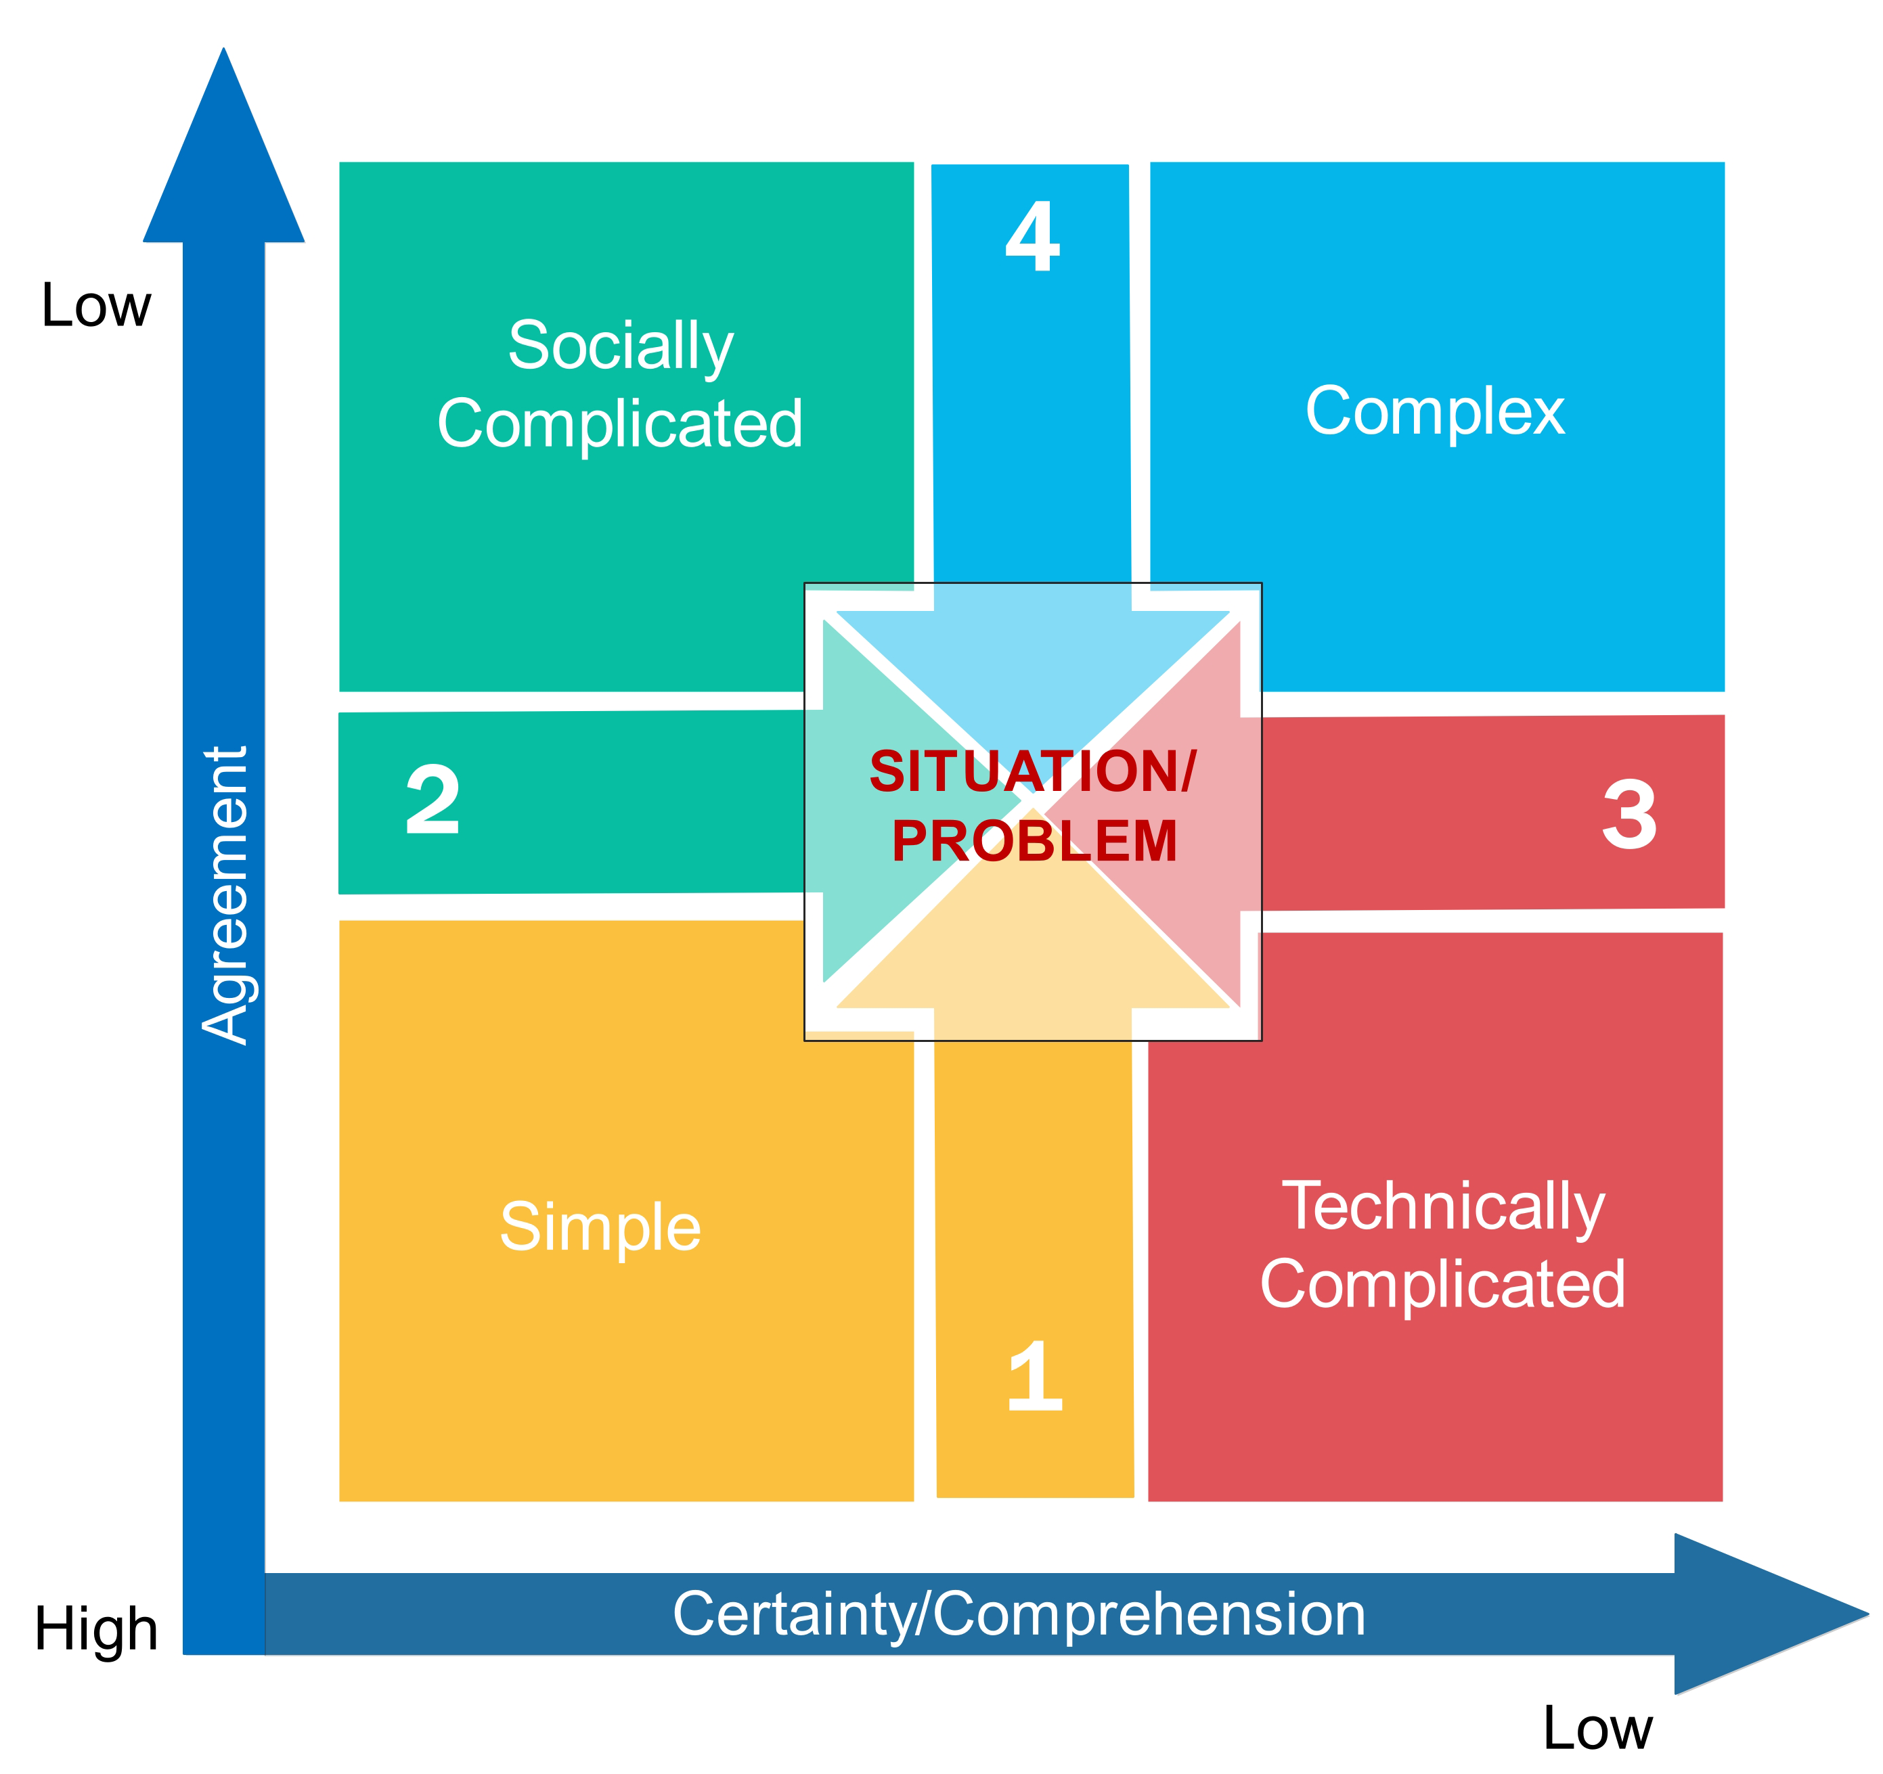
Situation Complexity Framework
Certainty describes the predictability of how to solve the problem.
The agreement describes the level of conflict about how to solve the problem.
A situation is simple, comprehendible and it can be solved with confidence.
It is complicated when experts are required to formulate a complicated solution that will yield the anticipated results with certainty.
An issue is complex when frustration arises from a lack of comprehension.
(Adapted from Zimmerman and Stacey)

Slide 9
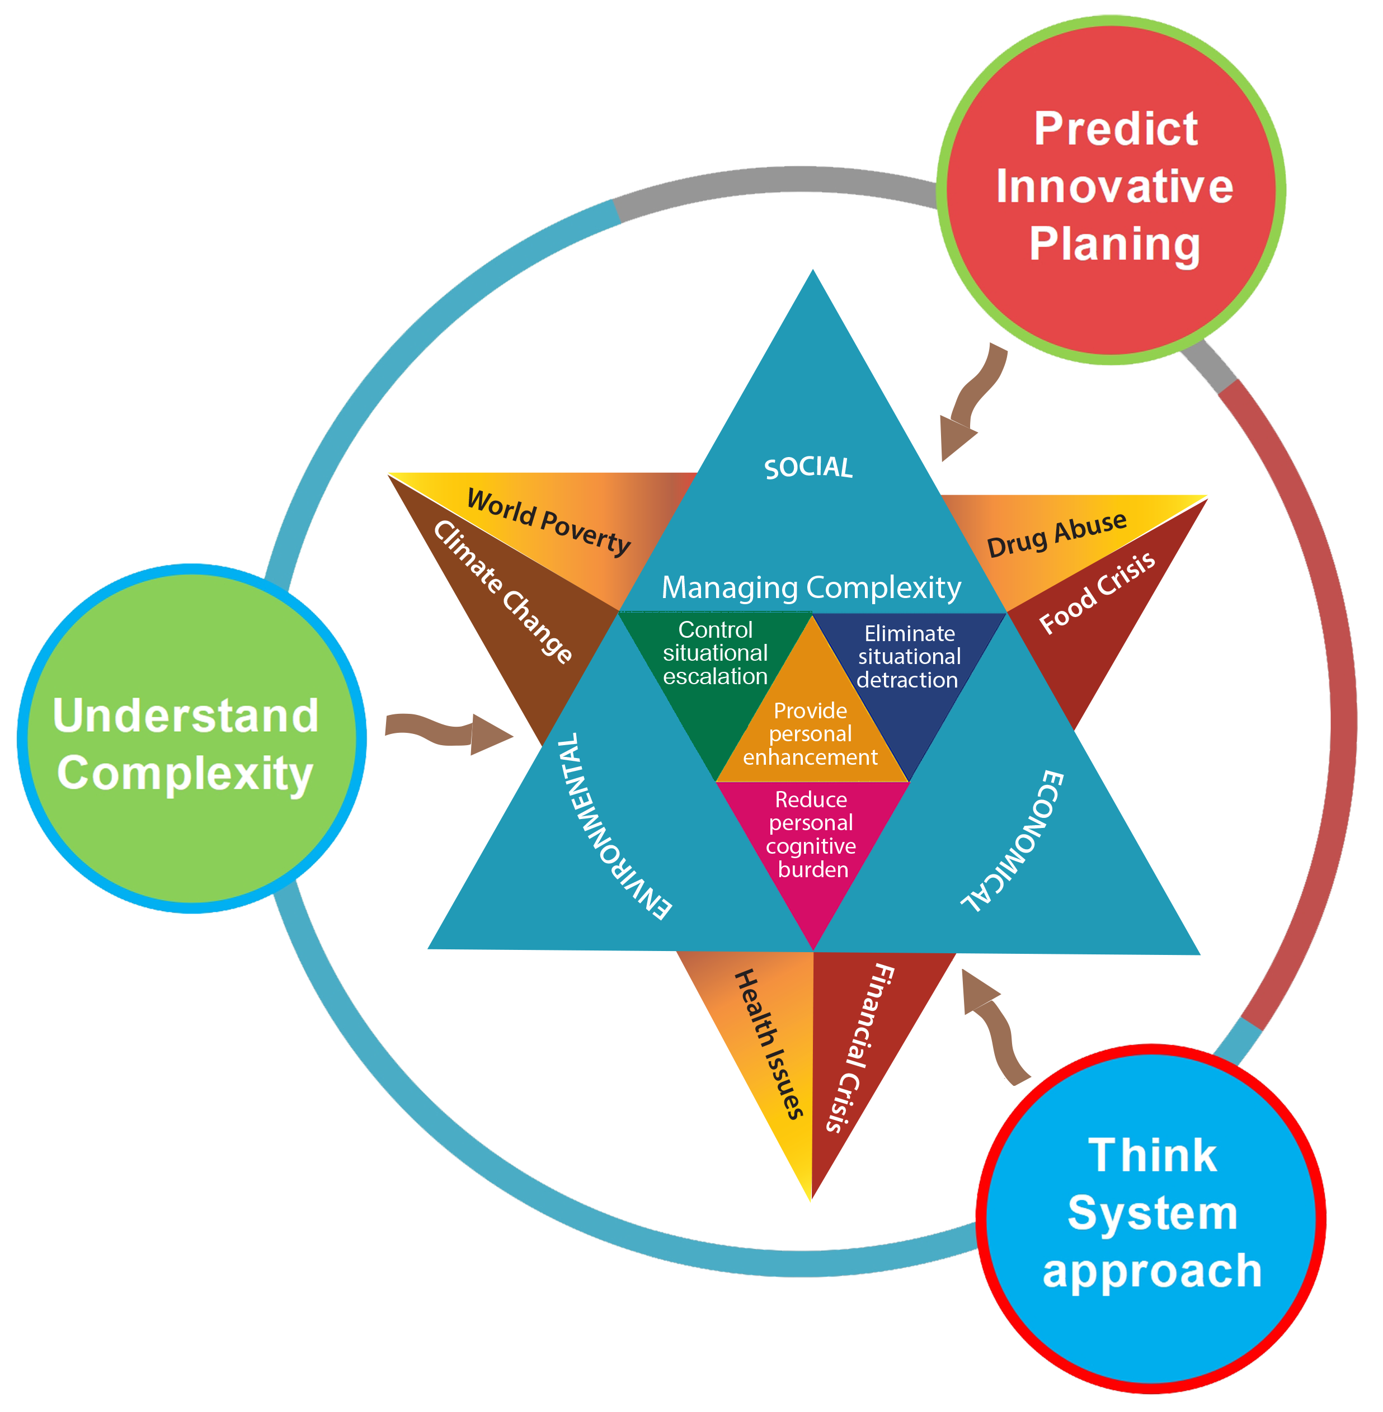
Managing Complexity

Slide 10
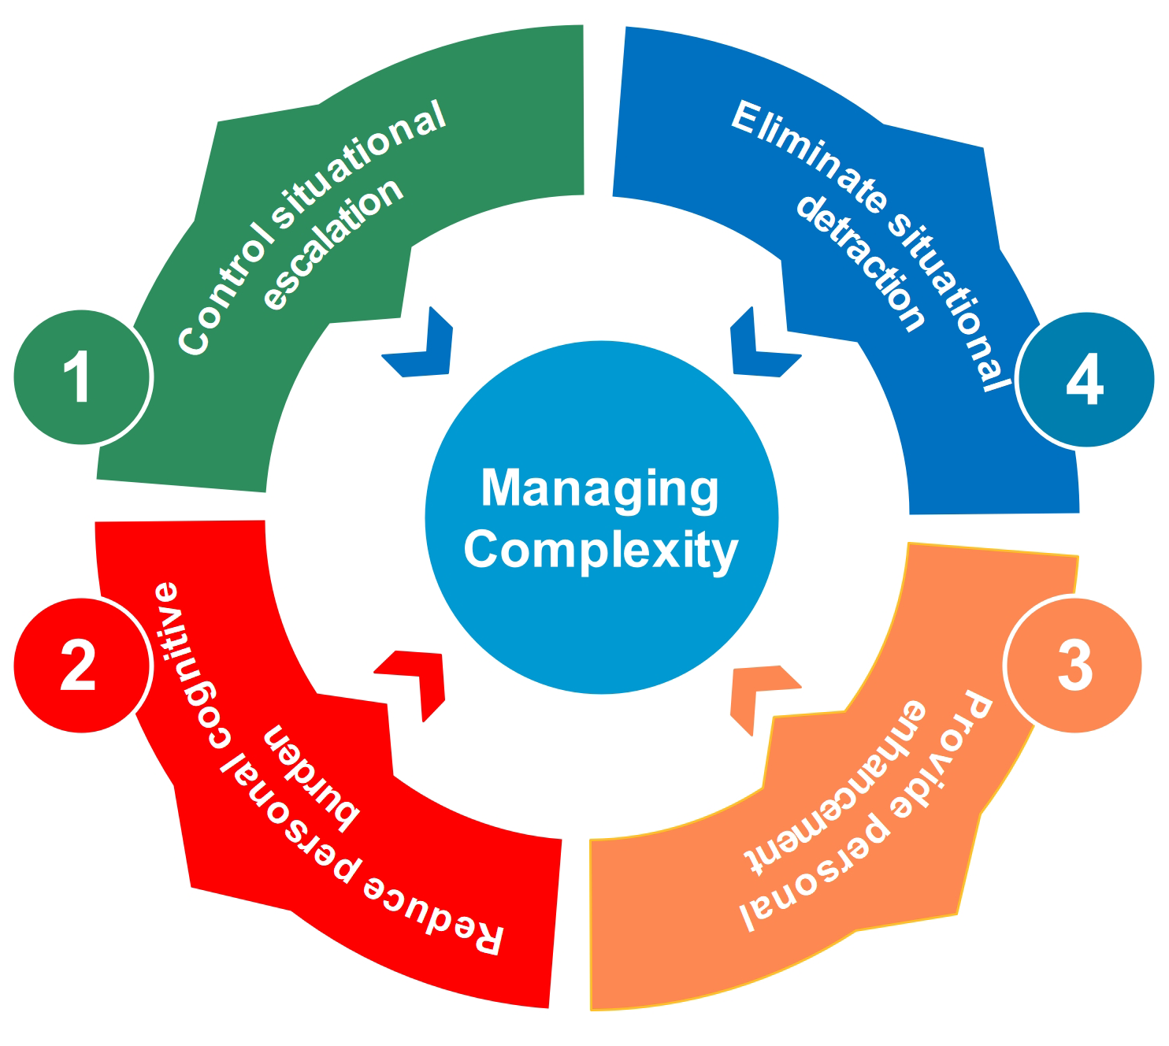
Managing Complexity
Control situational escalation: escalation occurs due to: varying perceptions among team members; difficulty in managing group problem solving efforts; organizational and cultural constraints; lock of actors to fill new roles; change in the problem situation with time -- as the interaction behavior between components changes over time, the ability to predict the system behavior is less robust, and the system becomes less stable.
Reduce personal cognitive burden: the common incidence of this situation will occur when a team member included in a position that requires knowledge to make a decision in which the member is not cognitively prepared.
From: Warfield, J. N., A Science of Generic Design: Managing Complexity
Through Systems Design, Ames: Iowa State University Press, 1994.

Slide 11
Managing Complexity
Eliminate situational detraction: limited thinking capacity, narrow-mindedness, or not open to new ideas, egotism, arrogant abuse of power, etc. -- detract from problem-solving.
Provide personal enhancement: Factors that enhance problem-solving -- the discipline of behavior, design experience, leadership, respecting other people's viewpoints, etc.-- enhance the capacity of an individual to be effective in a problem-solving situations.
From: Warfield, J. N., A Science of Generic Design: Managing Complexity
Through Systems Design, Ames: Iowa State University Press, 1994.

Slide 12

Measuring Situational Complexity
The Situation Complexity Index (SCI) has been proposed as a combined single metric to compare complexity among a group of problematic situations. It is defined as:
$SCI=(\frac{N}{7}$) $(\frac{V}{5}$) $(\frac{K}{10}$) (1.1)
If SCI is over 100 then the situation is considered to be complex.
In Equation (1.1), (N/7) is identified as the Miller Index, (V/5) is identified as the Spreadthink Index, and K/10 is the De Morgan Index.
(Warfield)

Slide 13
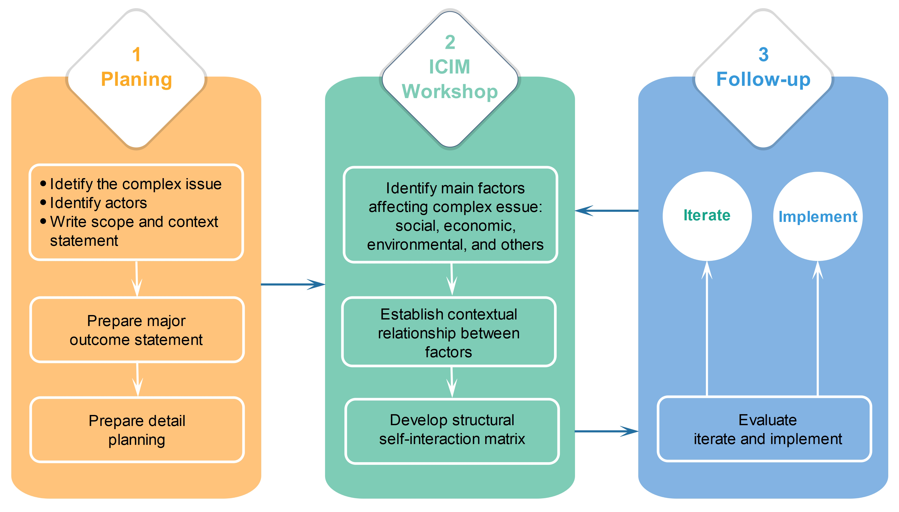
Three Phases of Interactive Collective Intelligence
Management (ICIM)

Slide 14
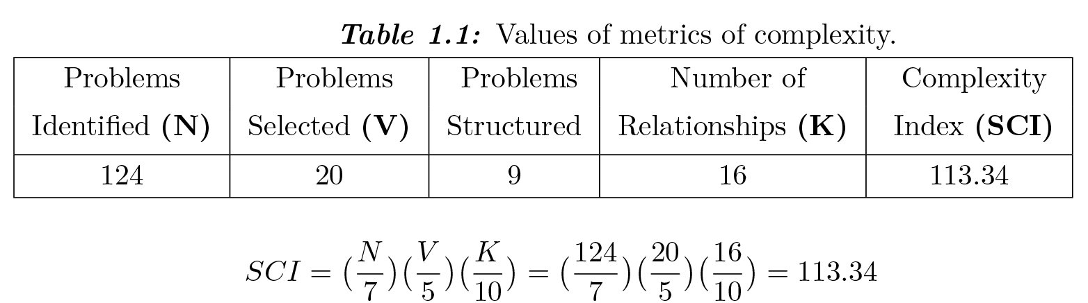
Example: Analyze the situational complexity of refugee resettlement.
The working group developed transdisciplinary collective intelligence using the Interactive Collective Intelligence Management (ICIM) workshop to investigate the issue. The Nominal Group Technique (NGT) was used to develop and clarify a list of factors affecting the complex issue. 124 problems identified and clarified. 20 problem categories are defined. 9 major problem areas were selected. Relationships among the major problem areas were 16. Table 1.1 shows values of the Miller Index, the Spreadthink Index, and De Morgan Index from the ICIM workshop carried out in the 2020 Spring semester at the Mechanical Engineering Department.
Since the value of SCI is larger than 100, the refugee resettlement issue is complex.

Slide 15
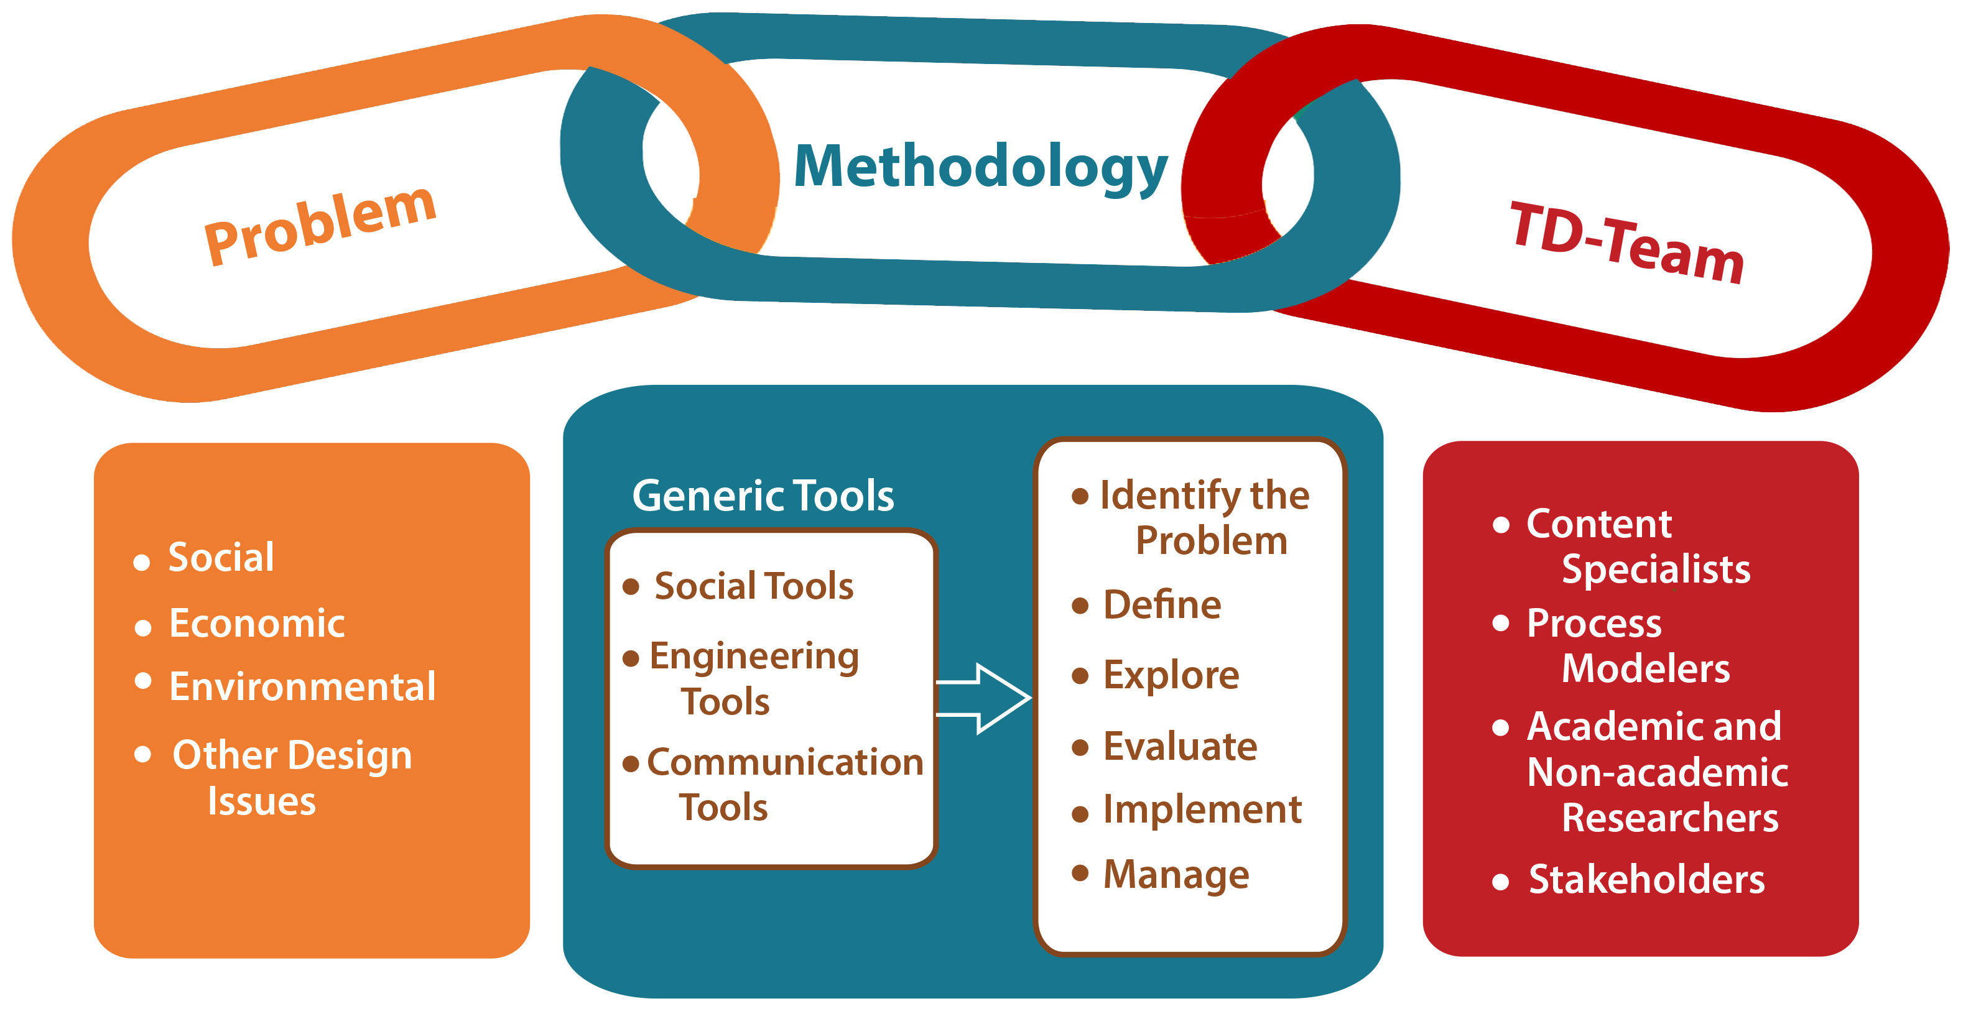
Societal Problems Solving Process

Slide 16
Understanding Hierarchical Relationships and
Complexity
Four aspects of complexity take the form of hierarchy. They are: (Simon)
1. “ The frequency with which complexity takes the form of hierarchy”,
2. “The relation between the structure of complex systems and the time required for it to emerge through the evolutionary process”,
3. “The dynamic properties of hierarchically organized systems and... How, they can be decomposed into subsystems in order to analyze the behavior”,
4. “The relations between complex systems and their descriptions.”

Slide 17
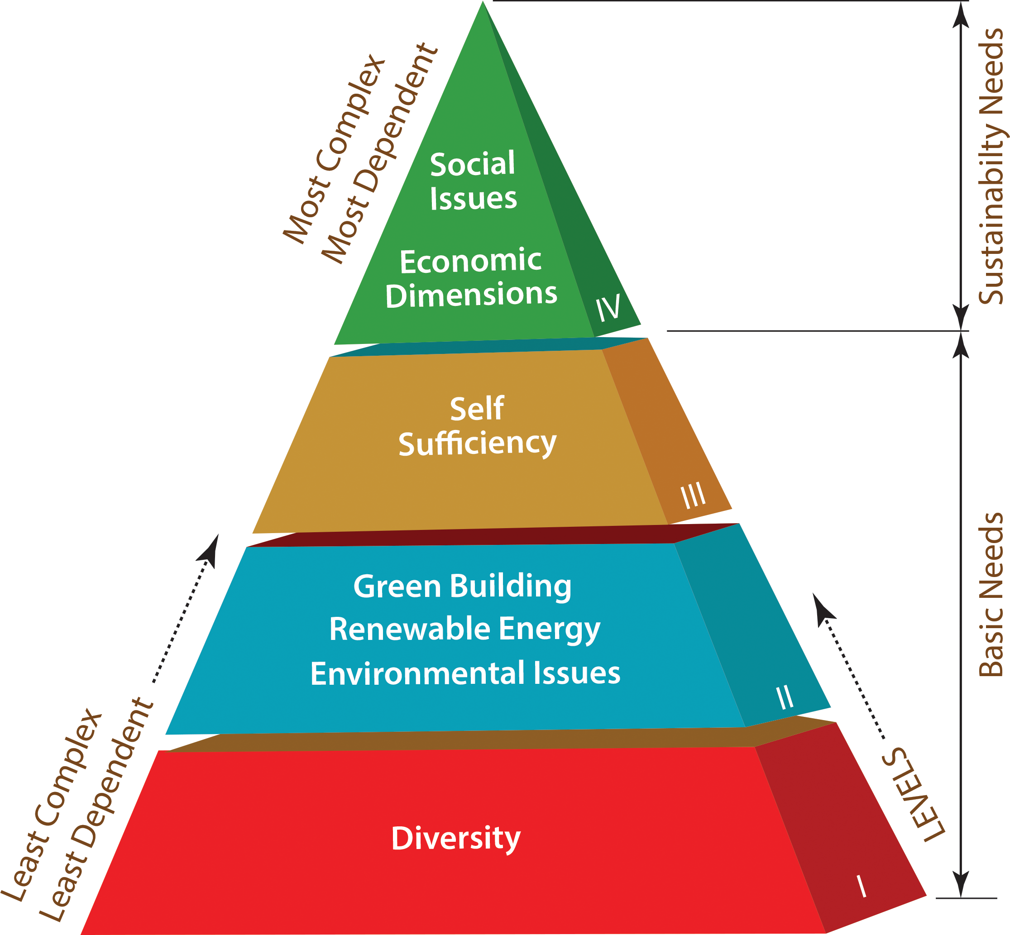
Example: Analyze the factors that are to be arranged in a hierarchy when studying sustainable self-sufficient ecovillage.
As shown in the figure, the bottom three levels of the pyramid are called ‘basic needs’ because, in order to have healthy ecovillage, those basic needs must be met.
Unity and strength through diversity;
Requirements of environmental issues such as nontoxic environment, recycling, air, water, and soil protection;
Renewable energy such as solar, wind, hydro energies;
Green buildings such as the efficiency of buildings with respect to conservative water, energy, and materials used are basic needs and requirements of any ecovillage designed to be fully self-sufficient.

Slide 18
Example (continued)
Once the basic needs of ecovillage have been met, our focus shifts to the highest level-IV of hierarchy – economic dimension and social issues. Top level-IV of the hierarchy of the pyramid is called ‘sustainability need’. To build a true ecovillage community for the positive transformation we should go beyond the basic needs.

Slide 19
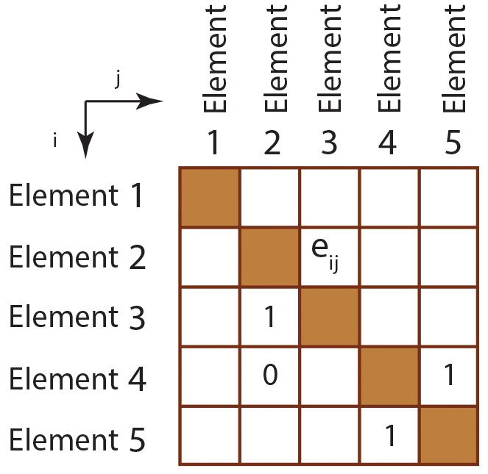
Forming the Relationships Matrix
Three main tasks to form the relationships matrix are:
identify the relevant set of elements affecting the issue or problem,
determine the relationship among the elements,
Translating the relationships in the form of a system matrix.
Note that, elements 4 and 5 are reaching each other, in other words, element 4 is affecting element 5, and element 5 is affecting element 4 – this is called a cycle.

Slide 20
Example
Develop relationships matrix to reduce the cholesterol level considering below identified factors:
1. to reduce cholesterol,
2. to diet,
3. to exercise every day, and
4. to run every day.
BACKGROUND
The American Heart Association (AHA) states that the above factors affect cholesterol levels by changing triglycerides, LDL, and HDL cholesterol levels. These changes may cause the risk for heart disease and stroke (adapted from Warfield, 1973).

Slide 21
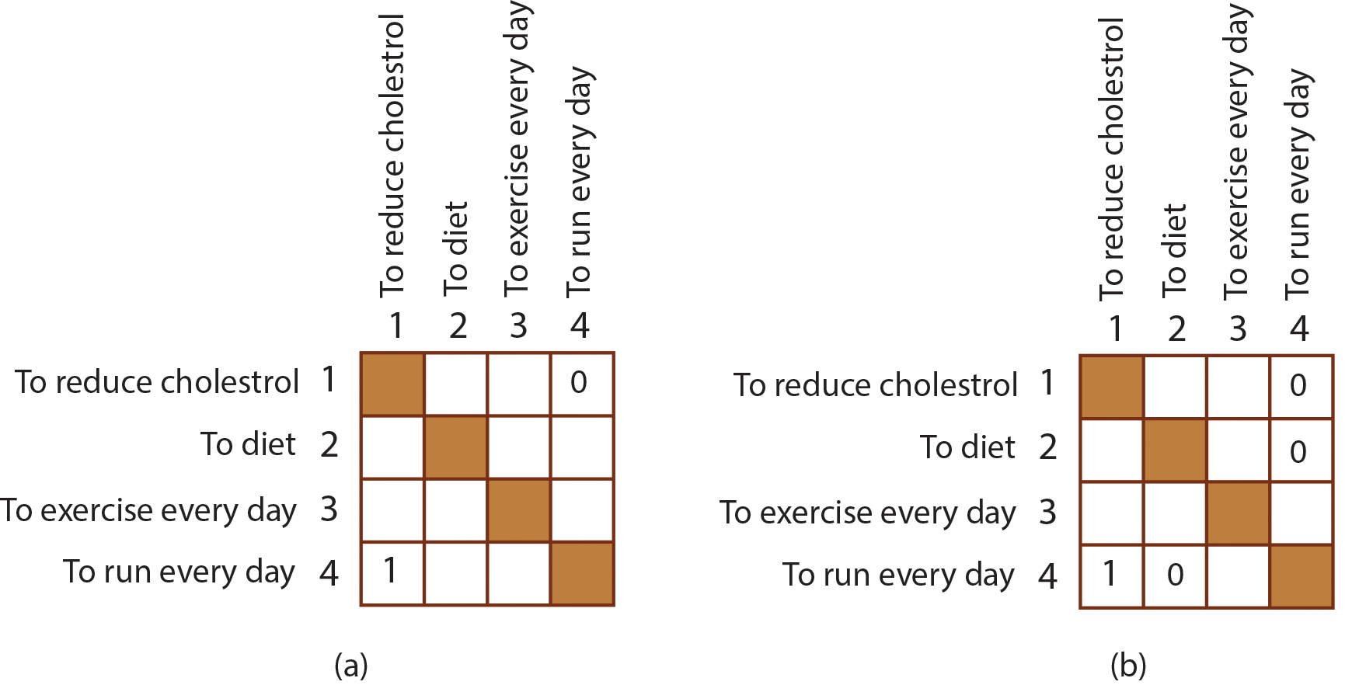
Example (continued)
As shown in Figure (a), To run every day affects the reduction of cholesterol (set e41 =1) but to reduce cholesterol doesn’t affect running every day (set e14 = 0). As shown in Figure (b), running every day doesn’t affect dieting (thus set e42 = 0), and to diet doesn’t have relationships with running every day (thus set e24 = 0).

Slide 22
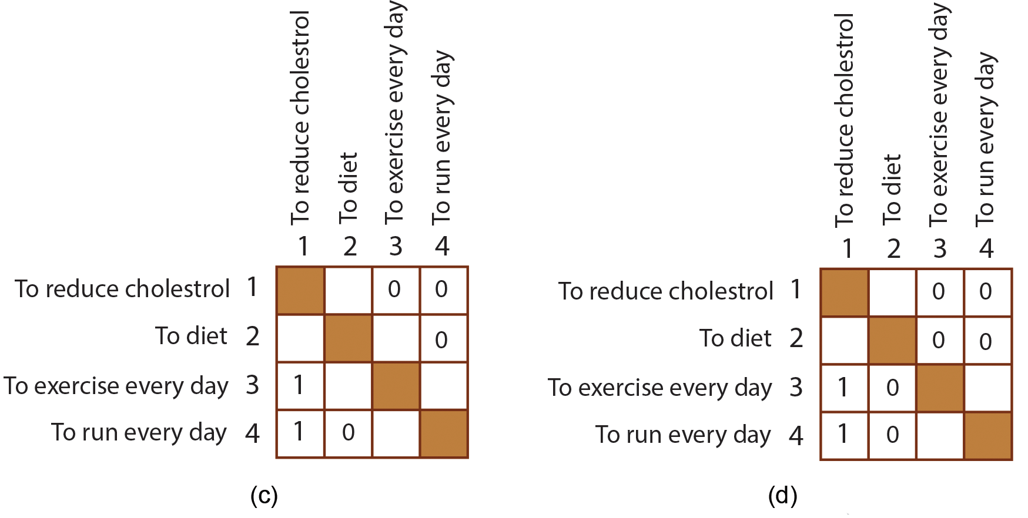
Example (continued)
Figure (c): exercise every day will reduce cholesterol level (thus set e₃₁ = 1) however, to reduce cholesterol doesn’t support the relationships with exercise everyday (thus set e₁₃ = 0). Figure (d): to exercise doesn’t contribute to diet (thus set e₃₂ = 0). Dieting doesn’t affect exercising (thus set e₂₃ = 0).

Slide 23
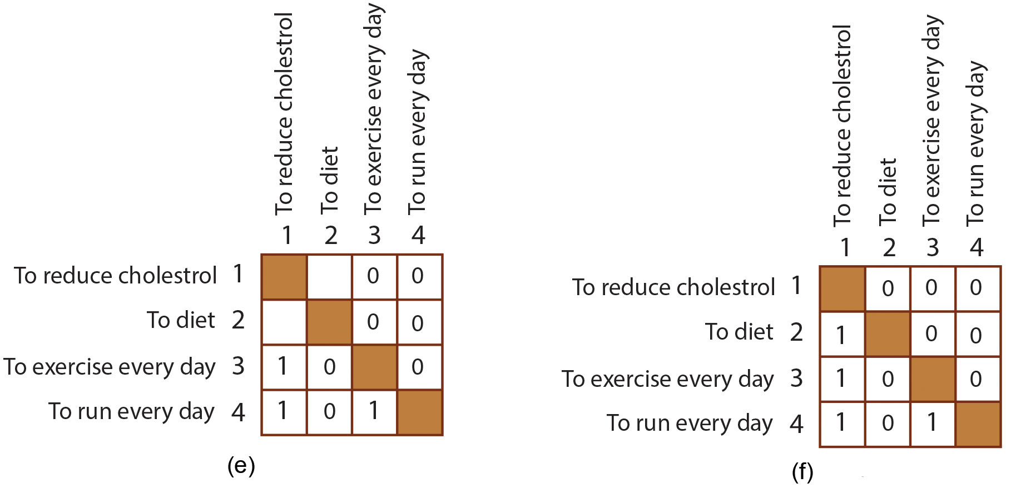
Example (continued)
Figure (e): to run every day supports to exercise (thus set e₄₃ = 1), however, to exercise every day doesn’t support the relationships with running every day (thus set e₃₄ = 0). Figure (f): to diet reduces cholesterol (thus set e₂₁ = 1). To reduce cholesterol will not affect dieting (thus set e₁₂ = 0).

Slide 24
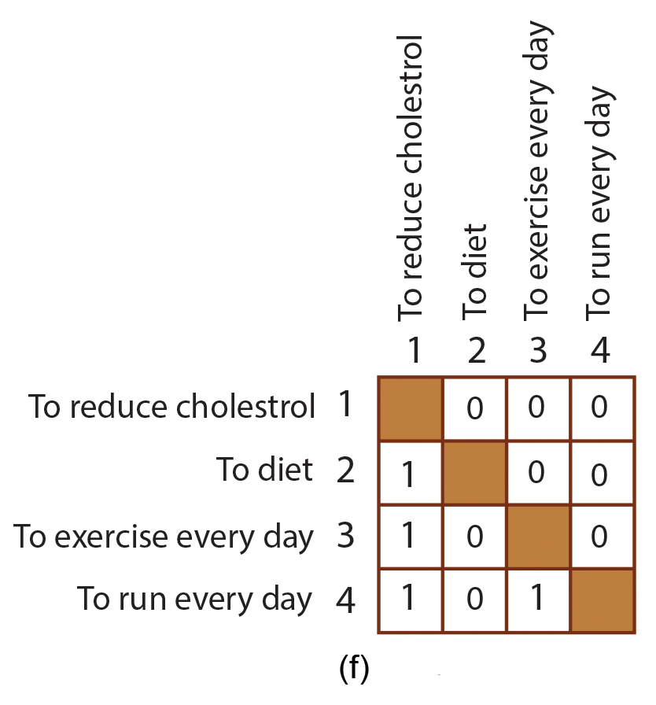
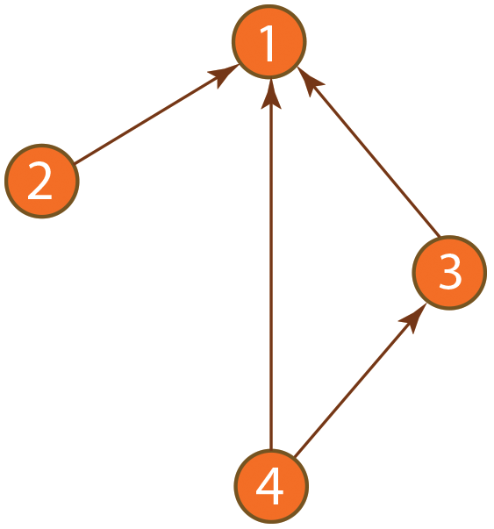
Example (continued)
Finally, using the final relationship matrix shown in Figure (f), develop a digraph as shown in Figure (g).
(g)

Slide 25
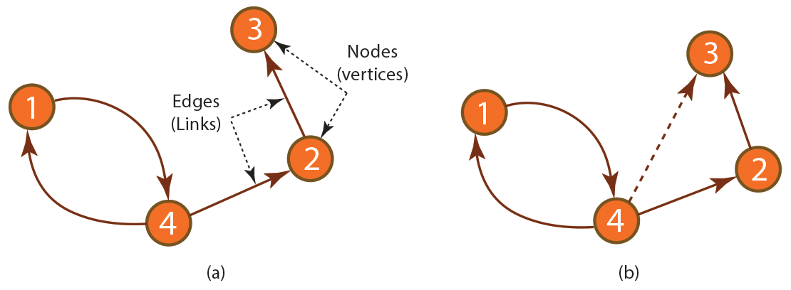
Graphical Representations
Complex systems,” have a large number of elements that have many interactions. Hierarchical systems consist of element relationships and can be represented by a directed graph. A directed graph (digraph) shown in the figure, has a set of elements (in this case 4 elements) that are connected together, where all the links are directed from one node (element) to another.
Since element 4 is related to element 2 and element 2 is related to element 3, then element 4 is related to element 3 through the intermediate element 2 (this is called transitivity rule). This is shown in Figure (b).

Slide 26
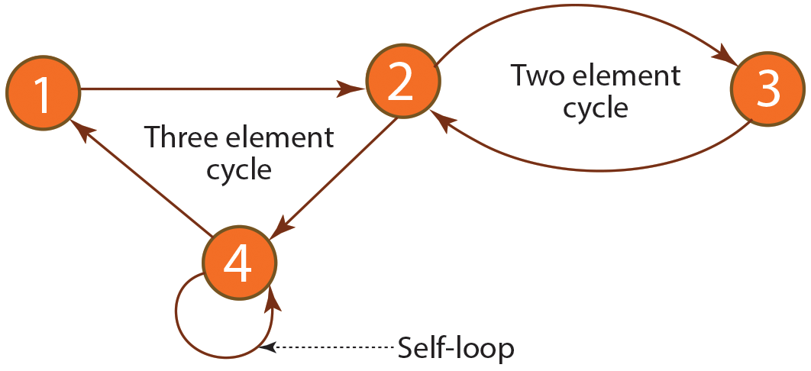
Cycles in Digraph
A cycle in a digraph is a non-empty directed path in which the only repeated nodes are the first and last nodes. If a graph has a cycle it is a cyclic graph. A graph without cycles is called an acyclic graph.

Slide 27
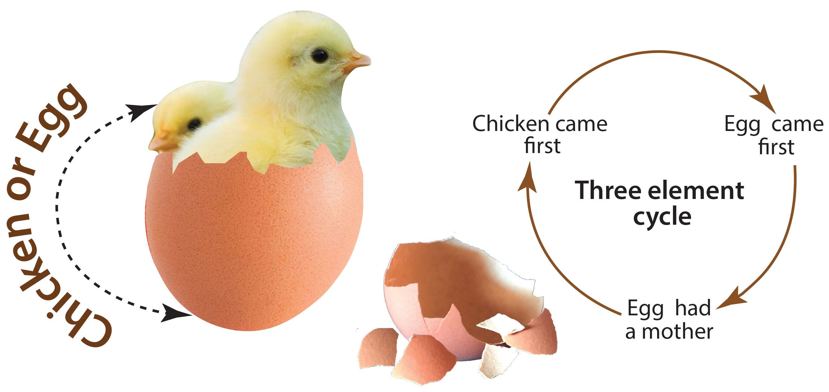
Example
The chicken or egg situation is a good example to explain the cyclic graph – it is impossible to make a decision which of two things existed first: chicken or egg?
For example, in order to get a job you need to have experience, but oftentimes without work experience, you cannot get a job. This is a chicken and egg situation – it is difficult to know if the cause of the problem is not to have work experience or not have of job.

Slide 28
Example (continued)
A more complex cycle involving of three-element is shown in the figure – the chicken or egg cycle. If the chicken came first, then it eventually had to hatch from an egg. If the egg came first, then it had to have a mother to create the egg. If the egg had to have a mother, then the mother should be the chicken – it is impossible to identify the starting point of a circular (cyclic) cause. This situation may create uncertainty in design and makes the design effort complex.

Slide 29
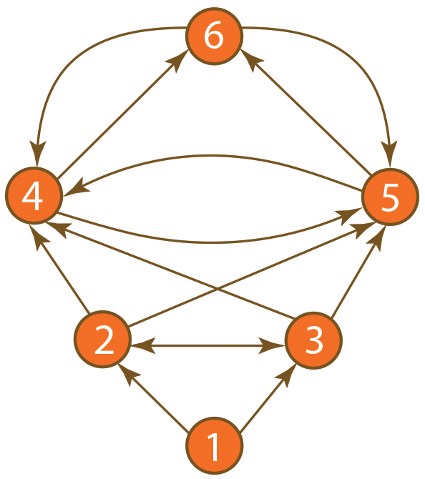
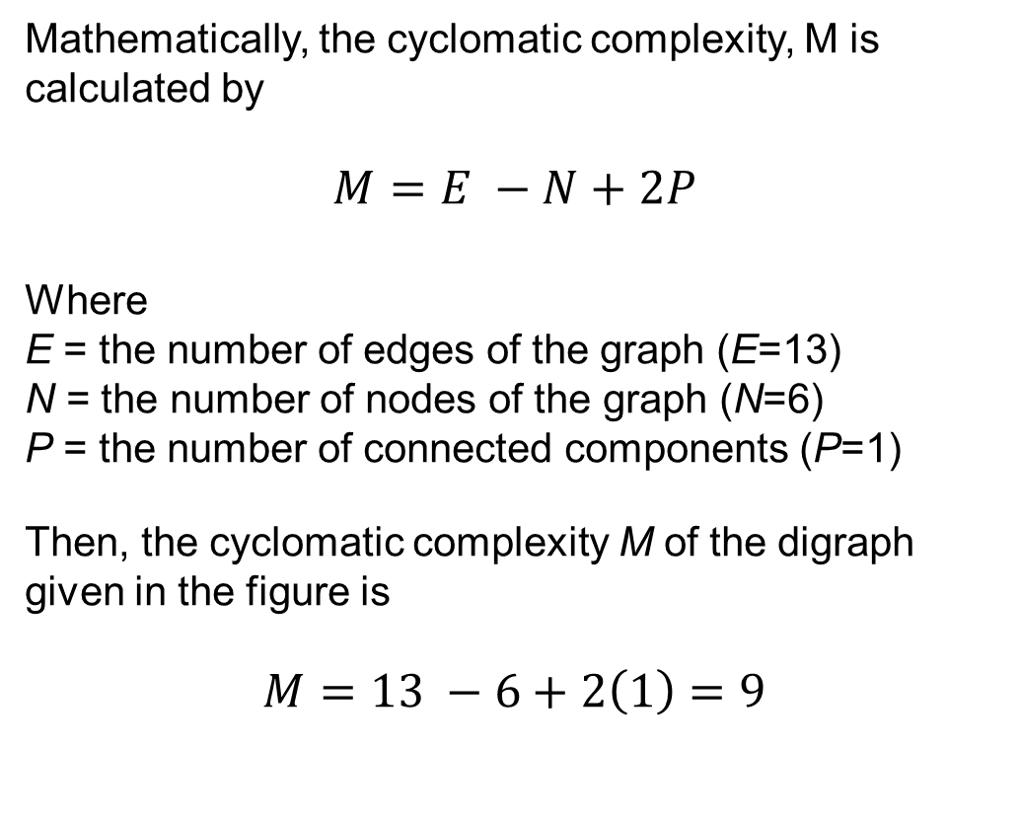
Cyclomatic Complexity
Mathematically, the cyclomatic complexity, M is calculated by
$$M=E −N+2P$$
Where
E = the number of edges of the graph (E=13)
N = the number of nodes of the graph (N=6)
P = the number of connected components (P=1)
Then, the cyclomatic complexity M of the digraph given in the figure is
$$M=13 −6+2\left(1\right)=9$$

Slide 30
Cyclomatic Complexity
The system represented by the figure is considered very close to the limit to be complex suggested by McCabe.
The Complexity of an issue will be difficult to understand when the cyclomatic complexity number is high. The threshold limit value of cyclomatic complexity was suggested by McCabe – “the particular upper bound that has been used for cyclomatic complexity is 10 which seems like a reasonable, but not magical, upper limit.”

Slide 31
Complexity
Profound measurement of complexity can help to improve our understanding and ability to work with complex systems. With the help of cyclomatic complexity measures, it will be possible to track complexity changes over several product generations. It is also possible to benchmark one company’s product or processes complexity with respect to its competitors.

Slide 32
Complexity
Although a general complexity measure has remained abstract, the following factors can be considered for complexity measures:
The number of decomposed elements (components, tasks, or teams)
The number of interactions to be managed across the elements
The uncertainty of the elements and their interfaces
The patterns of the interactions across the elements (density, scatter, clustering, etc.)
The alignment of the interaction patterns from one domain to another

Slide 33
Transdisciplinary Research Process
The key characteristics of transdisciplinary research distinguishing from other related research approaches are:
Related to real-life complex problems and specific problem solving
Eliminate disciplinary boundaries for strong collaboration
Participation of (non-academic) stakeholders
Acceptance of diverse perspectives, problem framing, and interpretations
Holistic (non-reductionist) approach to produce new knowledge for solving specific problems (transformative knowledge)

Slide 34
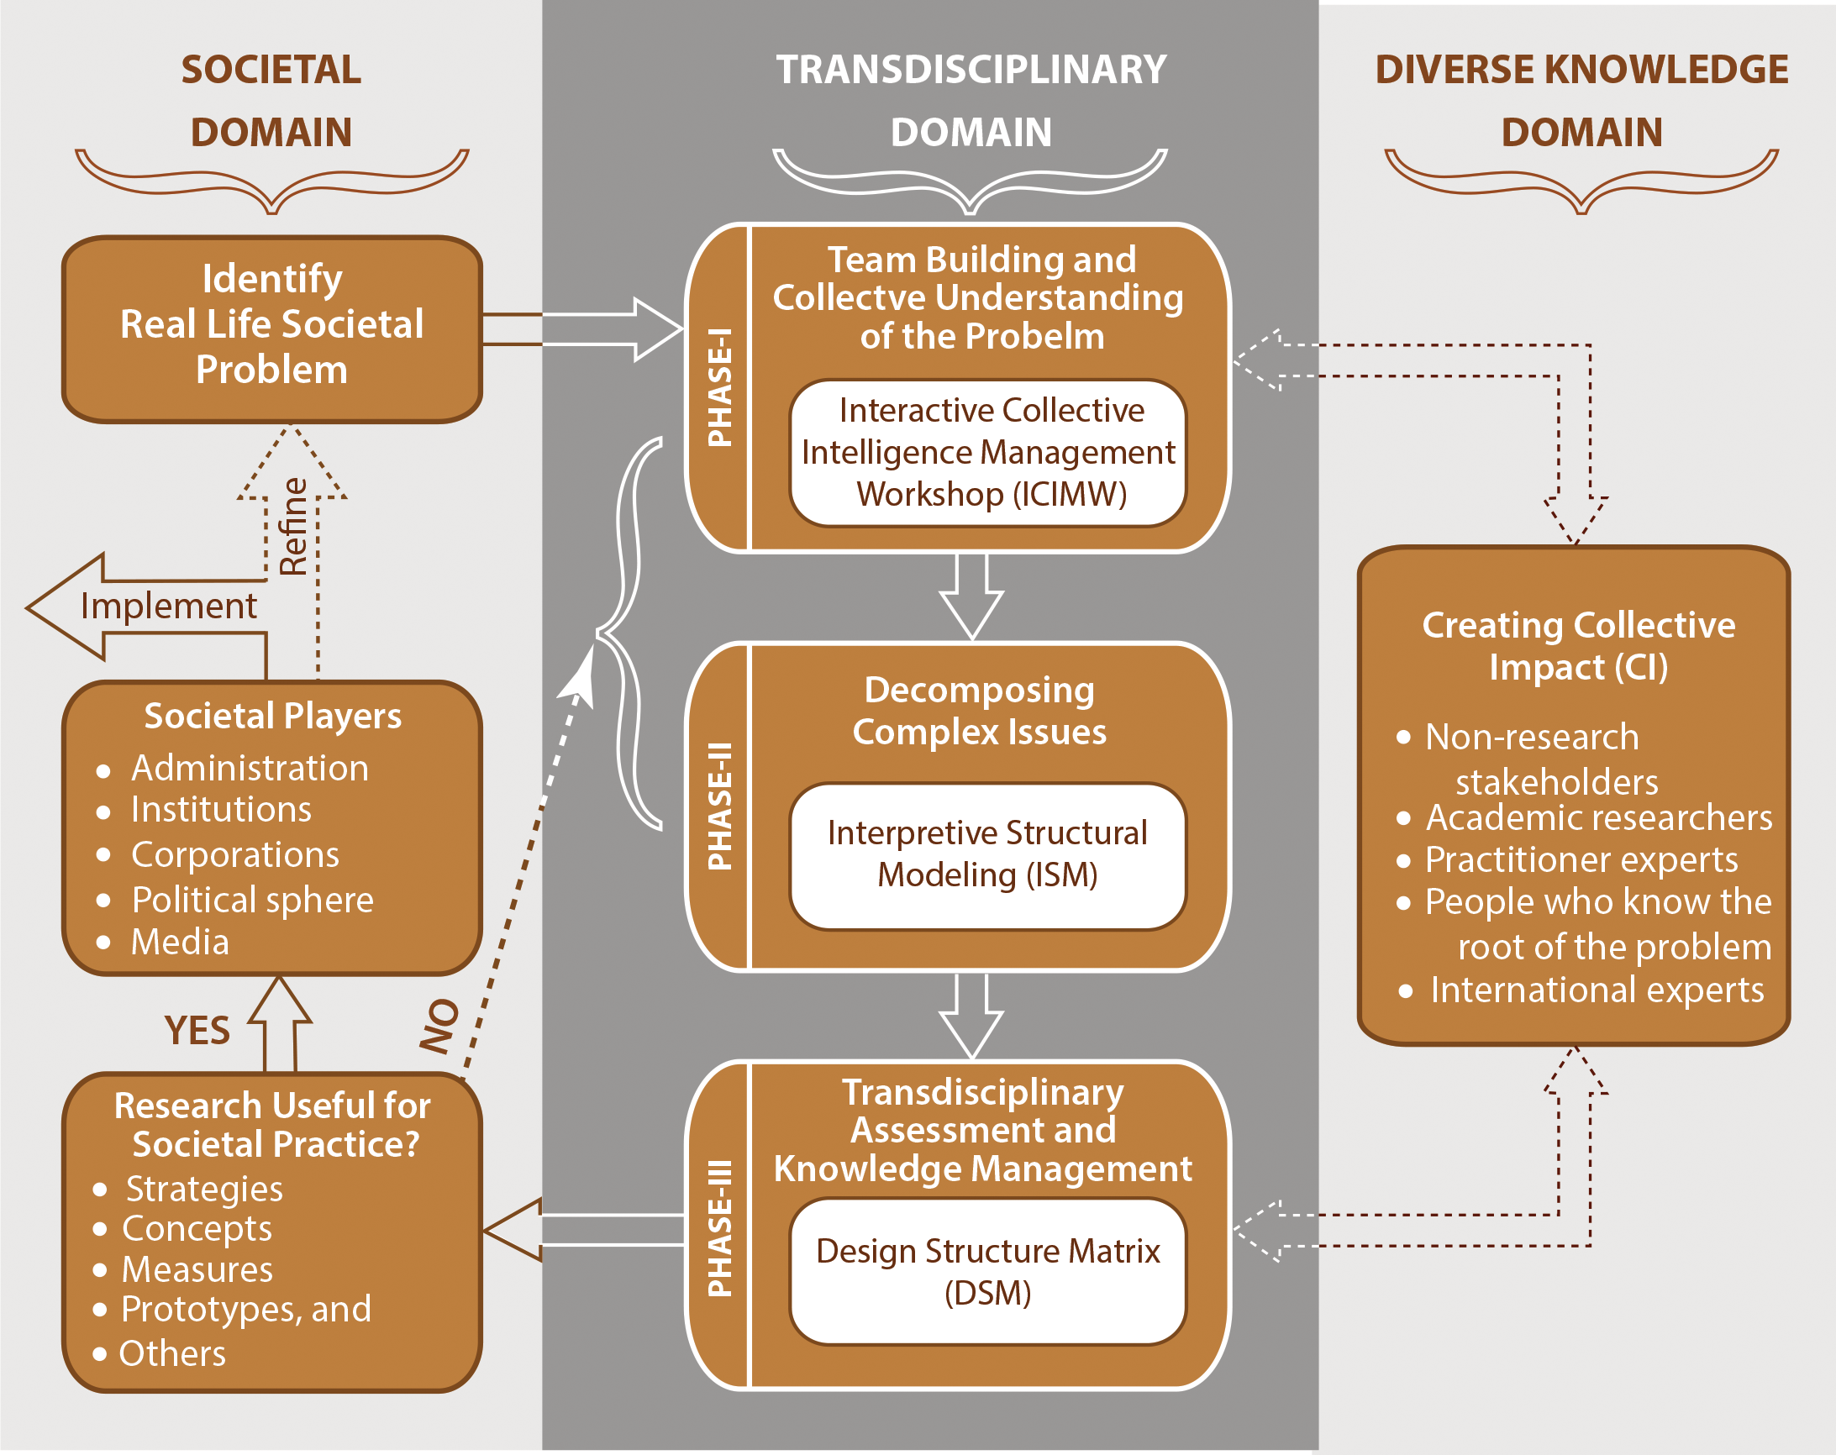
Transdisciplinary Research Process
The figure shows the proposed TD research process model, which is hypothesized in three phases:
Team building and collaboratively understanding of the research problem to develop collective intelligence,
Decomposing complex issues,
Transdisciplinary assessment and knowledge integration.
Figure: Transdisciplinary research process.

